Slide 1
CWGC

Slide 2
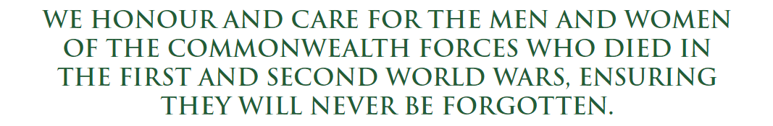
The Commonwealth War Graves Commission (CWGC) was established by Royal Charter in 1917 as the sole organization charged with the commemoration of Commonwealth servicemen and women who died during the First World War.
The remit was later extended to include the Second World War.
Today, it maintains the graves or commemorations of over 1.7 million of such fallen service personnel worldwide, including more than 165,000 war graves at over 12,000 locations in the UK

Slide 3
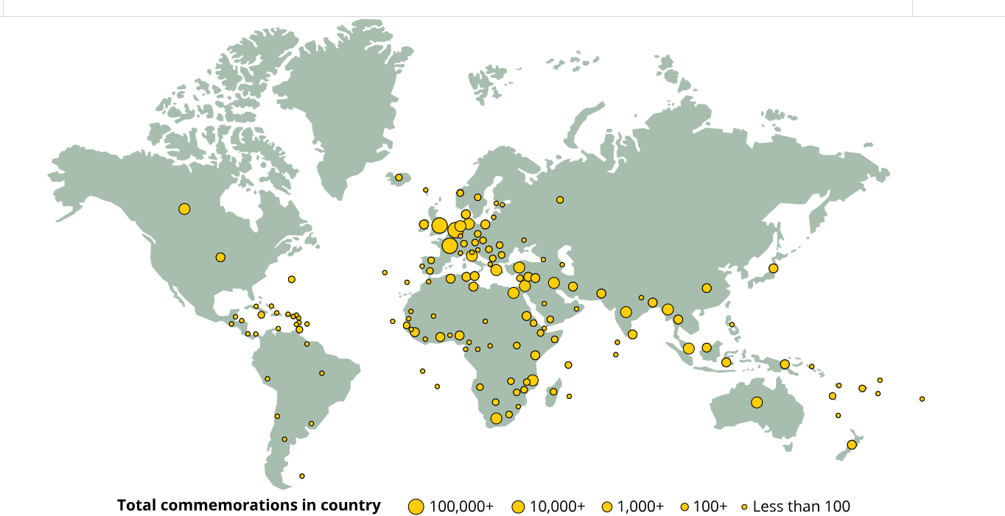

Slide 4
Where to find the graves
Military cemeteries
Civilian cemeteries and churchyards, sometimes grouped
together into a plot, or scattered amongst the civilian
graves.

Slide 5
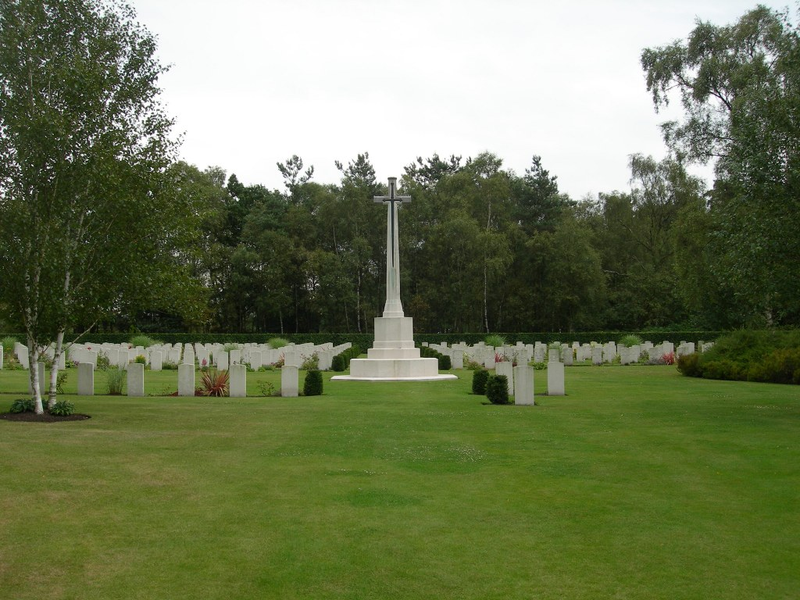
Military cemeteries: Cannock Chase War Cemetery
GRAVES
97 Commonwealth burials (WW1) most of them New Zealanders,
286 German burials (WW1); . 3 (WW2)
58 German burials in Plot 4 were all brought into the cemetery in 1963, as part of the German Government's policy to remove all graves situated in cemeteries or war graves plots not maintained by the Commonwealth War Graves Commission.
Large military training camp for the New Zealand Rifle Brigade.
Prisoner-of-war hospital with 1,000 beds

Slide 6
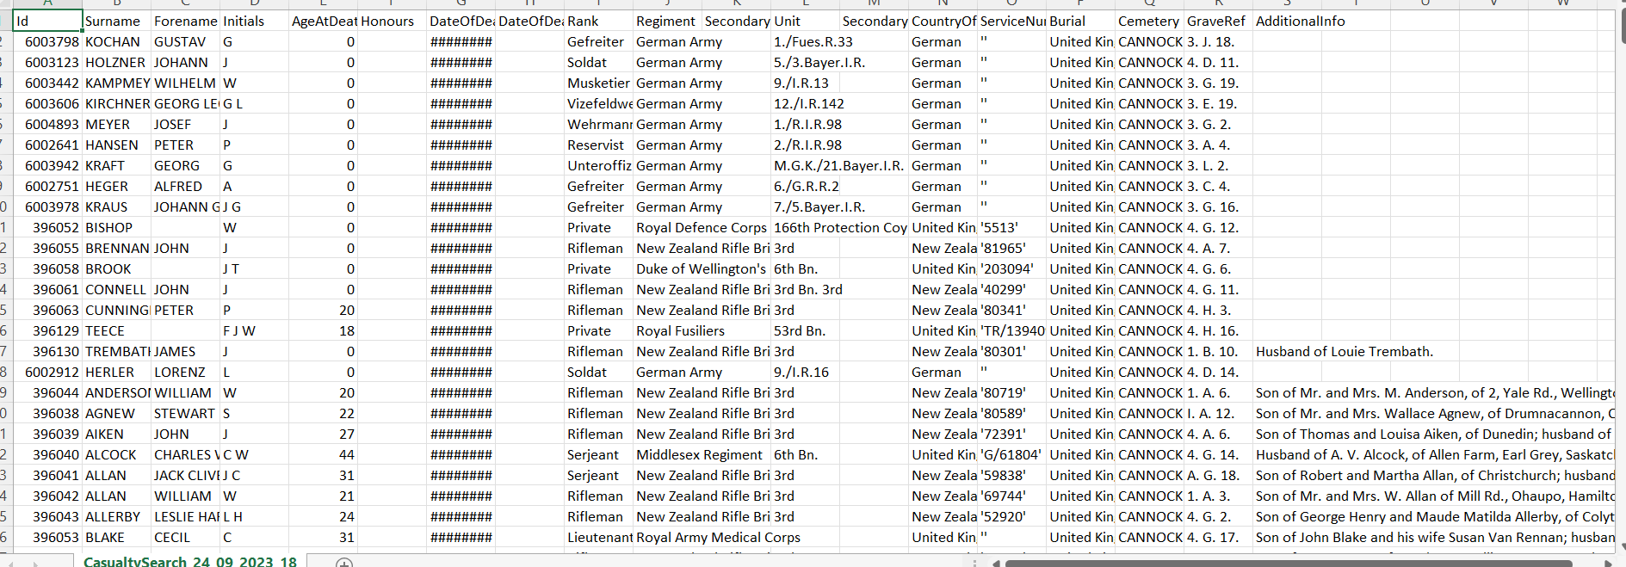

Slide 7
Scattered Graves
Individual graves account for the great majority of war burials in the UK and are to be found in every conceivable type of burial ground - including many local churchyards.
The majority are marked with standard Commission headstones.

Slide 8
Eyes On Hands On: Duties
The role undertaken by EOHO volunteers encompasses two broad activity streams:
Eyes On:
going out into local cemeteries and report back on the condition of War Graves there, via an online form.
Hands On:
carrying out certain maintenance tasks, such as trimming vegetation or cleaning the headstones.

Slide 9
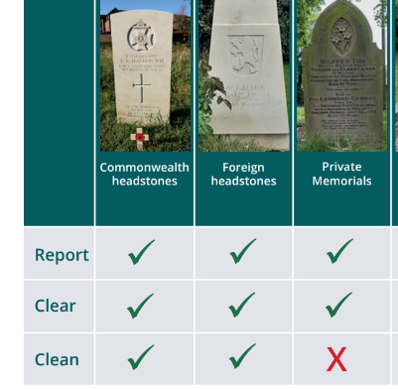
Identify the grave
Clear and clean as required
Take a photograph
Complete a report online and attach photograph

Slide 10
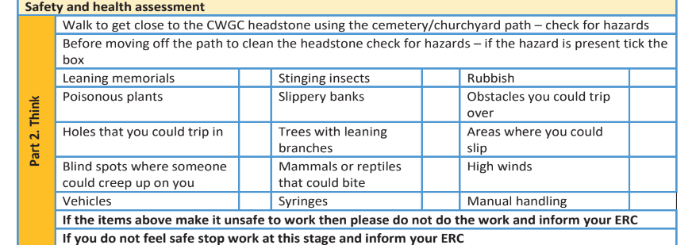
Health and Safety training!

Slide 11
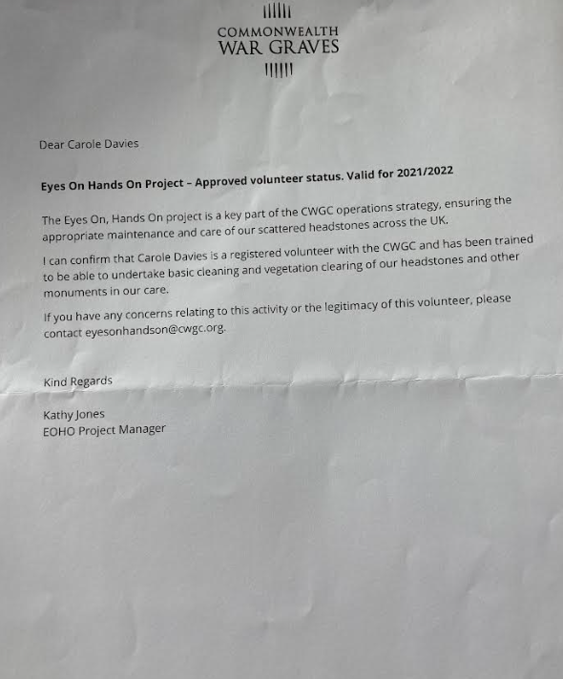

Slide 12
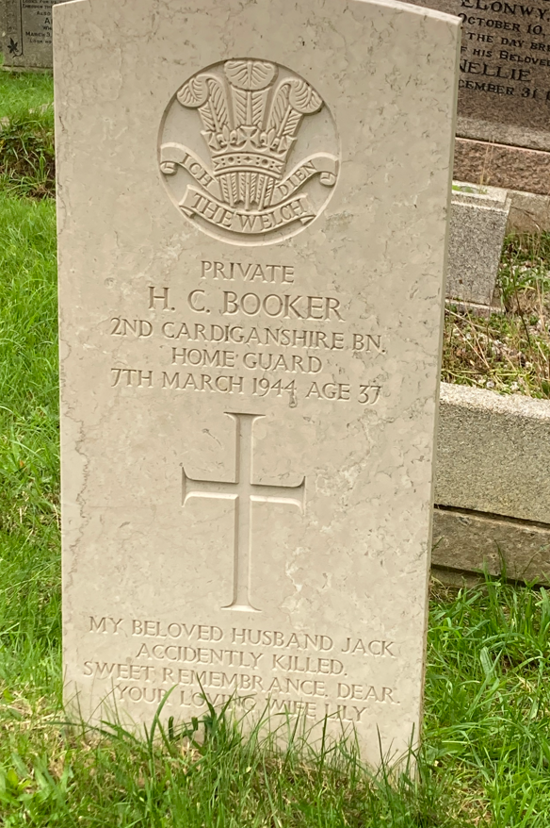
Standard CWGC Headstone
Uniform size and shape .It is a founding principle of the War Graves Commission that there be no difference in size or shape.
Usually made from Portland stone.
Inscribed on each headstone are the details of the individual.
A regimental, unit or national crest or badge is usually at the top of the headstone, followed by a service number (except officers), rank, name, awards (if any), the regiment/unit, date of death, age (if known), religious emblem and a personal inscription provided by the family. (Not all of these details will be present in all cases and the layout will vary from person to person based upon the information available.)
Cardigan Cemetery

Slide 13
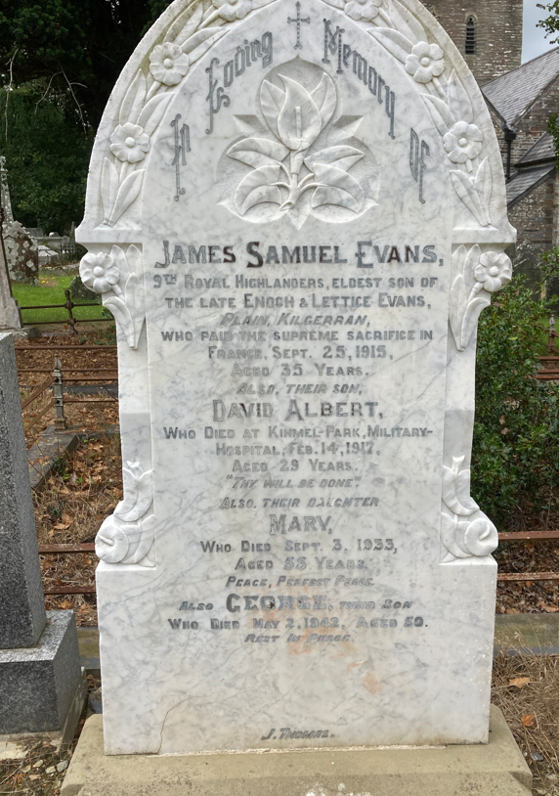
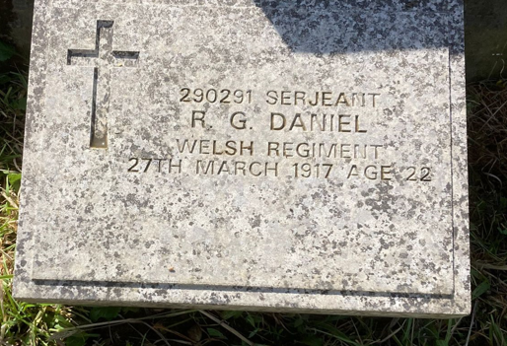
Scattered Graves: Private memorials
Over 30,000 graves, are marked by private memorials chosen by relatives at the time.
Newport (St Mary’s) Churchyard
Cilgerran (St Llawddog) Churchyard

Slide 14
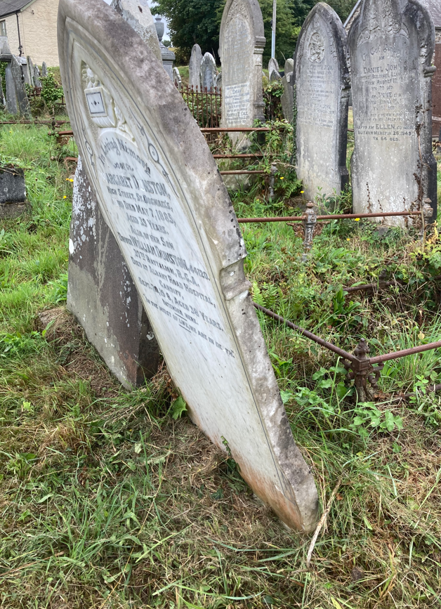
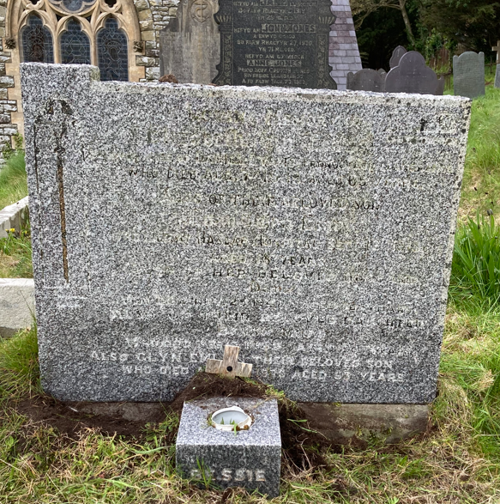
Newport (St Mary’s) Churchyard
Llangranog (St Caranog) Churchyard

Slide 15
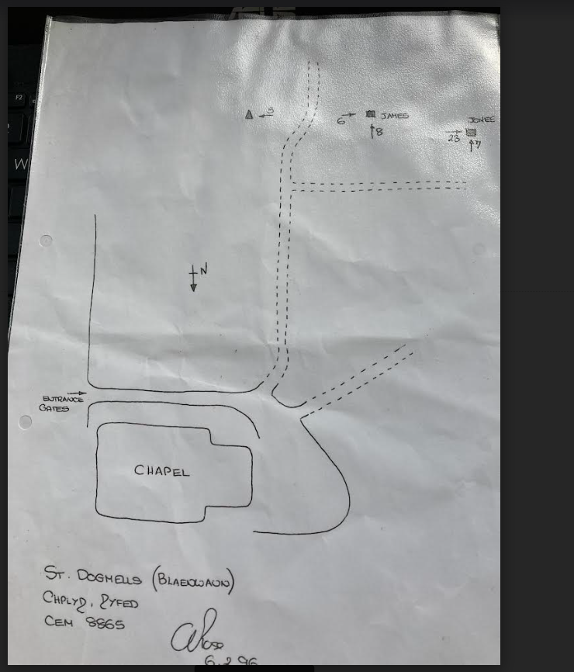
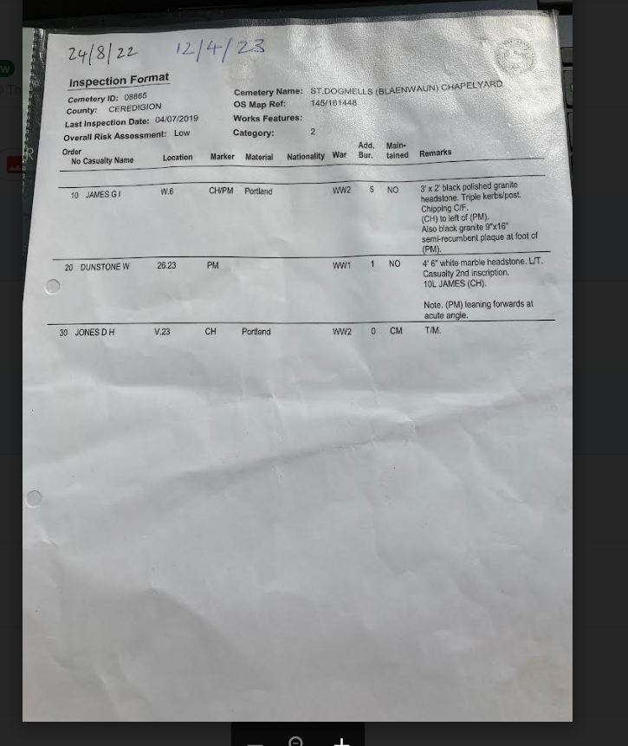

Slide 16
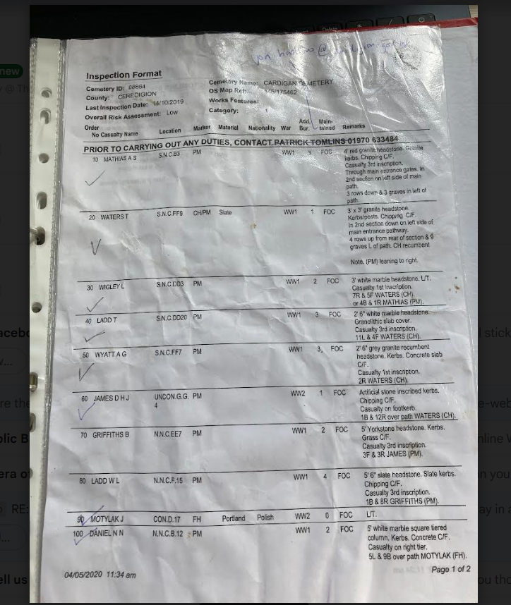
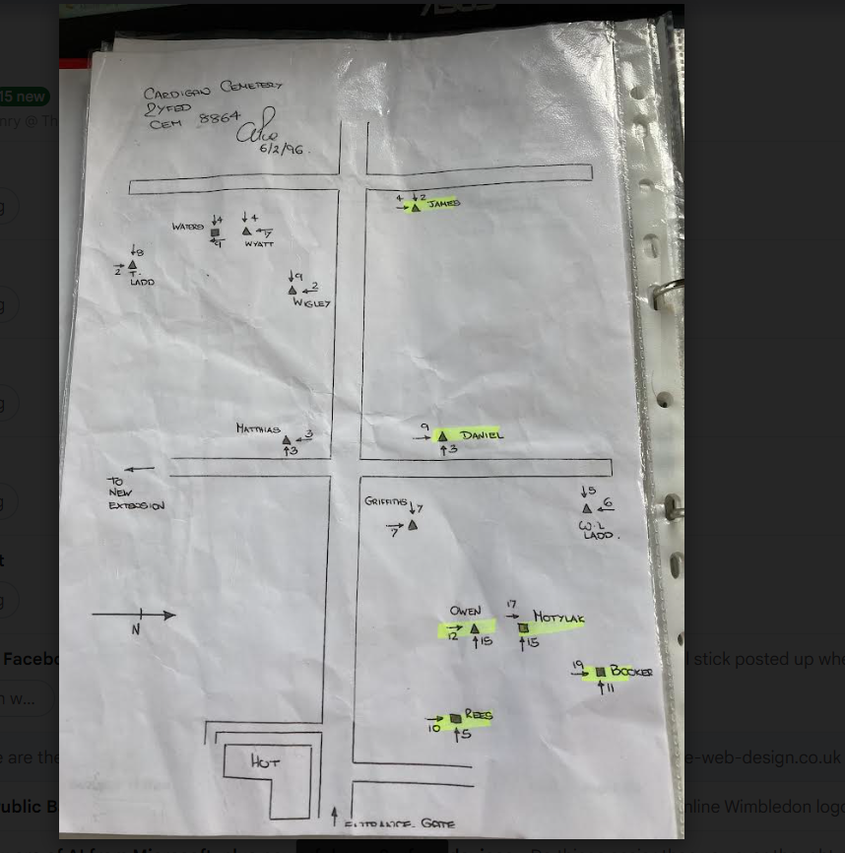
Cardigan Cemetery

Slide 17
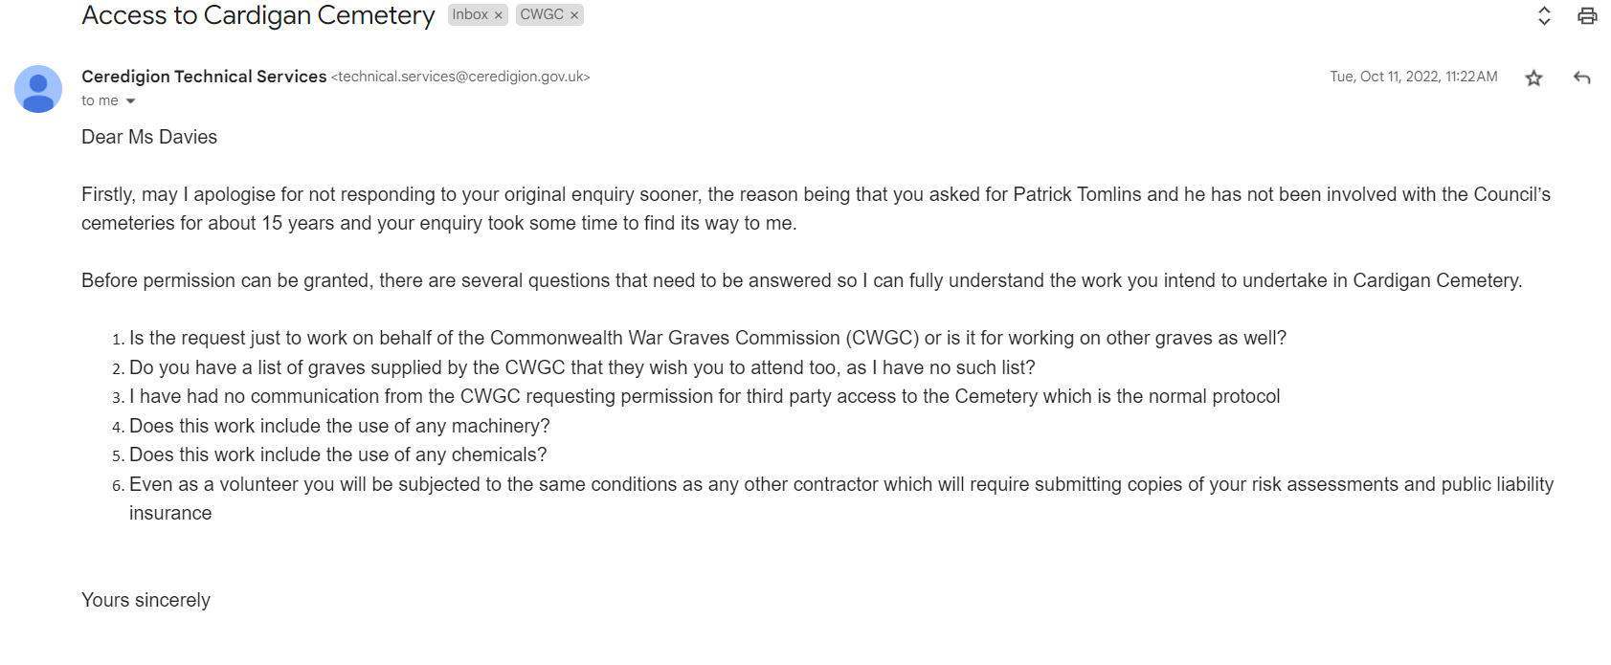

Slide 18
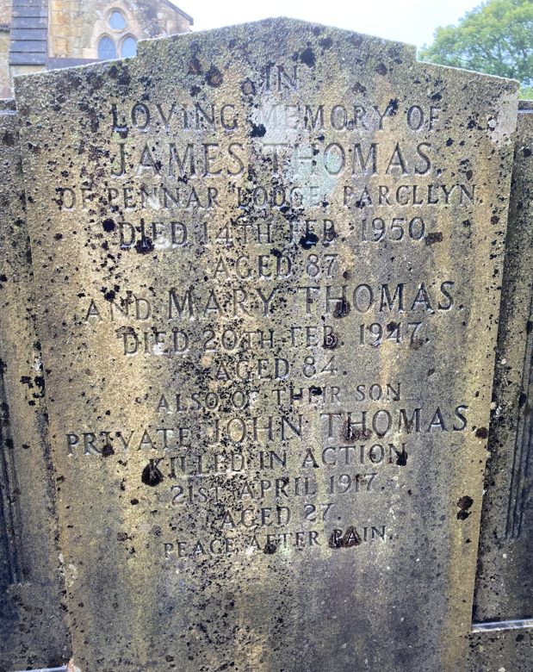
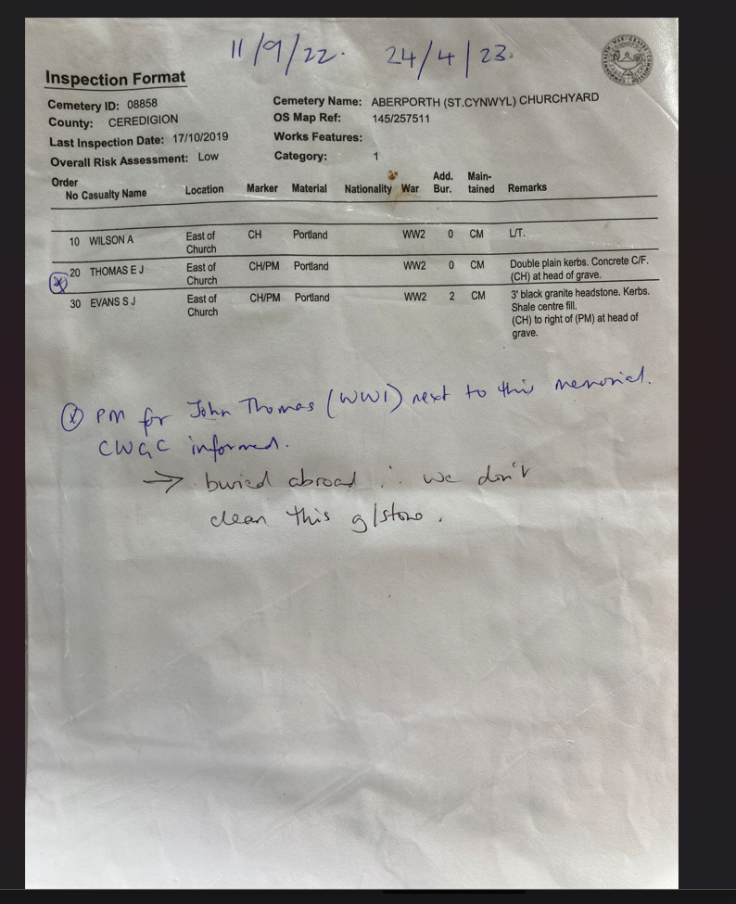
In loving memory of James Thomas of … and Mary Thomas….
Also their son Private John Thomas killed in action
21st April 1917 aged 27.
Peace after pain.
Aberporth (St Cynwyl) Churchyard

Slide 19
Hidden tragedies (1)
Homeguard Casualty:
‘accidentally killed.’

Slide 20
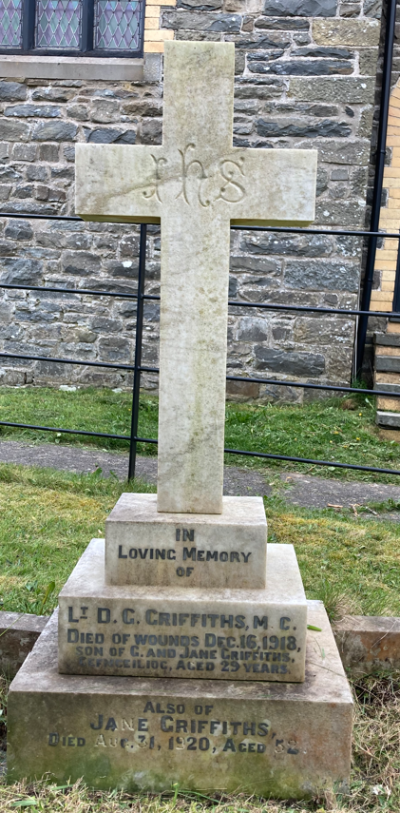
Lt D.C. Griffiths M.C
Died of wounds
Dec 16th 1918
Aged 29
Hidden tragedies (2)

Slide 21
Cilgerran Churchyard
Hidden tragedies (3)
In loving memory of
James Samuel Evans
Who paid the supreme sacrifice in France
Sept 25 1915
Aged 35 Years
David Albert (Evans)
Who died at Kimmel Park Miliary Hospital
Feb 14th 1917
Aged 29 years
Thy will be done

Slide 22
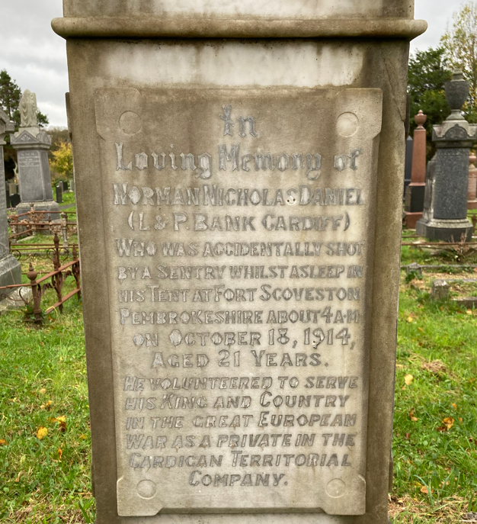
Hidden tragedies (4)
In loving memory of Norman Nicholas Daniel
Who was accidentally shot by a sentry whilst asleep in his tent at Fort Scoveston*, Pembrokeshire
On October 18th 1914
Aged 21 years
He volunteered to serve his king and country in the great European war as a Private in the Cardigan Territorial Company.
*used mainly as a training camp for volunteers and militia. World War I saw increased activity in the fort. In order to protect the dockyards of Milford Haven, Neyland and Pembroke Dock, a complex system of trenches was built in the land surrounding the fort to ward against land based attack.
Cardigan Cemetery

Slide 23
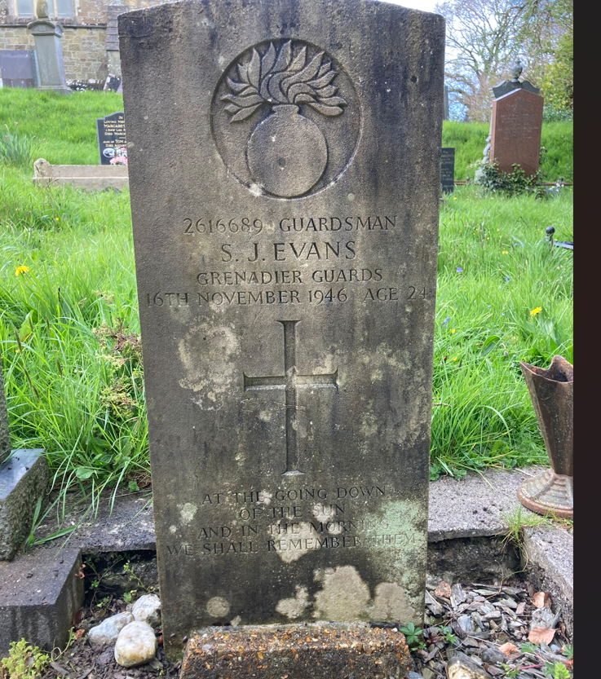
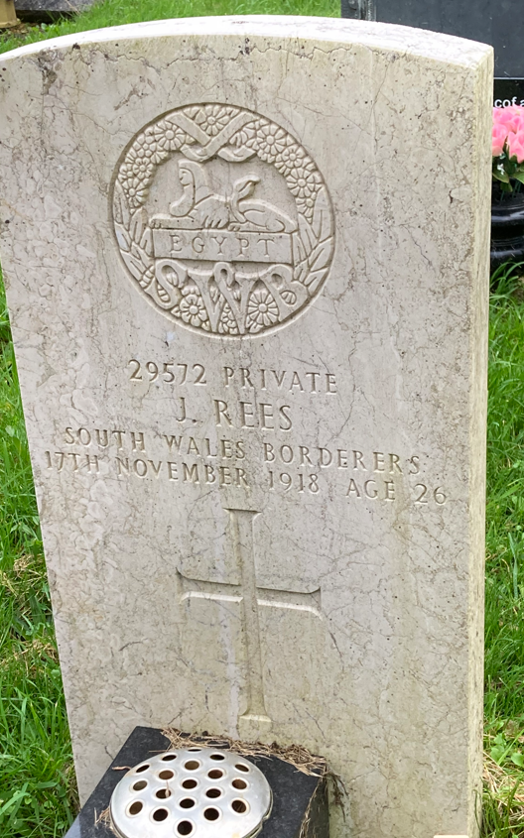
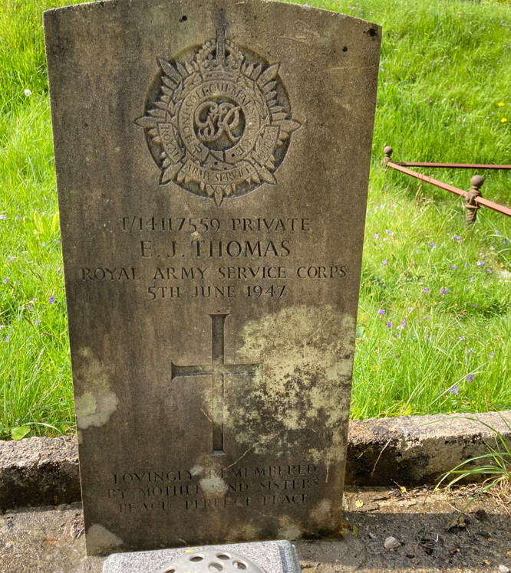
Hidden tragedies (5)
S.J. Evans
16th November 1946
Aged 24
At the going down of the sun and in the morning we will remember them
J.Rees
17th November 1918
Aged 26
E. J. Thomas
5th June 1947
Lovingly remembered by his mother and sisters
Aberporth Churchyard

Slide 24
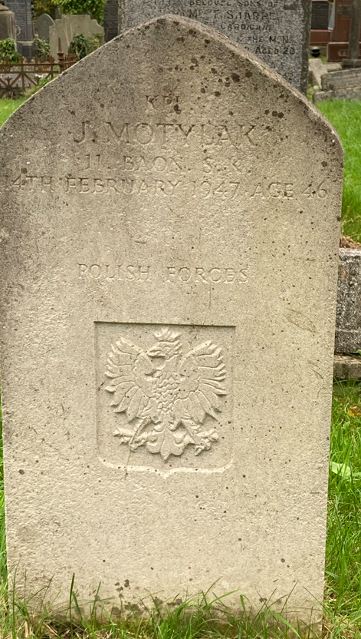
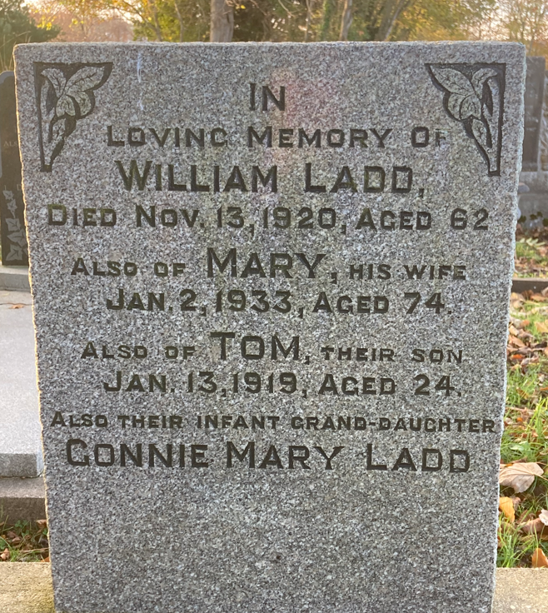
Cardigan cemetery
Tom Ladd
J. Motylak

Slide 25
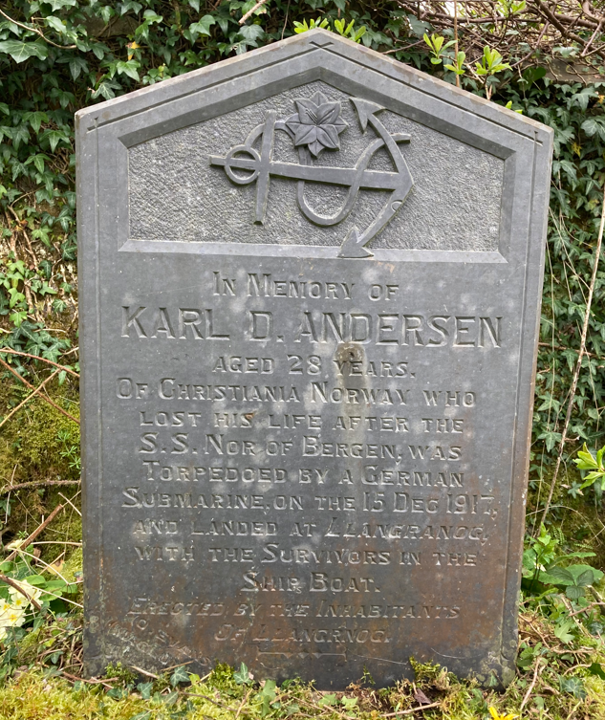
Llangrannog (St David) Churchyard
In Memory of KARL D. ANDERSON aged 28 years
Of Christiana, Norway who lost his life after the SS Nor of Bergen was torpedoed by a German submarine on 15th December 1917
and landed at Llangranog with the survivors in the ship’s boat .
Erected by the inhabitants of Llangranog.
436 Norwegian ships were sunk by German submarines in the period 1914–1917.
More than 1,500 Norwegian sailors died during this period, creating an increasingly anti-German sentiment throughout the nation of Norway.

Slide 26
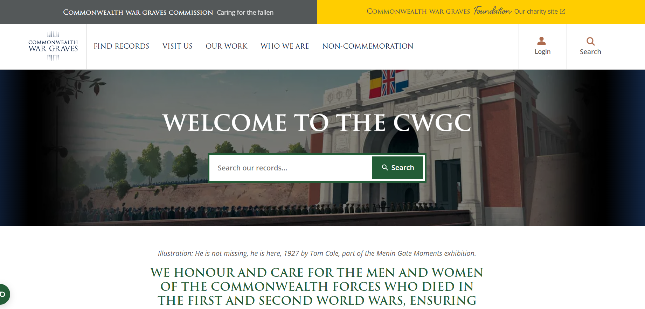

Slide 27
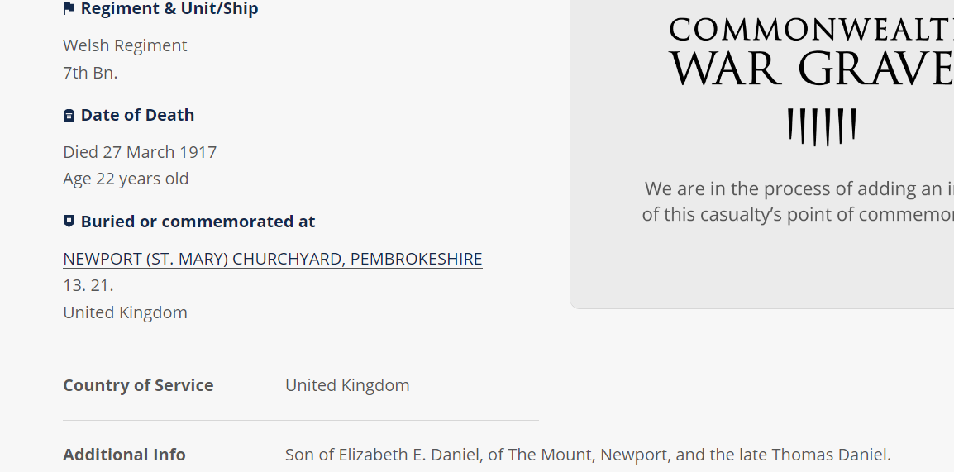

Slide 28
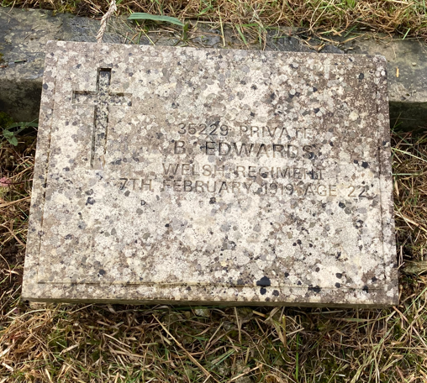
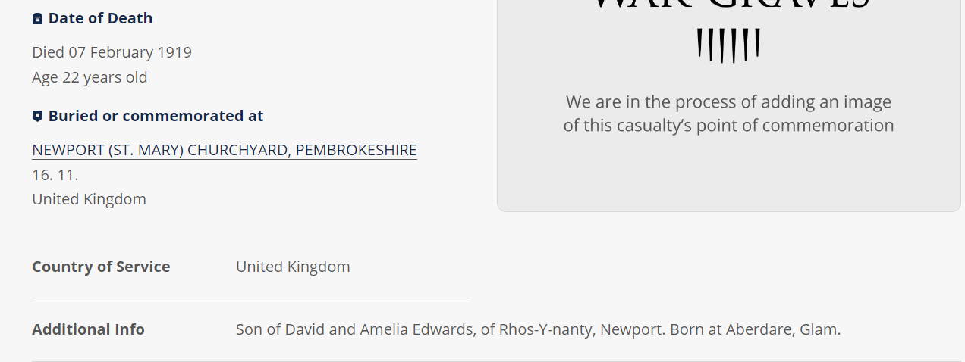

Slide 29
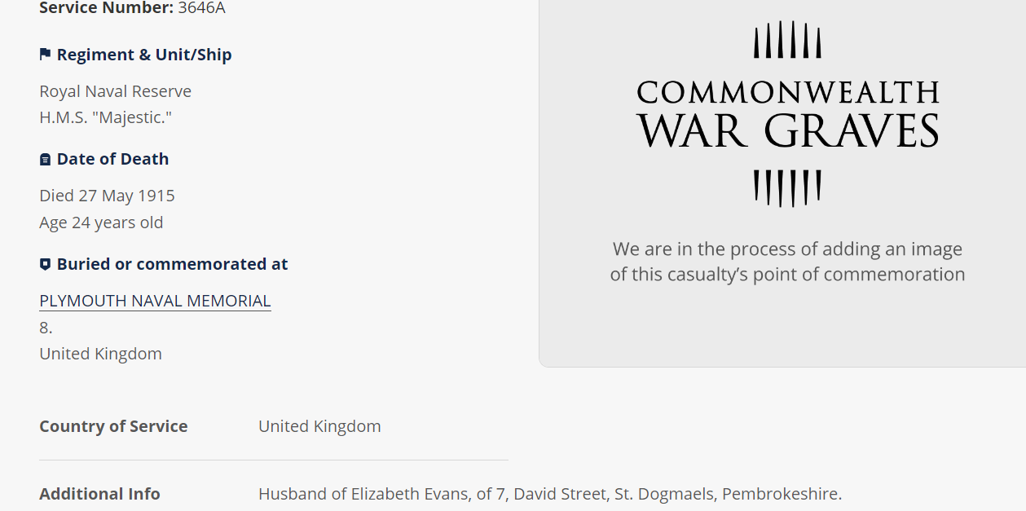
Postcode search on CWGC website
Seaman Thomas Evans

Slide 30
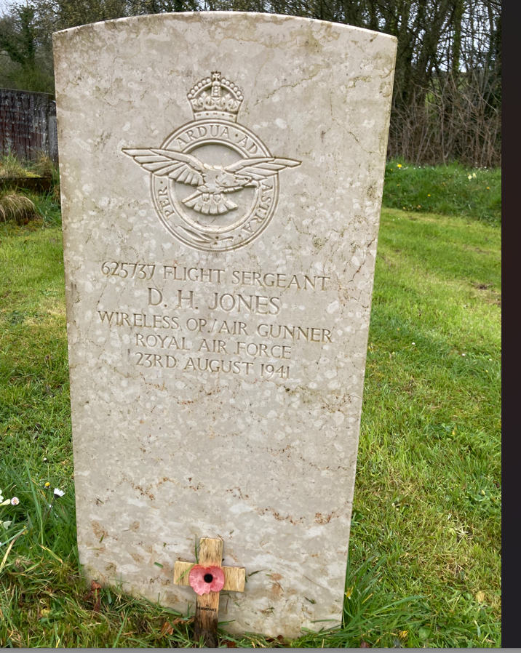
How I became interested
BLAENWAUN CHAPEL YARD
625737 FLIGHT SERGEANT
D.H.JONES
WIRELESS OP./ AIR GUNNER
ROYAL AIR FORCE
23 AUGUST 1941

Slide 31
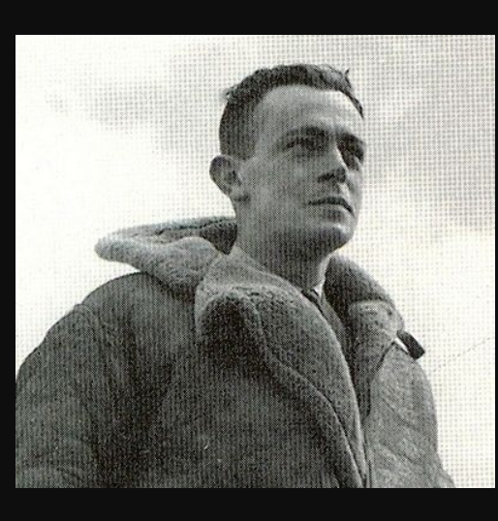
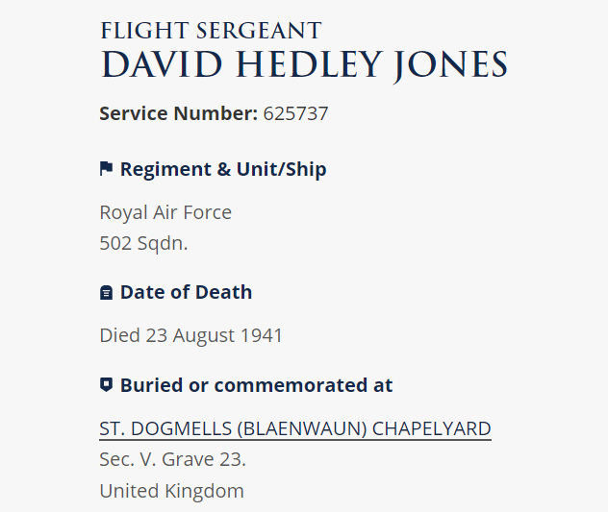
Research
An Irish Airman foresees his Death (W.B.Yeats)
I know that I shall meet my fate
Somewhere among the clouds above ….
On 28 November 1938, with war looking ever more likely, No.502 Squadron became part of Coastal Command, and was re-equipped with the Avro Anson. When war broke out, the squadron was used to fly patrol in the Atlantic off Ireland, guarding the crucial western approaches to Britain
On 19thAugust 1941 G.A.S. reported to the War Cabinet that the loss of 107 bombers since the month opened.

Slide 32
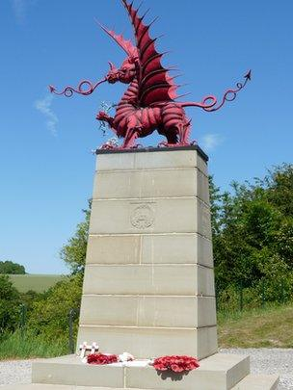
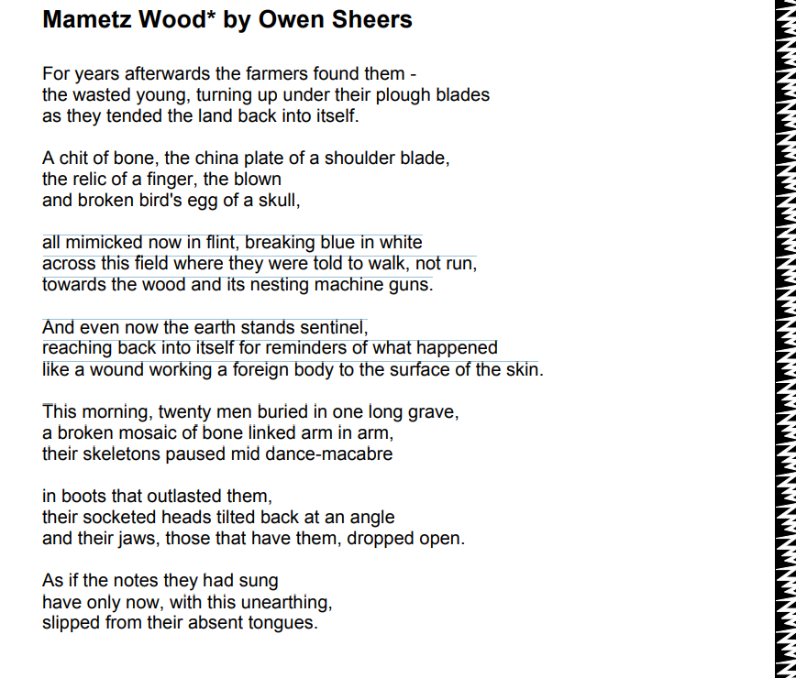
The Battle for Mametz Wood
This was the first major offensive of World War One for many Welsh soldiers in WW1.
Mametz Wood was the objective of the 38th (Welsh) Division during the First Battle of the Somme.
The attack was made in a northerly direction over a ridge, focusing on the German positions in the wood, between 7 July and 12 July 1916.
On 7 July the men formed the first wave intending to take the wood in a matter of hours.
However, strong fortification, machineguns and shelling from the better trained and equipped German soldiers killed and injured over 400 soldiers before they reached the wood.
By 12 July the wood was effectively cleared of the enemy.
The Welsh Division had lost about 4,000 men killed or wounded in the engagement

Slide 33
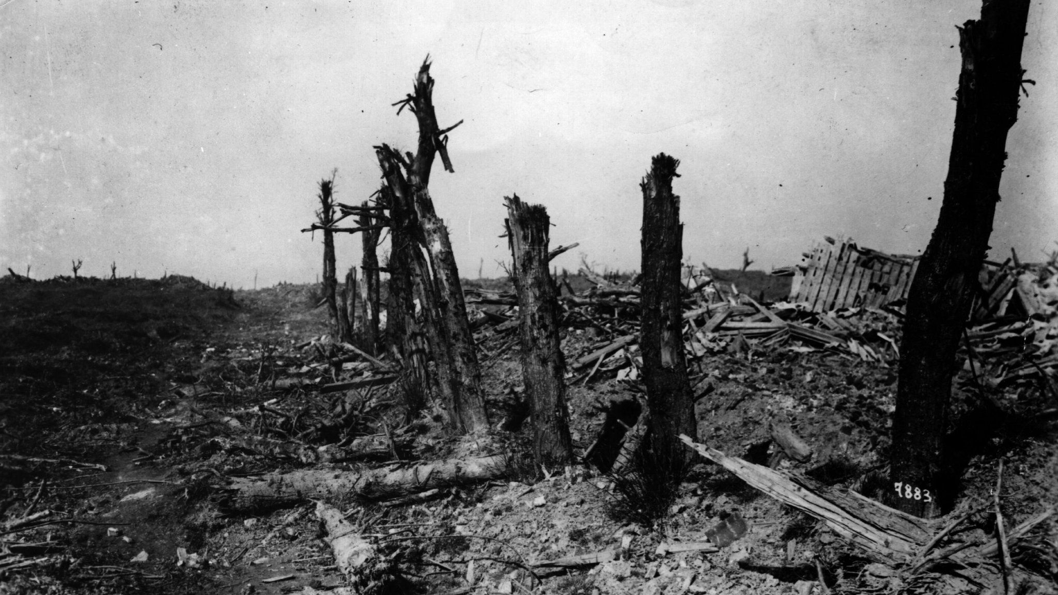
Reports from survivors
“That enchanted wood was a fair hell, what with the rifle firing, bombs, mortars, high explosives.
“Together with the groans of the wounded and dying, and the Huns shouting for mercy and firing at every opportunity, and the Welsh cursing, blinding and strafing them.”
“The wounded and dead around us – friends falling never to rise again, us without time to neither help nor cherish.”

Slide 34
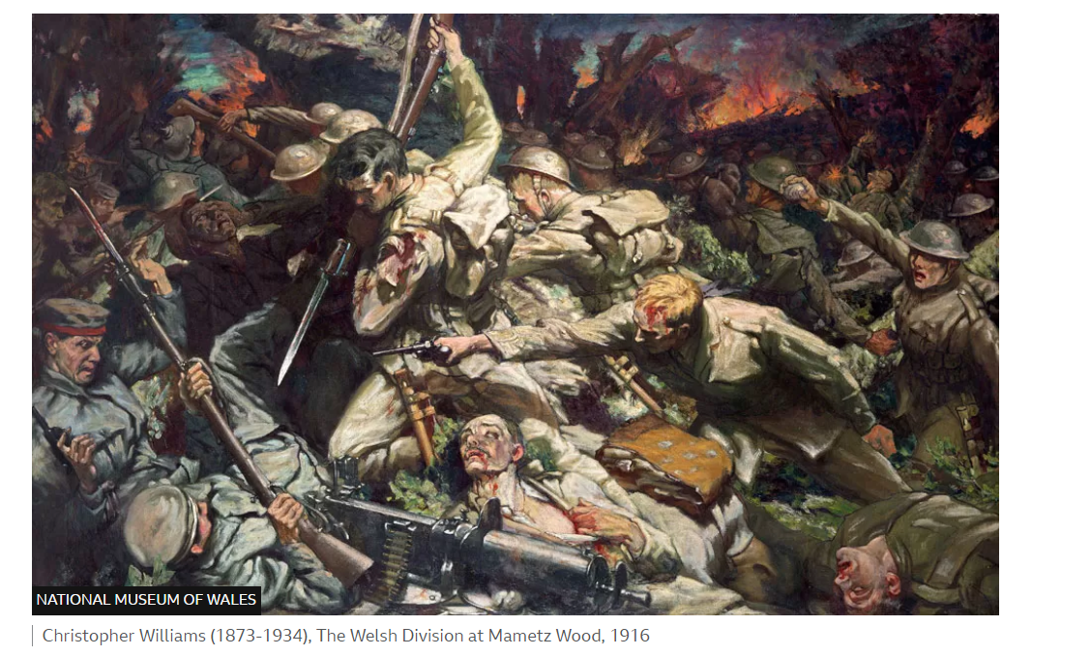

….the bodies of the Welsh soldiers that were killed fighting for the woods were so numerous, and the amount of remaining men to bury them so few, that it meant a large number were lying on the ground the entire time it was there…No longer can anyone claim that war is romantic who has been testament to the sight of rotting bodies that have been neglected without care and understanding that what remains is a person that was once loved’

