Slide 1
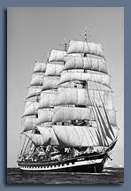
ST DOGMAELS AND CARDIGAN. A MARITIME HERITAGE.
John Rhys
Social history. Understanding our past and how we lived. Rebecca Riots, the Poor Law, non-conformism and the chapels ……
World history. Connections to major events. Crimea, the Irish famine, US Civil War, Boer War, Empire…….
Economic history. Technological change. The railways. Sail and steam co-existed for a long time! Into the 1930s!
Notes:
We learn from history. Dealing with poverty. The Poor Law and the Rebecca Riots.
This presentation is a particular collection of tales about local people in the past but it’s also about connections
International. Economic history. Sail to steam like petrol to electric.
My fascination is with connections that we can make to all these trends.
Recently discovered a book about local man and the 7th Cavalry.

Slide 2
A Maritime Heritage and Global Connections
Barques and Cape Horn. The Hawarden Castle
Mariner families.
Wrecked in the Gallegos River.
”From Hawse Pipe to Cabin Door”. The story of Billy Probert of Cardigan.
The Loss of the Claverdale. Pirates, war or weather?
My Beautiful Imperial. Civil War in Chile.
Three Shipwrecks and Chapel Expulsions. Poor navigation, Christmas cheer and moral outrage.
The Record Breaking Voyage(s) of Captain Williams, Cannon House
Adventures with the Corsairs – the Barbary Pirates. The East India Company and the Saunders family.
The Mathias family of Hendre, Colonel Britton Evans and the Texas War of Independence. Family letters from 1791 and later.
Thomas Williams gives evidence to Parliament (on the Rebecca Riots and the Poor Law)
David Phillips of Blaenwaun and the Albion.
Notes:
These are just a few of the things I hope to cover over two talks

Slide 3
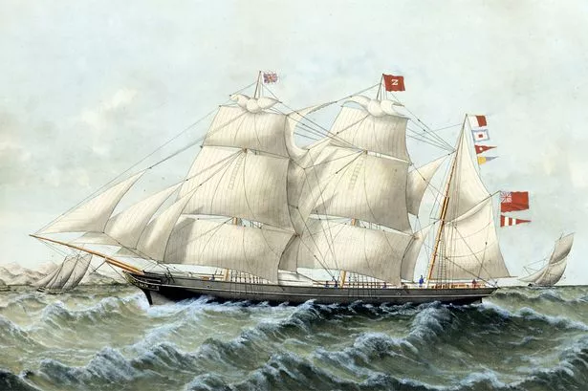
The most important object in Welsh history? The case for the copper barque
The copper ore barque Delta, built Cardiff 1865, owned by Henry Bath of Swansea
Three or more masts, square rigged except for the mizzen mast fore and aft
Workhorse of the South American trade – coal, copper ore, guano
Notes:
“Barques were made for steadiness rather than speed. Even so, crews had to contend with terrifying conditions. A Cape-Horner had to dip below 56° south if it was to pass into the Pacific. Rounding the Cape could sometimes take weeks as the ship beat into towering seas and westerly gales. It was a gruelling ordeal for professional seafarers; for passengers – smelters and miners on their way out to Chile – it was worse. The diary account of John Chellew, a furnace man who sailed from Swansea on the Florence Nightingale in 1857, tells of days spent battling against wind and currents. Making headway past the Cape, which appeared through the snow flurries as “a huge chain of dark mountains”, seemed impossible.
Yellow fever a deadly scourge
Shipwreck was not the only threat facing Cuba-bound Swansea mariners. Santiago was a notoriously unhealthy city where yellow fever was a deadly scourge: “Scarcely a vessel arrives in our port from Cuba but has one, two, three or even four hands dead on board”, Swansea’s Cambrian newspaper noted. Ship owners had to offer a special premium to get mariners to undertake the high-risk voyage. When owners tried to introduce a standard wage rate for all routes in 1856 they met with determined resistance on the part of the sailors: “This has been most resolutely opposed by a large number of the seamen of our port, who on Tuesday last paraded the principal streets of the town, accompanied by three or four flags and headed by a Scotchman playing the bagpipes”.
By the 1850s the Cuban mines had gone into decline. Chilean ore remained prominent, however. Copper barques continued to anchor in the bay at Valparaíso; others headed north to Coquimbo, the main port of Chile’s fast-growing Norte Chico mining district. Other barques were dispatched to completely new areas of mineral exploitation. Port Nolloth in Namaqualand, on South Africa’s arid Atlantic coast, became familiar to Swansea seamen, so too Tilt Cove in Newfoundland.
Life became cosmopolitan
The copper trade introduced a cosmopolitan note to Welsh life. Swansea barques were carrying coal around the world well before Cardiff began its ascent as the world’s busiest coal exporter. The places to which coal was carried and from where ore was fetched have left their imprint on Swansea’s landscape. Cuban ore was landed at the Cobre wharf and sailors home from Santiago no doubt drank in the Cuba Inn on the town’s North Dock. The world came to Swansea and the copper trade turned Wales outwards. Seafarers from small maritime centres in West Wales like Aberaeron were recruited to serve on the barques despatched to the remotest locations.”

Slide 4
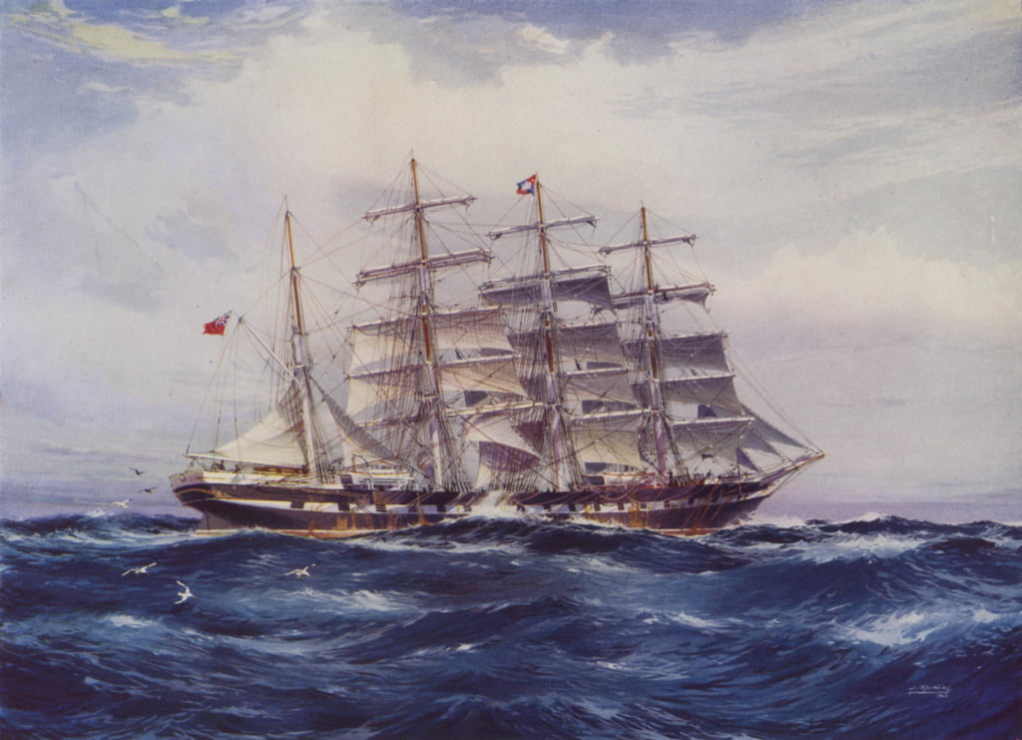
THE MEDWAY
Training ship of the Devitt and Moore line
Sailed during WW1 by Captain Williams, Cannon House
Notes:
Just a beautiful picture

Slide 5
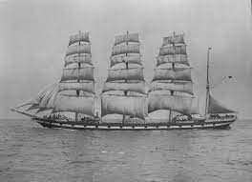
THE MEDWAY
Notes:
And a photo of the same ship

Slide 6
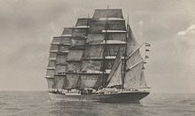
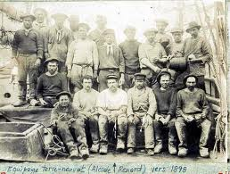
Hazards for seamen. ”Below 40º South there is no law. Below 50º South there is no God.” Contemporary saying.
“Roaring forties, furious fifties, screaming sixties”
Cape Horn is 56º South; icebergs year round
Rounding Cape Horn, East to West against prevailing winds in square rigged ships
With no land to East or West, 60 to 70 ft waves not uncommon*, with “rogues” of up to 100 ft
Ports notorious for yellow fever; premium pay demanded; ”most voyages would lose a few crew to yellow fever” – Potato Jones
Combustible cargoes of damp coal. Shifting cargoes
* the mathematics of wave height; a function of wind speed, duration and “fetch” - the distance over which the wave can build
A five masted barque
Notes:
The prevailing winds in latitudes below 40° south can blow from west to east around the world almost uninterrupted by land, giving rise to the "roaring forties" and the even more wild "furious fifties" and "screaming sixties". These winds are hazardous enough that ships traveling east would tend to stay in the northern part of the forties (i.e. not far below 40° south latitude); however, rounding Cape Horn requires ships to press south to 56° south latitude, well into the zone of fiercest winds.^{[22]} These winds are exacerbated at the Horn by the funneling effect of the Andes and the Antarctic peninsula, which channel the winds into the relatively narrow Drake Passage.
The strong winds of the Southern Ocean give rise to correspondingly large waves; these waves can attain great height as they roll around the Southern Ocean, free of any interruption from land. At the Horn, however, these waves encounter an area of shallow water to the south of the Horn, which has the effect of making the waves shorter and steeper, greatly increasing the hazard to ships. If the strong eastward current through the Drake Passage encounters an opposing east wind, this can have the effect of further building up the waves.^{[23]} In addition to these "normal" waves, the area west of the Horn is particularly notorious for rogue waves, which can attain heights of up to 30 metres (98 feet).^{[24]}
The prevailing winds and currents create particular problems for vessels trying to round the Horn against them, i.e. from east to west. This was a particularly serious problem for traditional sailing ships, which could make very little headway against the wind at the best of times;^{[25]} modern sailing boats are significantly more efficient to windward and can more reliably make a westward passage of the Horn, as they do in the Global Challenge race.
Ice is a hazard to sailors venturing far below 40° south. Although the ice limit dips south around the horn, icebergs are a significant hazard for vessels in the area. In the South Pacific in February (summer in Southern Hemisphere), icebergs are generally confined to below 50° south; but in August the iceberg hazard can extend north of 40° south. Even in February, the Horn is well below the latitude of the iceberg limit.^{[26]} These hazards have made the Horn notorious as perhaps the most dangerous ship passage in the world; many ships have been wrecked, and many sailors have died attempting to round the Cape.
Bottom right is a fairly villainous looking crew, but this is not St Dogmaels men who would obviously have been a lot smarter

Slide 7
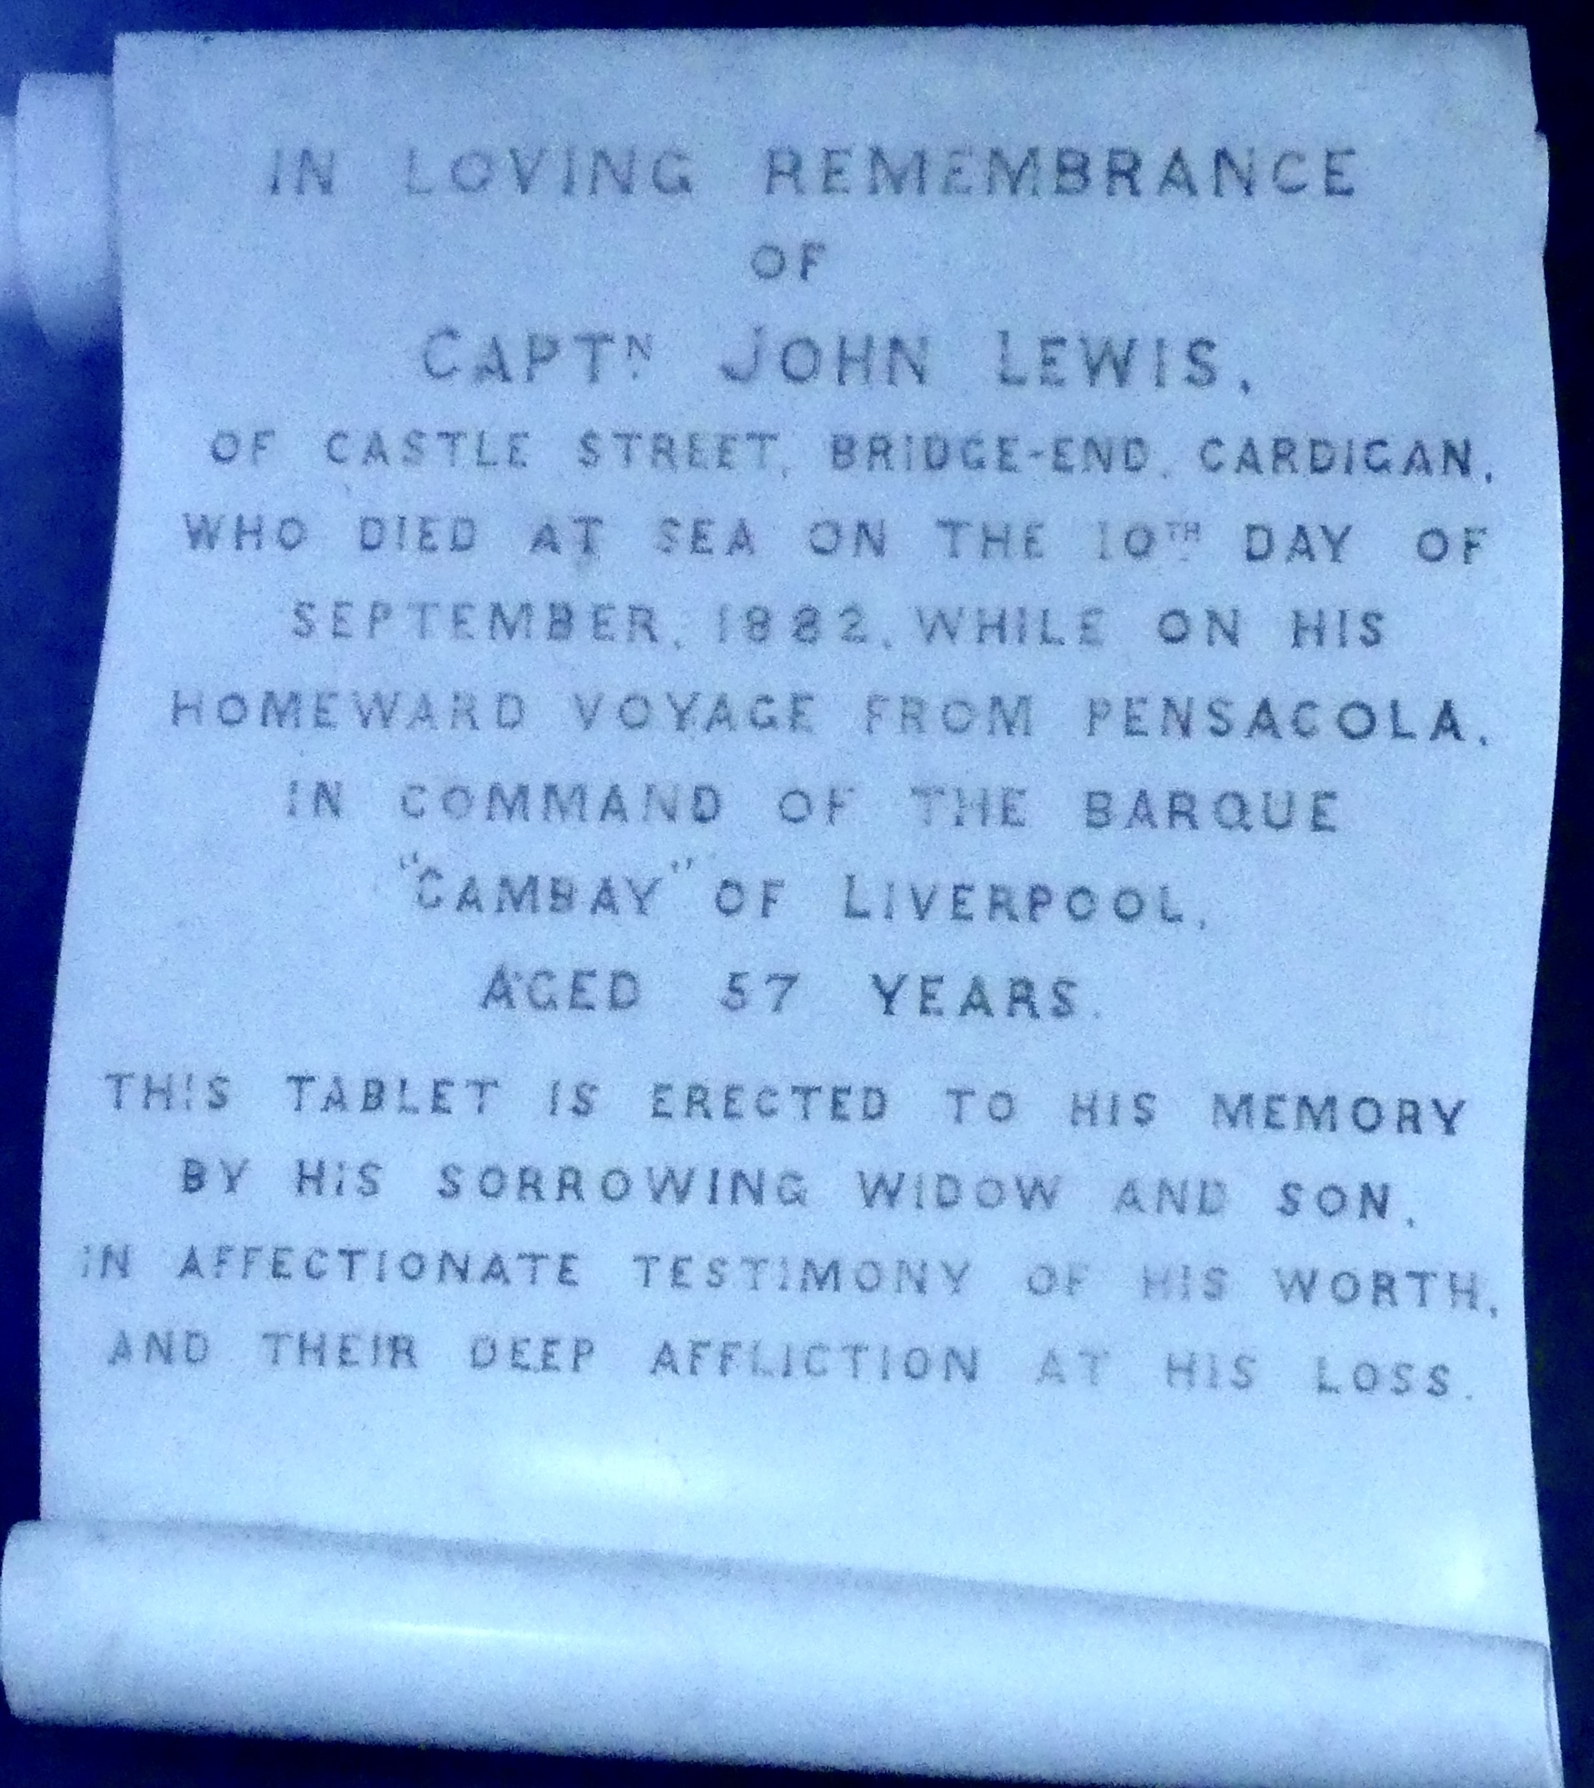
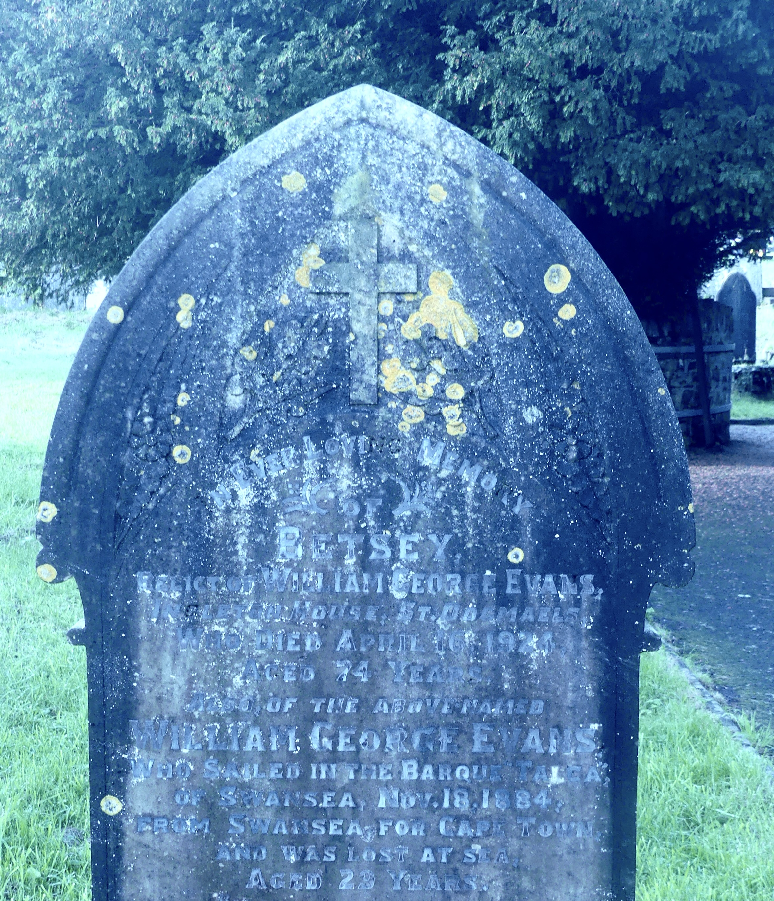
The role of the barque, and the ever present risks
In St Thomas church and churchyard. The Cambay of Liverpool – homeward from Pensacola.
More later on the Cambay of Liverpool.
The barque Talca – Swansea to Capetown.
Notes:
Evidence of how significant the barque was for local sailors. The Cambay of Liverpool will appear in a later story c. 1890

Slide 8
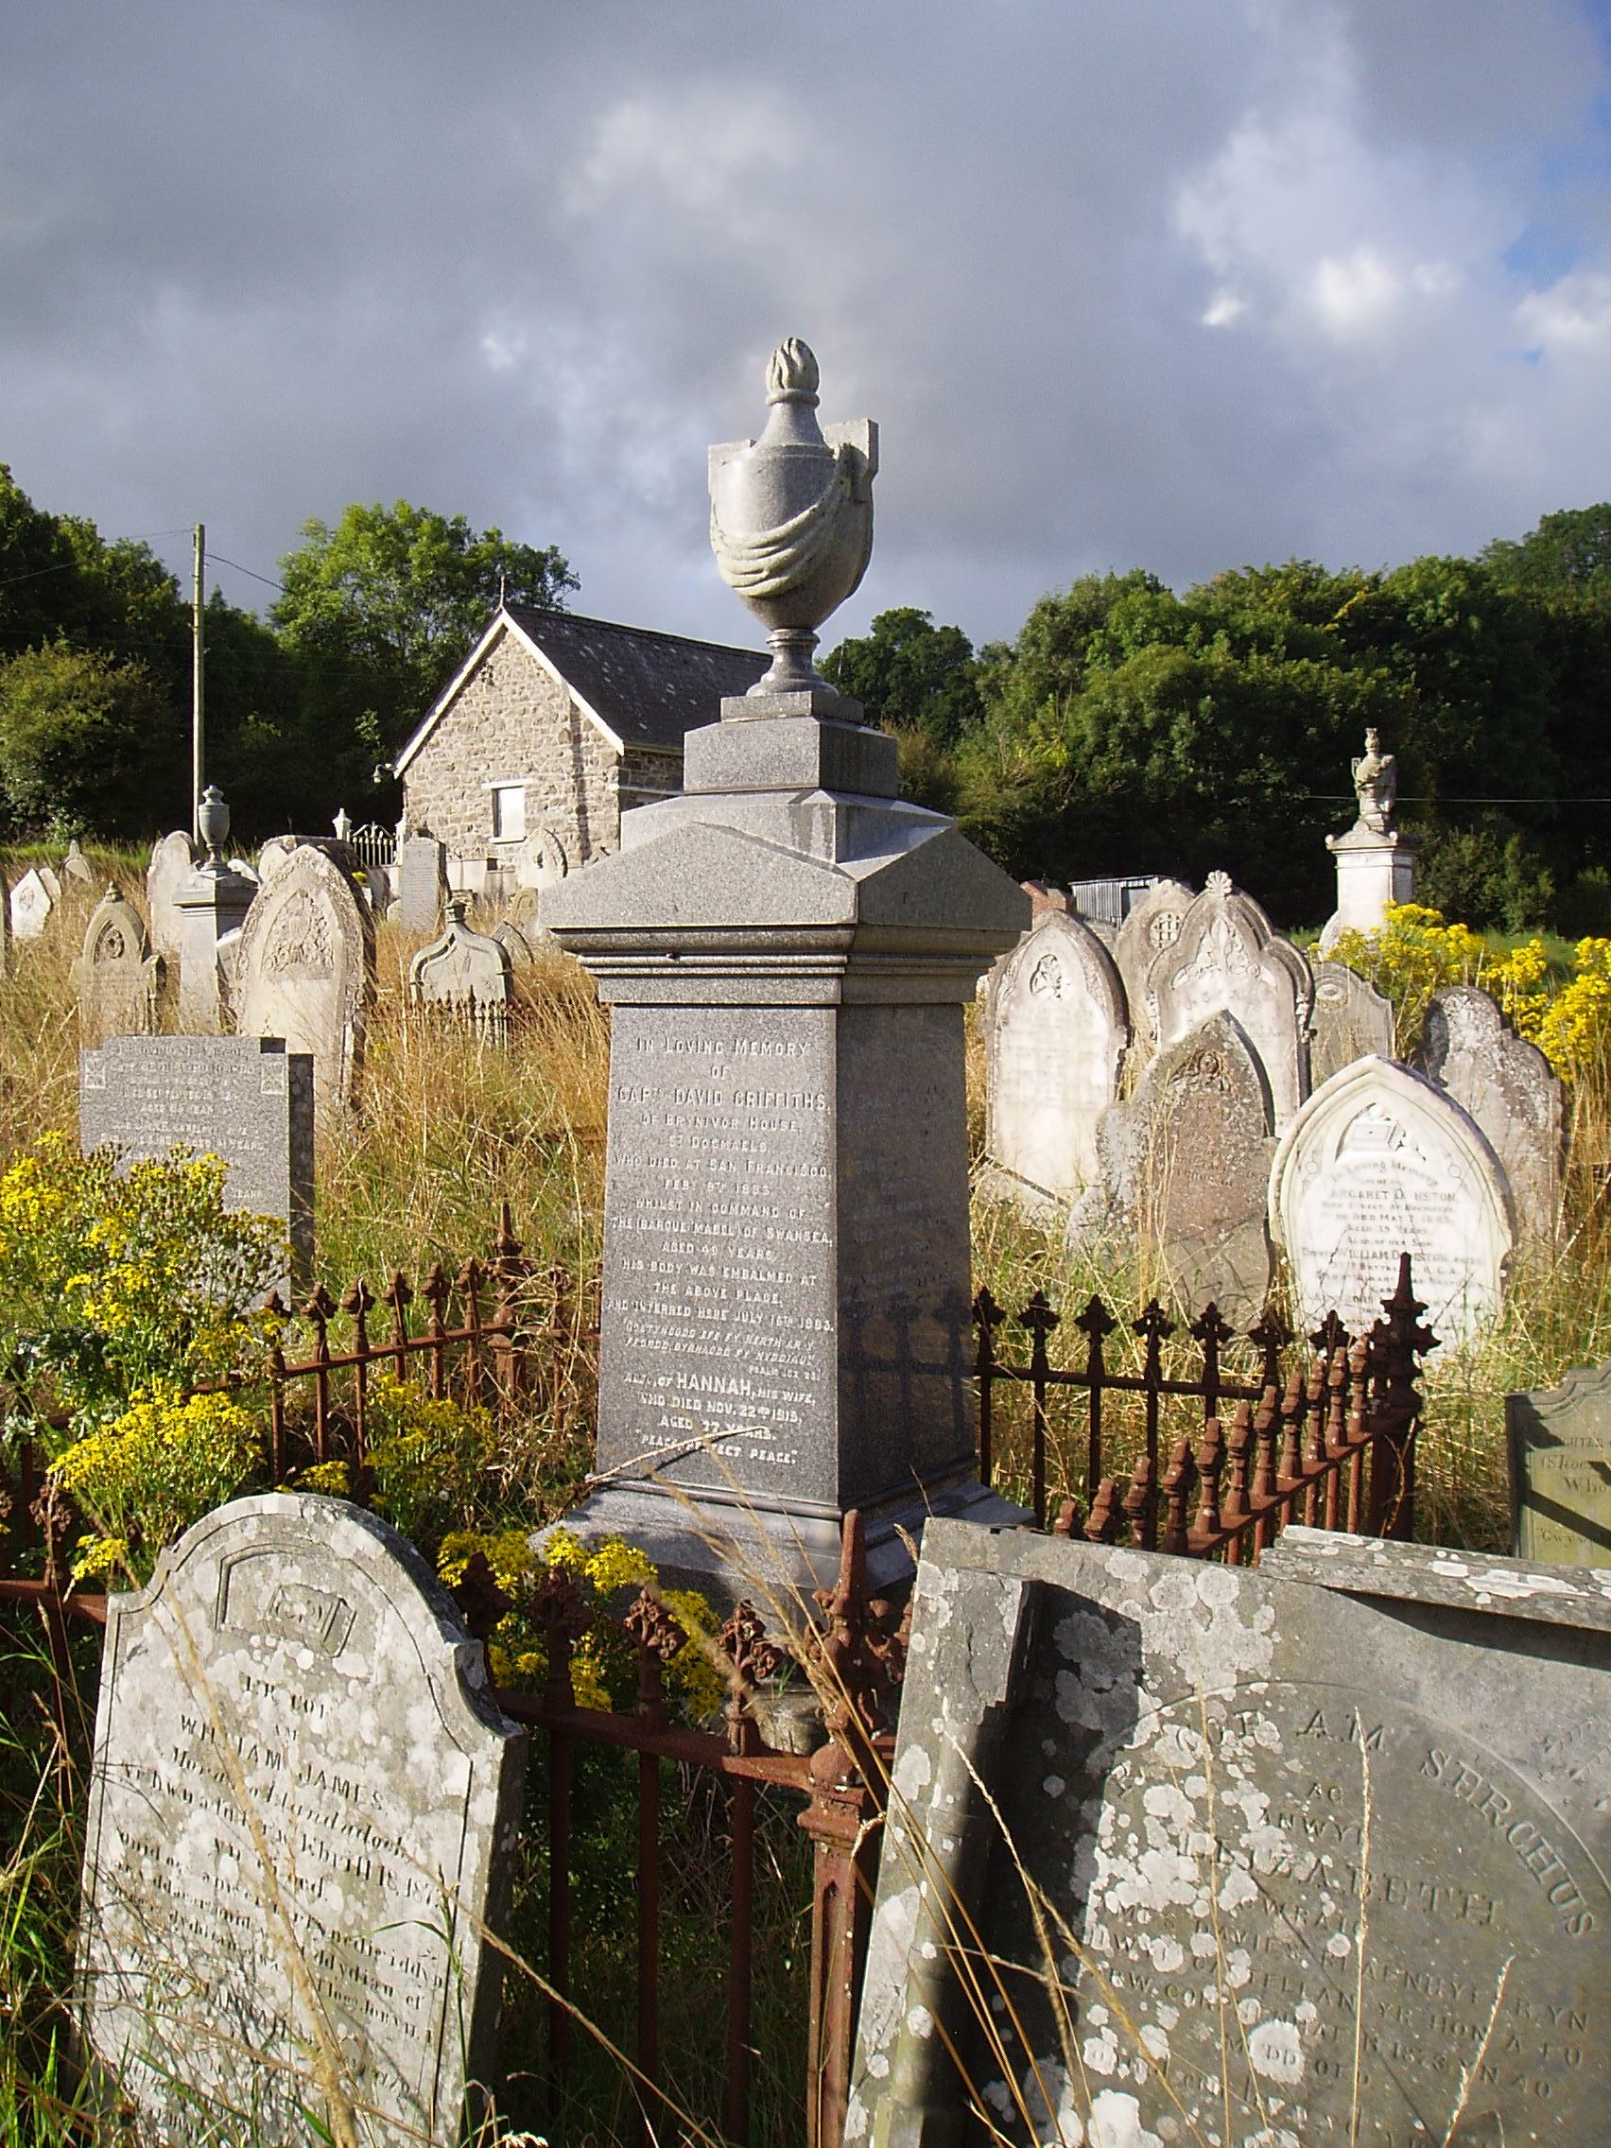
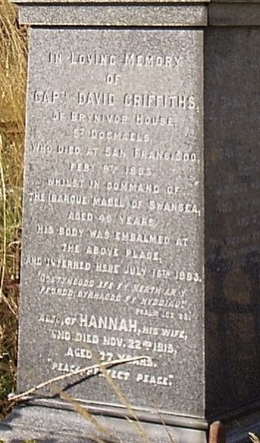
Blaenwaun and other memorials tell many stories
Captain Griffiths of Brynivor House. His ship, the barque Mabel
Died in San Francisco.
Embalmed and buried in Blaenwaun
Notes:
Capt David Griffiths of Brynivor House, St Dogmaels who died at San Francisco Eeb 8th 1883 whilst in command of the barque Mabel of Swansea aged 49 years
His body was embalmed at the above place and interred here July 16th

Slide 9
The Hawarden Castle. Its last voyage(s).
“The iron clipper ship Hawarden Castle, which has been here on previous voyages, comes on this occasion with general cargo.
In this is a line of dynamite … and [this] … necessitated her being brought up at the outer anchorage …. A survey by the Government analyst, previous to the commodity being lightered.”
There follows an account of the passage including severe gales in the North Sea, winds and passage round the Cape of Good Hope, etc.
“… still under the command of Captain D Davies, and he has brought her into port clean and in admirable order”
Notes:
Many of you will have seen the very prominent MI at St Thomas’, on the path below the yew tree. Just by chance I found local paper reports of its last days before setting off on its fatal voyage.

Slide 10
The Hawarden Castle. NSW loading for Valparaiso. The Newcastle Morning Herald and Miners’ Advocate. 5 March 1890
A lucky escape in harbour when a tug fails to pull against current from the river
Prompt action in dropping the anchor
“… in ballast and after discharging will load Wallsend coal for Valparaiso”
Mr Evans is the Chief Officer

Slide 11
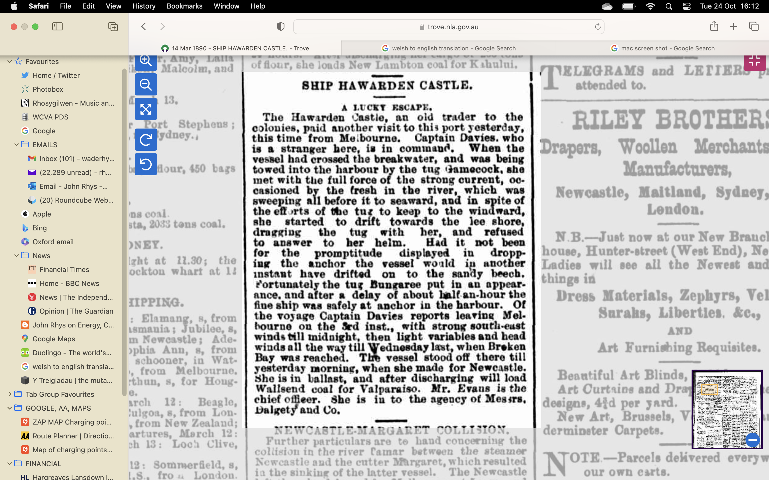
The Newcastle Morning Herald
and Miners’ Advocate.
5 March 1890
“In ballast and after discharging
will load Wallsend coal for
Valparaiso.”
St Thomas’ s churchyard:
Lost with all hands between
Newcastle, NSW and
Valparaiso

Slide 12
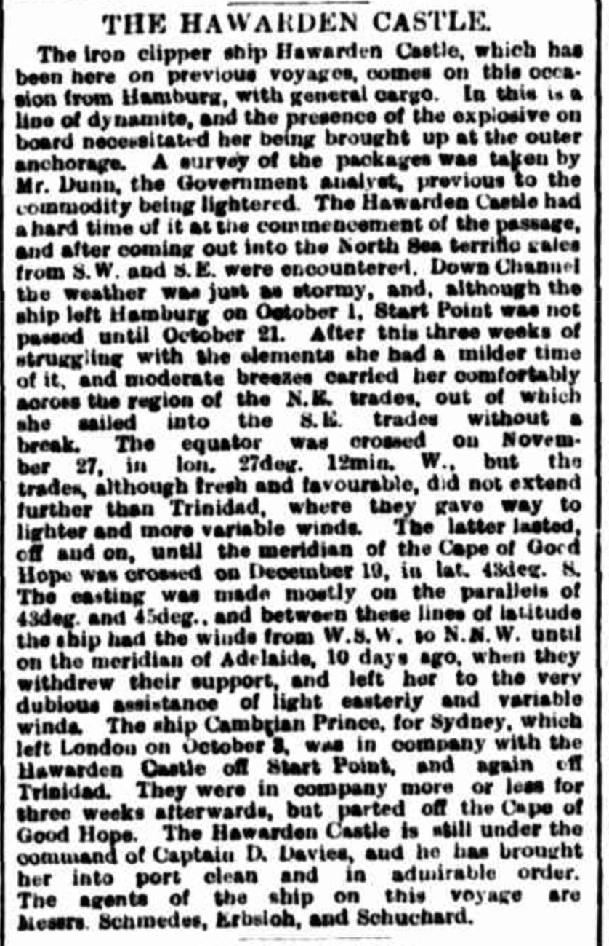

Slide 13
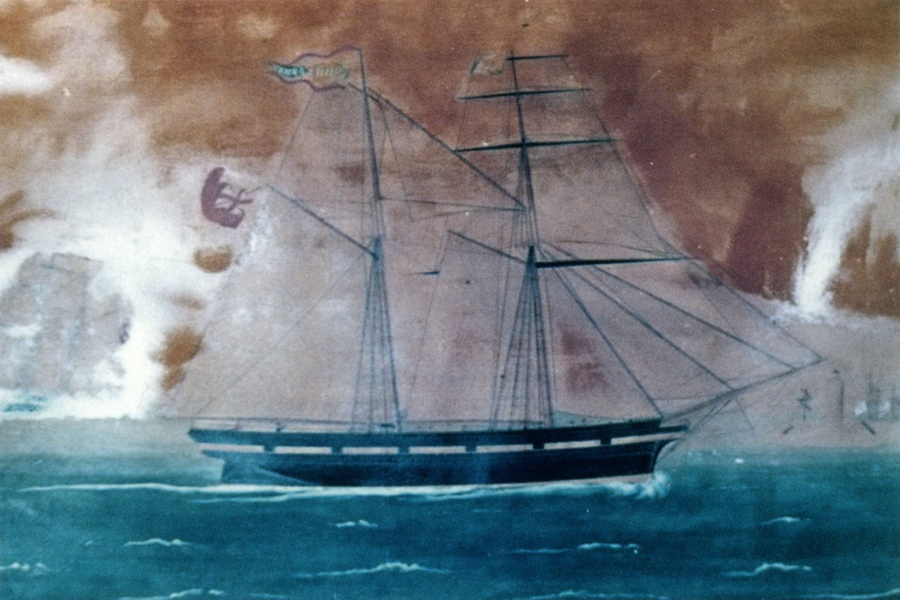
A SOCIETY BUILT AROUND SEAFARING
In earlier times, with smaller boats, a lot of coastal trade - ”the Cwm Traders” - culm and other commodities - captains as small scale entrepreneurs looking for profitable cargoes.
But still plenty of Irish, Mediterranean and trans-Atlantic trade. The Revd Phillips of Blaenwaun and emigration to Canada. The “Albion”. 1820s.
With bigger ships and improving communications, captains as employees of the big shipping companies, further afield with the great expansion of world trade.
In St Dogmaels, mariners and seafarers substantially outnumber fishermen. The small lane of Alltfach, has at least 5 mariners’ families in the 1860s and 1870s
”Hwyl fawr” – “Big sail”
The schooner John and Henry. 88 tons.
Built 1844, Aberaeron. Possibly the oldest surviving picture of a locally built ship
Notes:
Schooners. Typically two masted fore and aft

Slide 14
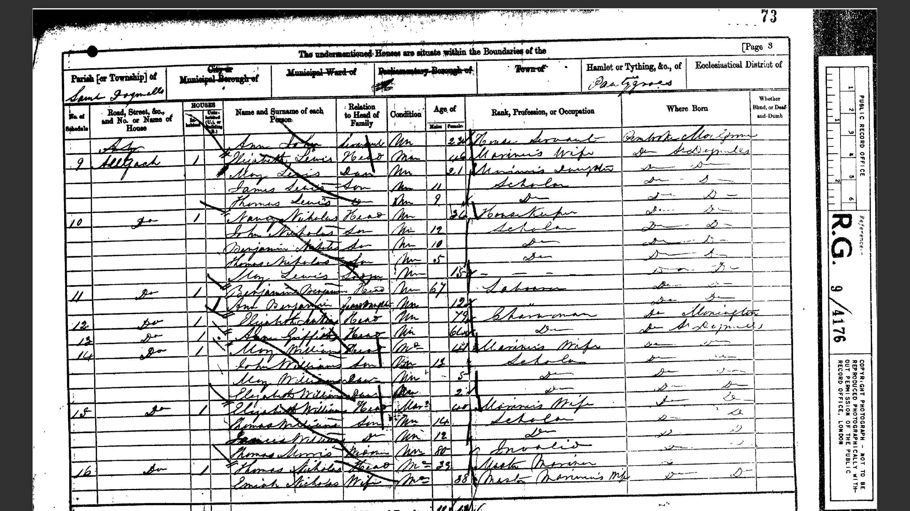
Notes:
A typical 1861 census sheet. Four mariner households. Three of the men are away

Slide 15
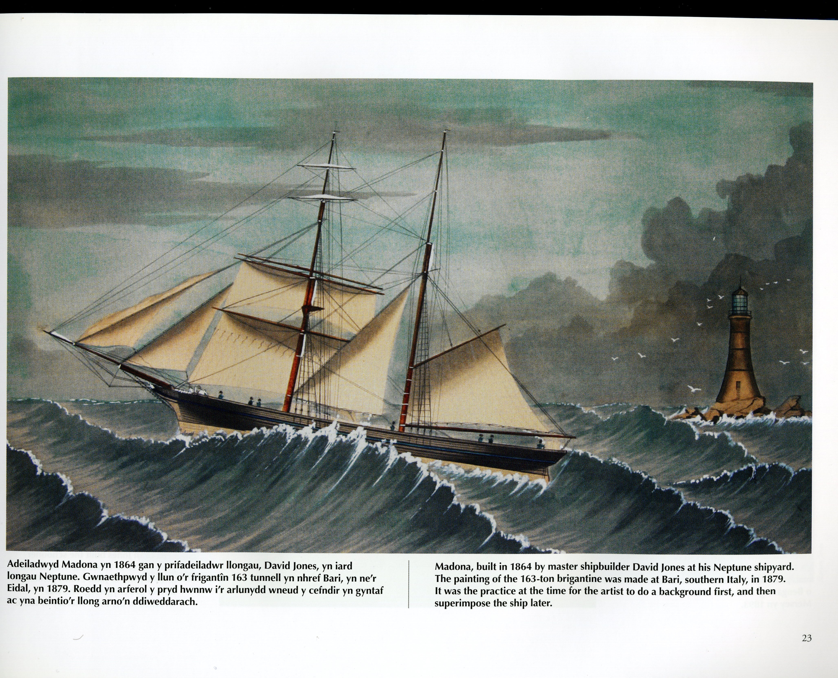
SOCIAL AND ECONOMIC DIMENSIONS
The personal, social and cultural impact of long ”deep sea” voyages must have been huge, not least …
the level of personal risk involved
explains the often matriarchal nature of society … and much else in the social and religious domain.
More awareness of the world than most of their urban contemporaries
”More at home in Valparaiso than in London or Cardiff?”
House names. Lee Cottage, Abigail House, Almora. Pomona, Norwood House, Milo, Sloop, Mariners….
Or … The Lovely Peggy, St Dogmaels
MI s often show a great pride in the sea and in their ship, as well as the numerous tragedies at sea
Madona. 163 ton brigantine
Notes:
Brigantine two mast, foremast square rigged and gaff sail

Slide 16
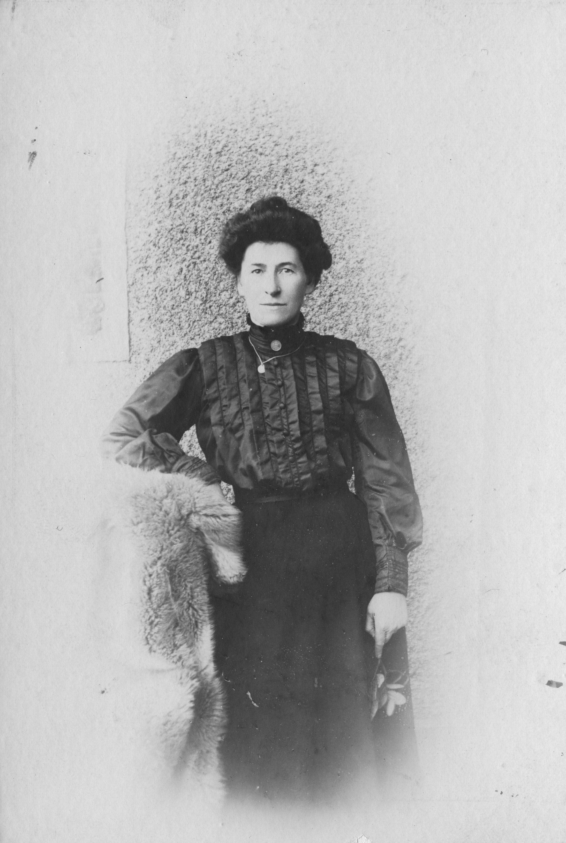
Sarah Elizabeth Williams (m. Owen) of Tivy View, Feidr Fawr
Husband. Captain James Owen. Master Mariner. 1873 – 1954.
Father. James Williams, Master Mariner. 1848 – 1882.
Paternal grandfather. John Williams of Abbey. Sea captain.
Maternal grandfather. Rees Lewis. Master Mariner. Of Lee Cottage, Alltfach, and captain of the Lee.
Father in law. William Owen. Mariner and Fishguard pilot, lost with the steamer Thomas Vaughan in Jack Sound, 1882, attempting to take the leaking ship from Fishguard to Milford Haven for repair.
Great grandfather. John Lloyd d. 1815. Master of the Peggy of Cardigan, and husband of Peggy Martin (of whom more later). Brother of George Lloyd.
Great grandfather. James Lewis. River pilot.
Lloyd relations include Shadrach Lloyd of Abigail House and Captain Williams, Cannon House. Both Master Mariners. The Lloyds were one of the notable maritime families of St Dogmaels.
Three sons at sea.
A great uncle, or rather his wife, ran the Rose and Crown (Bethsaida) when her husband was at sea.
Notes:
Constant awareness of the sea and the risks your family faced
My grandmother, but her mariner would have been quite typical of many women in St Dogmaels in the 19th century.
My impression has always been of a matriarchal society here. With so many men away it would have been the women who ran things.

Slide 17
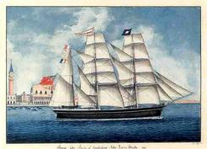
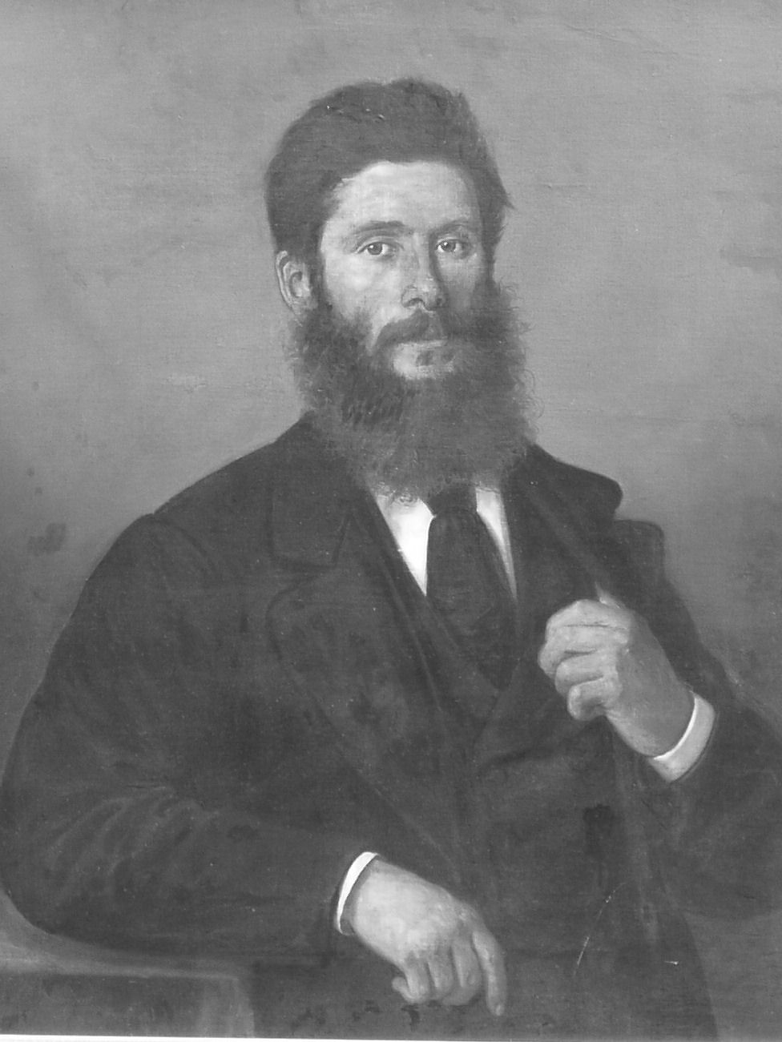
James Williams and the John Byers
The Mediterranean trade. James Williams. 1848-1882
Notes:
Looks like Venice in the background

Slide 18
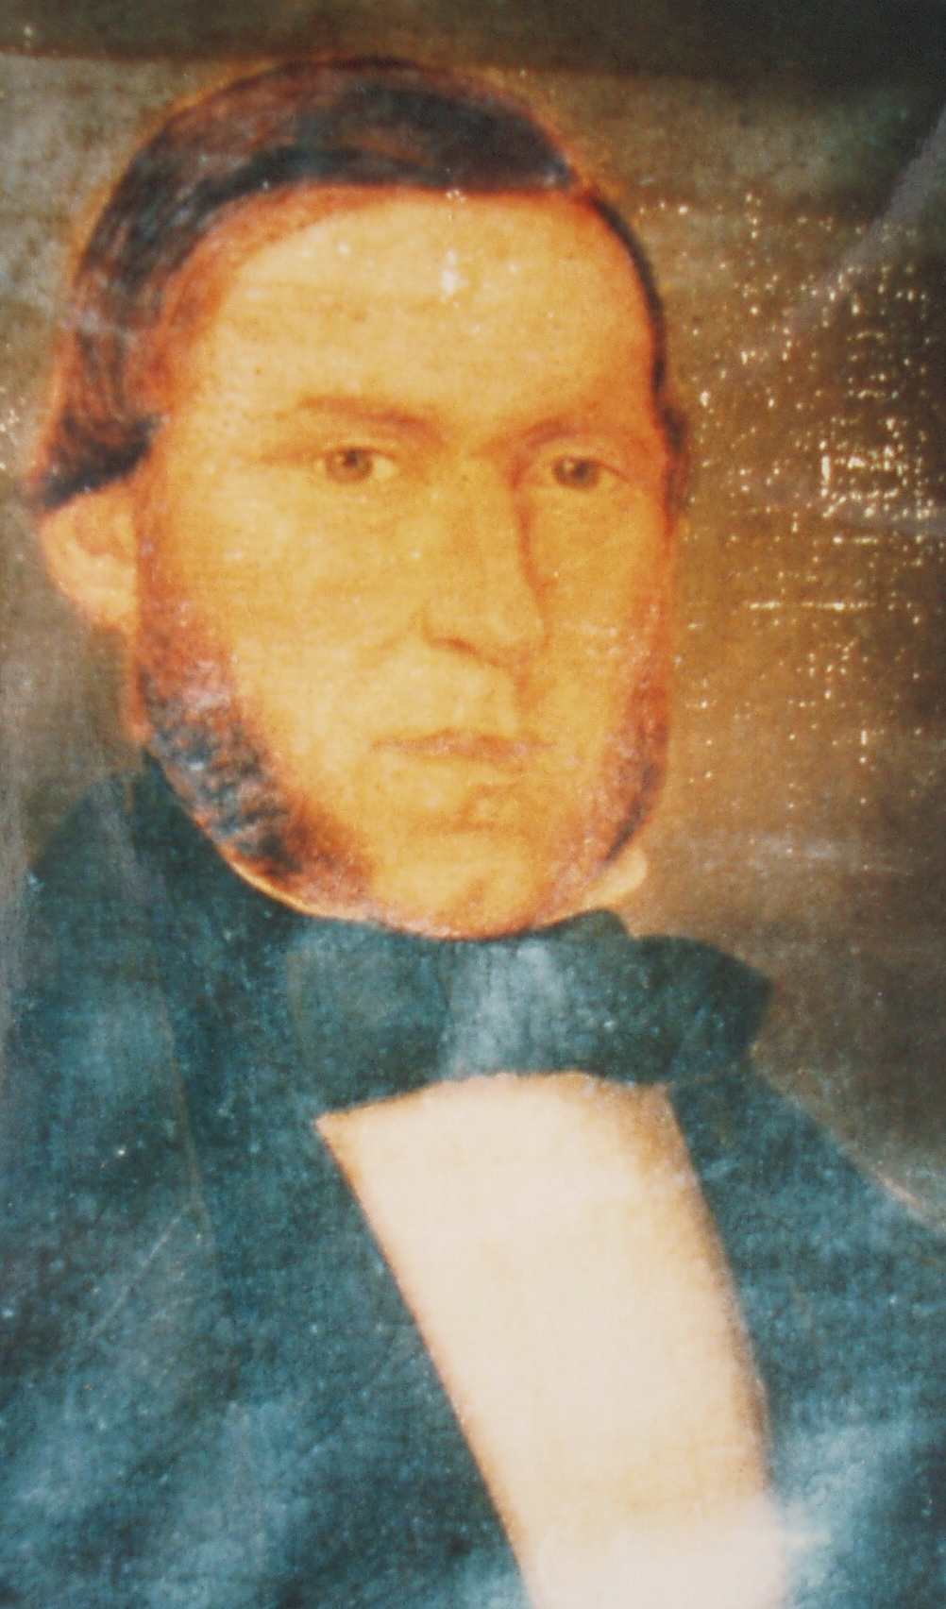
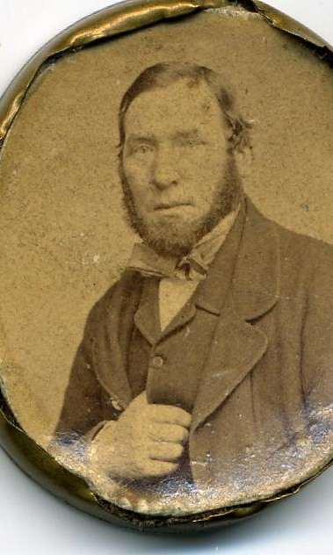
REES LEWIS, MASTER MARINER, OF LEE COTTAGE, ALLTFACH. 1819- 1892
Notes:
Her grandfather. Cottage named after one of his ships

Slide 19
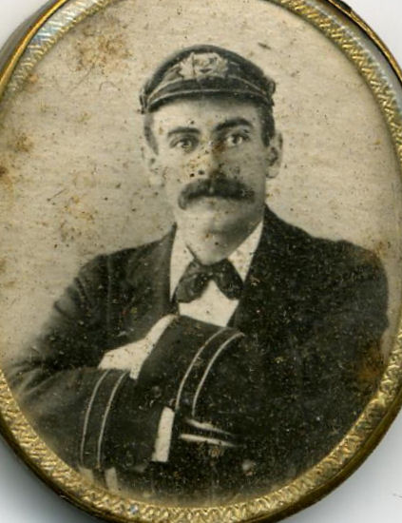
“In The Mersey.” by Max Sinclair. 1889.
James Owen.
1873-1954
Notes:
In the Mersey. The year is 1889 and behind a paddle steamer, two graceful barques and a ferry the recently launched liner City of New York gets underway on her maiden voyage across the Atlantic.
His favourite ship I discovered was the Pipiriki, built in German yards and handed over as part of post war reparations

Slide 20
“In the Mersey”*. The Lord Clyde is the 3-masted barque in the foreground.
First voyage for James Owen, age 14.
Swansea – Rosario – Cape Horn –Valparaiso/ Coquimbo - Port Nolloth – Swansea. 14 months.
Ten years later. 1898. First mate on the “Bootle”, another 500 ton square rigger. Captained by a Fishguard uncle.
* National Maritime Museum. Liverpool.
Notes:
James Owen, my grandfather. Found record of his first voyage via Swansea crew agreements. It was on the barque Lord Clyde.
By chance I then came across this 1889 painting In The Mersey, along with details that reveal the barque in the foreground is the same Lord Clyde. James Owen would have been on board

Slide 21
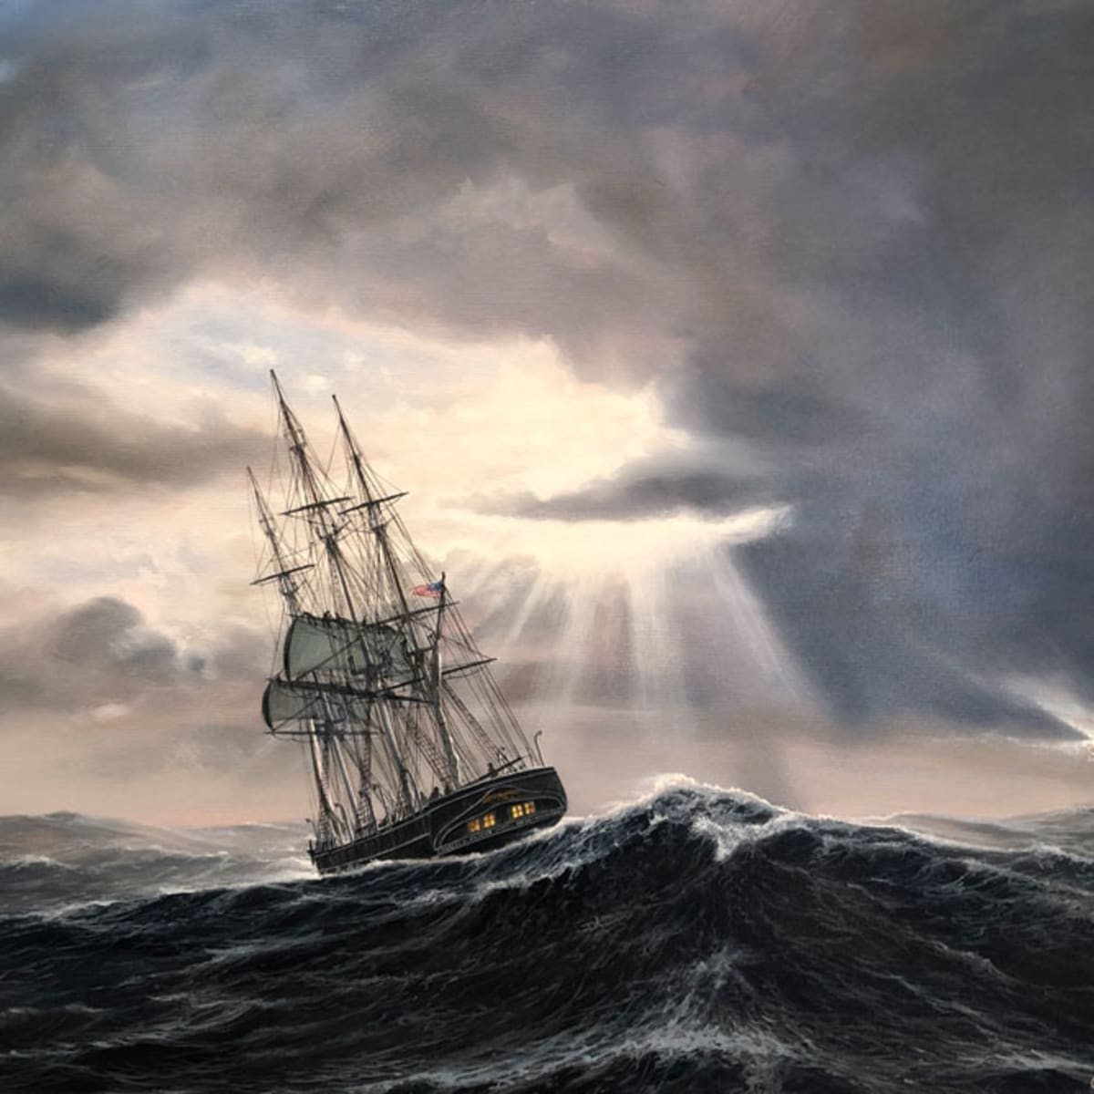
FAST FORWARD 10 YEARS. 1898. CAPE HORN
”Below 40º South there is no law. Below 50º South there is no God.” Contemporary saying.
Lloyds Weekly Shipping Index for January of 1898
Jan 21. Information received by the owners from their agents at Punta del Gada (Straits of Magellan) per cable from Valparaiso, states that the Bootle has been lost, all hands saved.
Jan 25. Concepcion Chili. Bootle totally lost off Gallegos River. All on board saved.
Notes:
Fast forward 10 years and James Owen is still on South American routes, this time as first mate

Slide 22
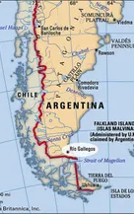
Lloyds Weekly Shipping Index for January of 1898
Lloyds Weekly Shipping Index for January of 1898
Jan 27. Montevideo. 12.35 pm. The following information is from the Lloyds agent at Punta Arenas, Straits of Magellan. Bootle, Cardiff for Punta del Gada wrecked and totally lost, ship and cargo at Cape Fairweather. All on board saved.
Feb 25. The brigantine Bootle, from Cardiff for Punta Delgada got on a reef off Cape Fairweather on Jan 3 and was broken up by a gale on the 5th. No cargo could be saved.
At about this time or soon after, James Owen must have met Sarah Williams of Tivy View. He had joined the RNVR training at the “Battery”. Very likely explains how they met.

Slide 23
A story of the barque Cambay
”From Hawse Pipe to Cabin Door”.
Lady Jenkins (Llangoedmore)
"Dedicated to the Memory of the Old Sailing Ships and the Intrepid Men Who Sailed and Worked Them".
True story of a Cardigan boy, Billy Probert. Story is 1890
The Cambay gets a mention in an MI at St Thomas’
Poverty and tragedy in Cardigan and Liverpool
A young man, not yet qualified and no master’s certificate
Desperate for work, signs on as second mate on the Cambay
Equivalent of a modern Do Not Travel notice is in force
… due to a major yellow fever outbreak in Brazil
Notes:
I owe a debt to Tony Bowen for this story, and I acquired a copy of the book. Written by Lady Jenkins, the story is substantially true but it is presented in form that does’nt make this explicit. Tony’s father remembers seeing the hero regularly cycling over to Llangoedmore to meet with Lady Jenkins to discuss his memoirs

Slide 24
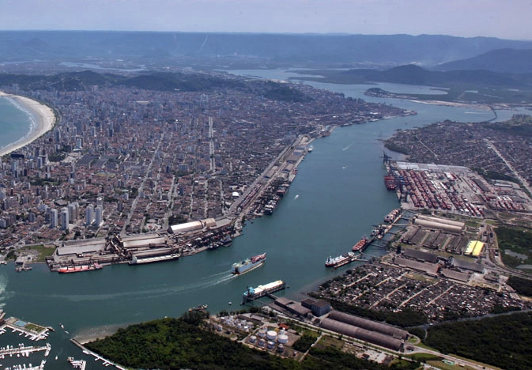
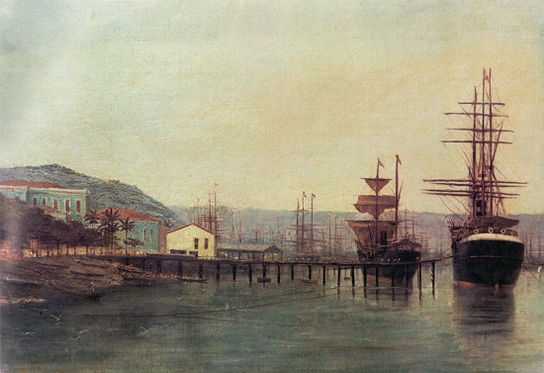
SANTOS NOW, AND IN 1889
The Cambay sails and docks at Santos (Sao Paulo), called the "port of death" in the 19th century
Within days most of crew contract yellow fever
The rest, including the captain, desert the ship
Billy Probert is successful in recruiting local crew …
who prove surprisingly able sailors
Manages to ensure the return of the ship,
a successful and profitable career
a large house on the Aberystwyth Road, “Rosario Hall” ?
Notes:
Tony had told me about Rosario Hall. When I presented this story at the WH, one of the audience was able to identify Rosario Hall as opposite Aldi’s in Cardigan. It’s not mentioned in the book, but this adds some small corroboration to the story. I also found some evidence of “real people” in census data from the period.

Slide 25
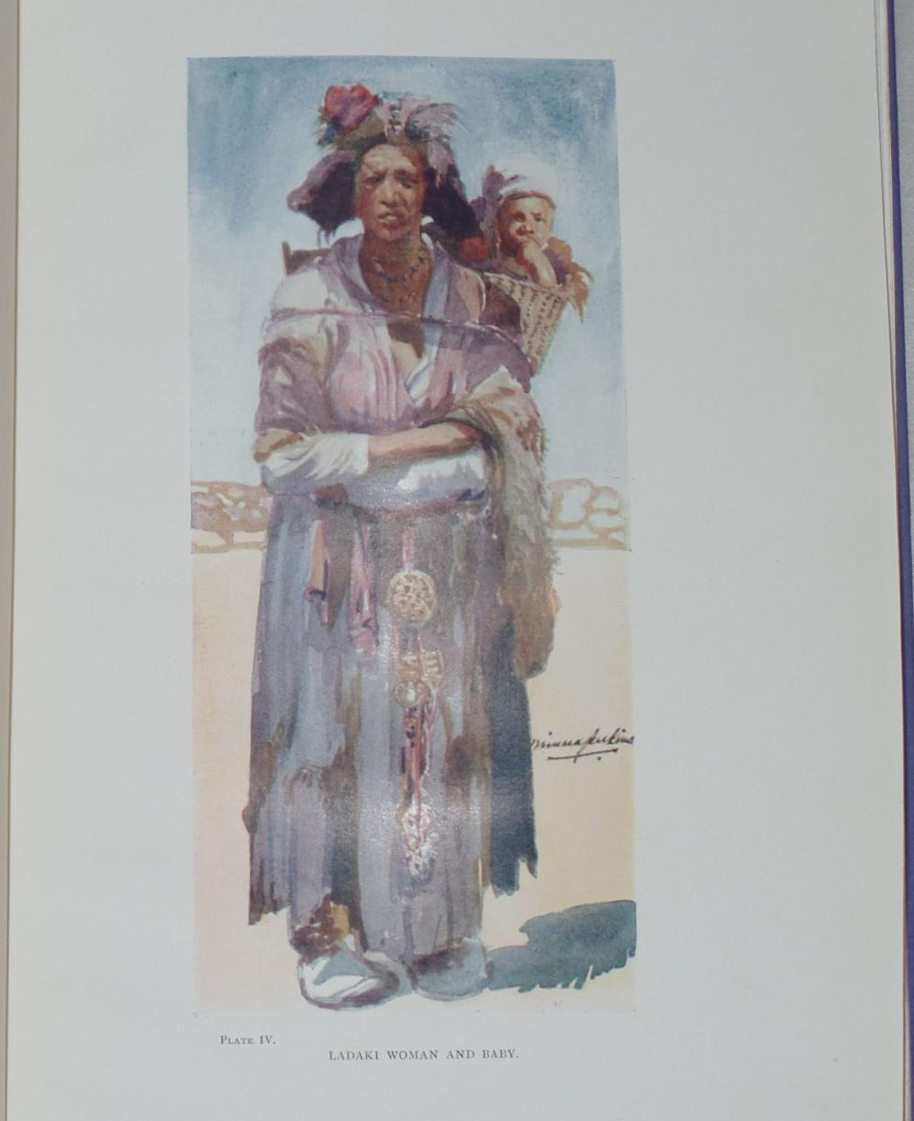
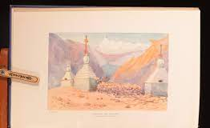
AUTHOR. Lady Jenkins of Llangoedmor
Lady Jenkins, wife of Sir Lawrence Jenkins of Llangoedmor,
a notable travel writer who travelled extensively in Tibet.
He was a distinguished judge, of a very liberal bent, in the Indian judiciary.
Family origins in Pantirion Farm, St Dogmaels
Notes:
She was a travel writer of some note. The images are taken from her book, and the bottom left image will be instantly recognized as a typical landscape by anyone who has trekked in the Himalaya.

Slide 26
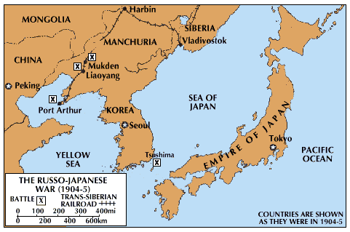
The Loss of the Claverdale. 1904
Hwyliodd o China i Vladivostock Hydref 1904. Ni chlywyd dim oddi wrthynt drachefn yn yr SS Claverdale.
[… sailed from China to Vladivostock in October 1904. Nothing more was heard of them in the SS Claverdale]
H. H. Thomas, Cardigan, commander; D. Llewellyn, St. Dogmaels,
first mate
Notes:
A note in Bethania Chapel Minutes first brought Owen Roberts to my attention. Under a list of deaths for 1905 is the following:
Owen Roberts, Feidrfair. Hwyliodd o China i Vladivostock Hydref 1904. Ni chlywyd dim oddi wrthynt drachefn yn yr SS Claverdale. [He sailed from China to Vladivostock in October 1904. Nothing more was heard of them in the SS Claverdale]
A bit of Googling revealed a few interesting items.
Under the heading ‘Fate of the Claverdale’ the Evening Express published the following account on 31 January 1905:
A boat belonging to the overdue British steamer Claverdale has been picked up and taken to Fukuyajna. None of the crew was on board. The Claverdale left Barry on September 1 for Manila, with a cargo of between 5,000 and 6,000 tons of coal on Russian account. On October 29 she was reported at Sabang, and on November 23 left Hong Kong for Vladivostok. Nothing has been heard of her since, and it is presumed that in running the blockade she kept in too close to the land and struck a sunken rock. Captain Thomas, the master of the Claverdale, is a native of Cardigan, and is well known in Cardiff shipping circles.
The Claverdale was the pioneer ship of the Claverdale Steamship Company (Limited), owned by Messrs. E. Hazelhurst and Co., who claimed that this is the first vessel they had lost. She was built in 1899 by Messrs. Graig, Taylor, and Co., of Stockton-on-Tees, is 330 feet long, with a 45 feet beam, and a draught of 18 feet, while her engines registered a nominal horse-power of 278.
By 09 September 1905 the Cardiff Times reported that a Vladivostok telegram dated August 31st stated that a steamer stranded north of Olga was reported to be the missing British s.s. Claverdale, bound from Cardiff to Vladivostok via Hong Kong.
But further inquiries found that the rumour was not true and the reporter on the Cardiff Times was not happy:
This is the second time that such a report has been cabled home from Vladivostok respecting the same ship, and it is unfortunate that the authorities do not make an effort to secure the name of the stranded vessel before telegraphing to England.
The mystery of the missing ship seemed to have been solved by November 1905, according to a report in the County Echo, quoting the Daily Chronicle:
Dispatches received in London reveal for the first time the identity of the wreck which has frequently been sighted to the south of Vladivostok, near the mouth of the Tandse River. The vessel turns out to be the British steamer Claverdale, which left a Chinese port last November with a full cargo of coal for the Russian cruisers at Vladivostok, and which has not since been heard of. As the result of a visit paid to the stranded steamer, it has been ascertained that the vessel has been pillaged by the natives in the neighbourhood, and every article of value taken away. The inhabitants residing in the vicinity, who were interrogated, declared that the crew of the Claverdale’ were removed shortly after the wreck by two boats presumed to be Japanese.
But the missing crew remained missing : Neither owners nor relatives, however, have heard from any of the men. By November 1905 the headline in the Weekly Mail suggested that worse was to come.
WRECK OF THE CLAVERDALE: SUPPOSED MURDER OF MEMBERS OF THE CREW.
The crew who are supposed to have been killed on the Manchuria coast, where the ship was wrecked, included:
H. H. Thomas, Cardigan, commander; D. Llewellyn, St. Dogmaels, mate James Reed, Swansea, second mate D. Jones, Cardiff, carpenter J. S Campbell, Sunderland, steward Owen Roberts, Cardigan, cook Watkin Evans, second steward John Waddle, boatswain A. Tripolis, A.B. seaman R. Thomas, Liverpool, A.B. seaman G. Marromatic, A.B. seaman Frederick Cooper, Sunderland, chief engineer Frederick Walker, second engineer James Beadle, Sunderland, third engineer Cornelius Gray, Sunderland, fourth engineer Carl Lundin (of Sweden), donkeyman Richard McGuire, Bootle, fireman B. Mynes, Brumiskin, fireman W. Flagg, fireman Gus Langer, fireman R. J. Jones, fireman S. Ostovski, fireman W. Howrie, apprentice G. B. McLaren, apprentice Reginald Turner, North-street, Lewes, apprentice G. A. Saunders, Kingston-road, Portsmouth, apprentice In addition to these, two other hands, names and nationalities unknown, were taken on to Hong Kong. These were possibly Chinese.
It was claimed that the ship had been boarded by Manchurian pirates and the crew thrown overboard.
In March 1906 the Cardiff Times reported on the proceedings of the Probate Court where the captain named as Edward Evan Thomas, Llangoedmore was presumed dead:
The vessel was found 450 miles north of Vladivostok ashore in the Gull of Tartary deserted, with her decks dismantled. In February, 1905, a boat belonging to the ship was found, and in May the ship was posted at Lloyd’s as a total loss. Eventually the vessel was discovered a total wreck, and only about 300 or 400 tons of cargo remained. The master and crew had disappeared. Captain Thomas left about £1,400. His Lordship granted leave to presume the death of Mr Thomas accordingly.
After all this we’re none the wiser, I’m afraid, as to what actually happened but suffice to say these brave local sailors probably came to a watery end: H. H. Thomas, Cardigan, D. Llewellyn, St. Dogmaels, and Owen Roberts, Cardigan, the cook from Feidrfair.

Slide 27
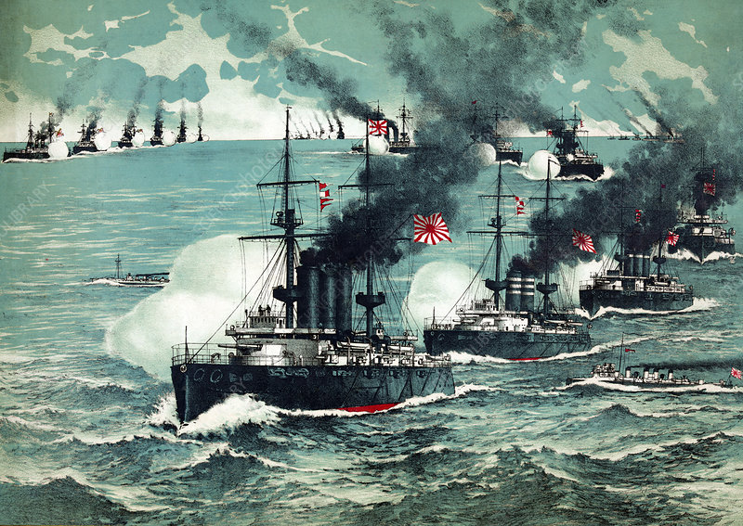
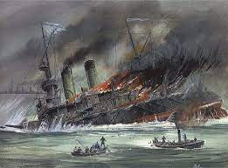
31 January 1905:
A boat belonging to the overdue British steamer Claverdale has been picked up and taken to Fukuyajna. None of the crew was on board. The Claverdale left Barry on September 1 for Manila, with a cargo of between 5,000 and 6,000 tons of coal on Russian account. On October 29 she was reported at Sabang, and on November 23 left Hong Kong for Vladivostok. Nothing has been heard of her since, and it is presumed that in running the blockade she kept in too close to the land and struck a sunken rock. Captain Thomas, the master of the Claverdale, is a native of Cardigan, and is well known in Cardiff shipping circles.
H. H. Thomas, Cardigan, D. Llewellyn, St. Dogmaels, and Owen Roberts, Cardigan, the cook from Feidrfair.
It’s hard to overstate the historical significance of the Russo-Japanese war
First defeat of a European by an Asian power
Emboldened Japanese imperial ambitions
Tactic of surprise attack was to be repeated at Pearl Harbour
[Russian navy almost completely destroyed in Strait of Tsushima, 2005.]
So the risks in running the blockade must have been huge
Maiden voyage of the Claverdale
31 January 1905.
The Claverdale left Barry on September 1 (1904) for Manila, with a cargo of between 5,000 and 6,000 tons of coal on Russian account. On October 29 she was reported at Sabang, and on November 23 left Hong Kong for Vladivostok. Nothing has been heard of her since, and it is presumed that in running the blockade she kept in too close to the land and struck a sunken rock. Captain Thomas, the master of the Claverdale, is a native of Cardigan, and is well known in Cardiff shipping circles. …

Slide 28
Dispatches received in London reveal for the first time the identity of the wreck which has frequently been sighted to the south of Vladivostok, near the mouth of the Tandse River. The vessel turns out to be the British steamer Claverdale, which left a Chinese port last November with a full cargo of coal for the Russian cruisers at Vladivostok, and which has not since been heard of.
As the result of a visit paid to the stranded steamer, it has been ascertained that the vessel has been pillaged by the natives in the neighbourhood, and every article of value taken away. The inhabitants residing in the vicinity, who were interrogated, declared that the crew of the Claverdale’ were removed shortly after the wreck by two boats presumed to be Japanese. ….
…. It was claimed that the ship had been boarded by Manchurian pirates and the crew thrown overboard.
Notes:
Various alternatives

Slide 29
When the Claverdale reached Hong Kong it was revealed that she would be going on to Vladivostok, which was being blockaded by the Japanese during the Russo-Japanese War. Several ships had already fallen victim to the blockade. Consequently the crew, who had been hitherto unaware that they would be sailing through a war-zone, were given the option to leave the ship. Seven men did so including David Jones, the second mate, aged 29, born in Cardigan, address 1 Greenfield Row, Cardigan; there is a brief interview with him on page 2 of the Cardiff Evening Express dated 12/1/1905. ……
It seems pretty certain that to avoid the Japanese blockade she took the much longer route to the east of Japan and was thus having to negotiate the la Perouse strait and approach Vladivostok from the north. Possibly her rudder was put out of action in the hostile winter environment, as happened to at least one other vessel at this time. The precise location of the wreck is also a mystery. Contemporary reports, including one from the Salvage Association, say that she was found at the mouth of the Taudse (or Tandse?) River, north of Ternei Bay, but I have been unable to discover a river of that name.
This stretch of coast affords little shelter from north-east winds which can ‘cause a very heavy sea’, NGIA, Sailing Directions: East Coast of Russia, 180. Anecdotal evidence suggests that the Claverdale had lost its rudder and/or propeller, R. Nash, pers. comm. Several reports on the loss of another steamer, the Carlisle, mention that the Claverdale also had lost propeller blades, although this does not appear to have been confirmed by more authoritative maritime sources: e.g. Evening Express (Cardiff), 8 Dec. 1905.
Notes:
Most likely explanation

Slide 30
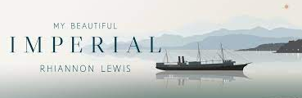
A Blend of Fact and Fiction. The story of the author’s great-great uncle.
1891. Civil war erupts in Chile.
The steamship Imperial is commandeered by the Chilean government in Valparaiso.
2600 mile coastline makes the ship invaluable for moving troops
Notes:
The book relies quite heavily on Hervey's contemporary reports. He was a Times journalist who spent time on the Imperial itself. Along with David Davies, other characters based on real people were Stewart, Whiteway, and all the other 'wartime' characters. Sepulveda did try to blow up the ship and was executed along with Cummings the shop owner. One of the officers did commit suicide (although his name may not have been Webb). It's probably easier to say which characters were created. Even though Mrs Ebrington was 'created' he would have known many similar landladies. Estella is imaginary but we know that David Davies did leave someone behind in Chile who he would weep over in the Black Lion in later years, so although she is fictional, there was very good evidence that someone similar existed. He was very popular with women but never married. His sister did die in a fire at the home farm and he did go on a voyage to Keppel Bay soon afterwards.
Captain David Davies. However, President Balmaceda conferred the nickname Jefferson on him and so in the family he was always known as Captain Jeff. The Jeff is included on his gravestone and on census results.
The story relies quite heavily on Hervey's contemporary reports. He was a Times journalist who spent time on the Imperial itself. Along with David Davies, other characters based on real people were Stewart, Whiteway, and all the other 'wartime' characters. Sepulveda did try to blow up the ship and was executed along with Cummings the shop owner. One of the officers did commit suicide (although his name may not have been Webb). Even though Mrs Ebrington was 'created' he would have known many similar landladies. Estella is imaginary but we know that David Davies did leave someone behind in Chile who he would weep over in the Black Lion in later years, so although she is fictional, there was very good evidence that someone similar existed. He was very popular with women but never married. His sister did die in a fire at the home farm and he did go on a voyage to Keppel Bay soon afterwards.
President Balmaceda conferred the nickname Jefferson on him and so in the family he was always known as Captain Jeff. The Jeff is included on his gravestone and on census results.

Slide 31
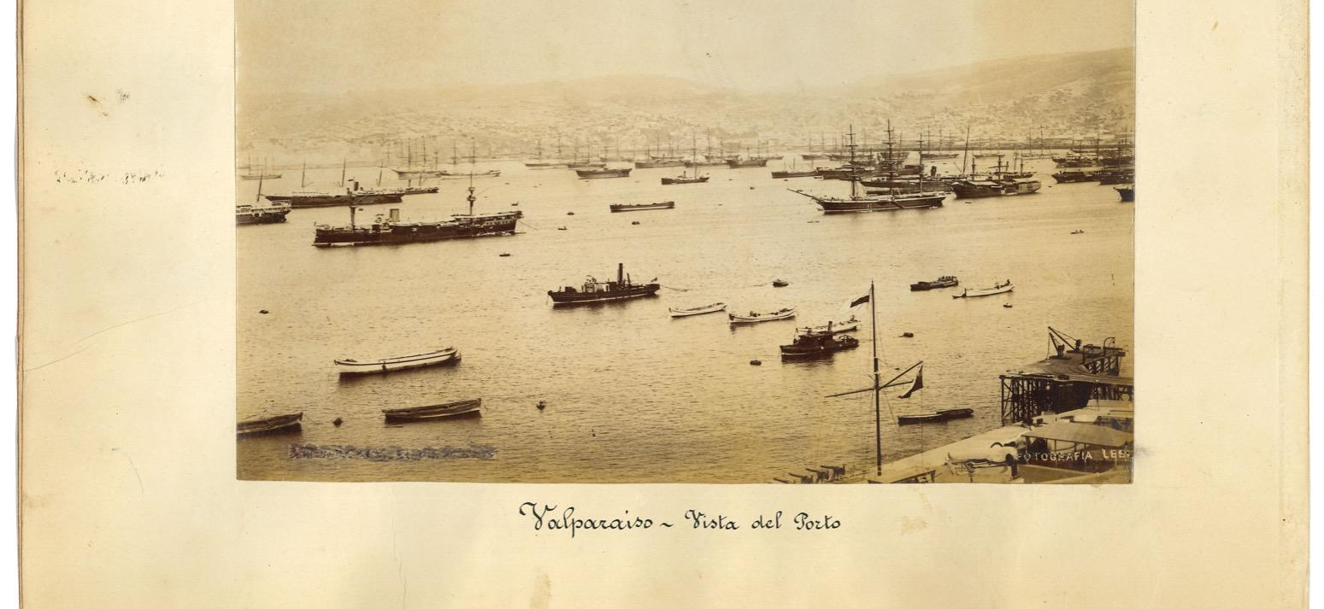
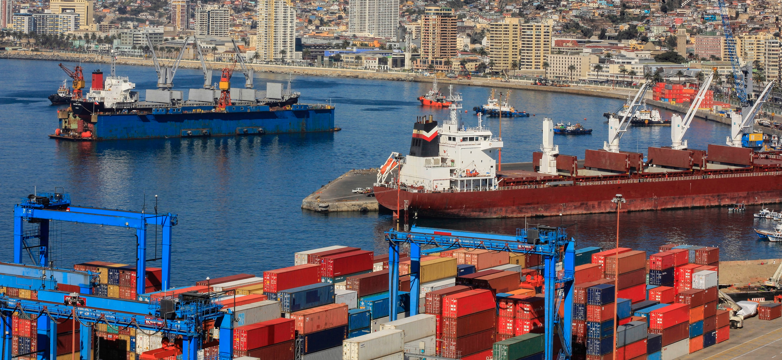
Valparaiso then and now
Captain David Davies of Cardigan
Story relies on contemporary accounts by Times journalist Hervey and events in the book are substantially true.
Episodes include an attempt to blow up the ship …
… and pursuit by the Chilean navy which had mutinied

Slide 32
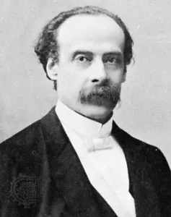
Involvement in Civil War
The importance of the ship to the Chilean government can be judged by the fact that Captain Davies was known personally by President Balmaceda …
… who gave him the nickname “Jefferson”
In later life ”Captain Jeff” was sometimes to be found in the Black Lion in Cardigan
Footnote. Balmaceda lost the civil war and committed suicide. He had been a liberal reforming politician, but the history is a complex one.

Slide 33
Sources and recommended books
My Beautiful Imperial – Rhiannon Lewis
From Hawse Pipe to Cabin Door – Lady Jenkins (out of print)
The War with Cape Horn – Alan Villers
Master Under God. Fred Nicholls. (Fiction)
Welsh Mariners website (for family historians). Lists nearly 24000 captains, mates and engineers. Certificate references. Then records at Greenwich, etc. https://www.welshmariners.org.uk
Strangers From a Secret Land. Peter Thomas. Migration on the Albion
If God Will Spare My Life. Mike Lewis of Aberporth. Not maritime but story of Will James of Dinas who joined the ill-fated US 7th Cavalry

