Slide 1
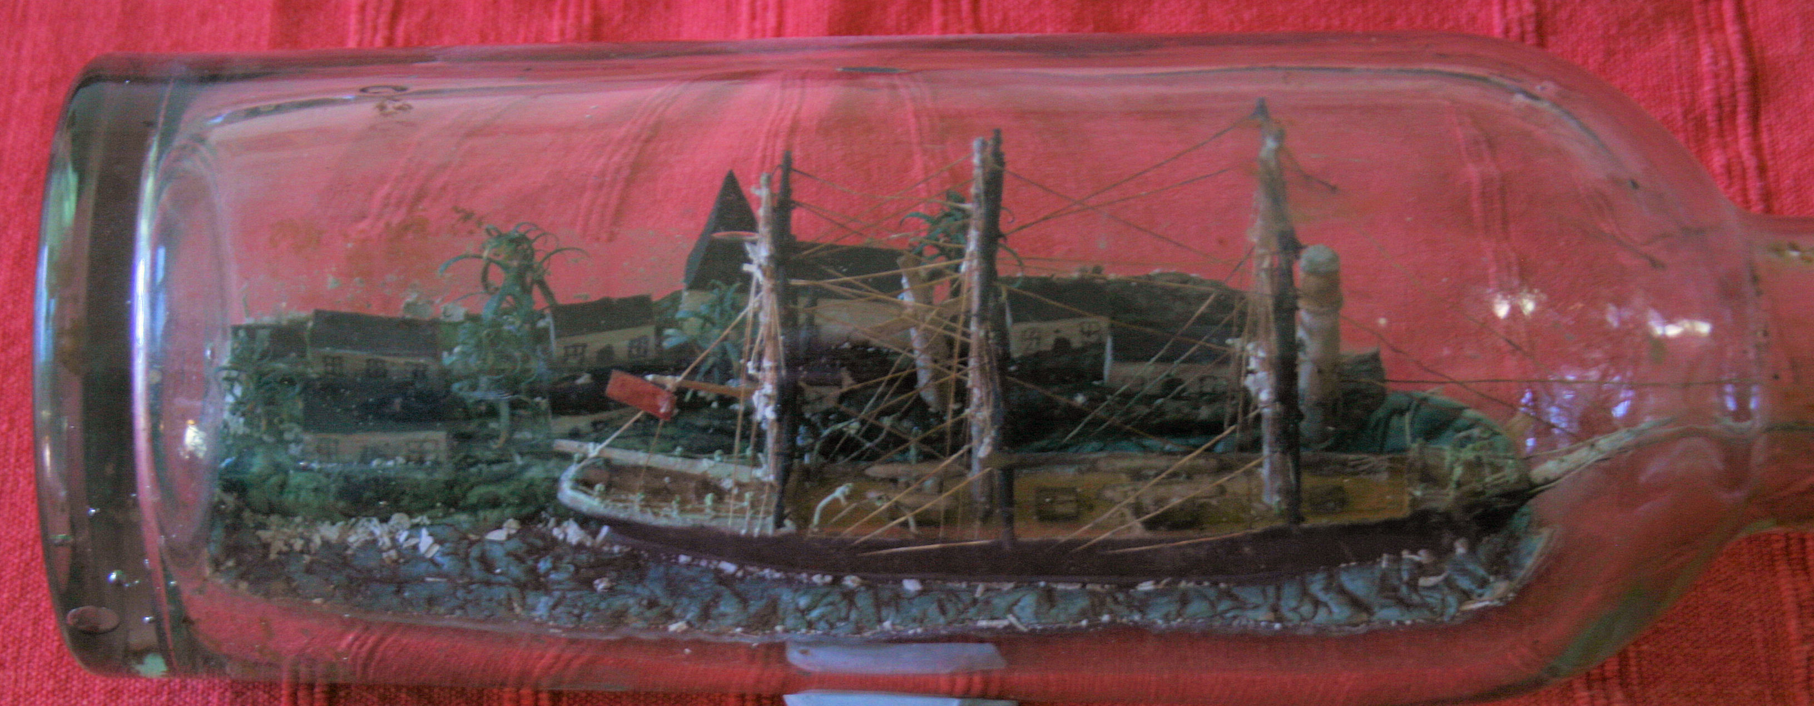
ST DOGMAELS AND CARDIGAN. A MARITIME HERITAGE. PART 2.
Part 1.
Connections!
Yellow fever, the barque Cambay and (Lady) Minna Jenkins
Captain “Jeff” Davies and the Chilean Civil War
Mysterious loss of the Claverdale and the Russo-Japanese War. (probably not pirates)
How seafaring would have dominated the life of the village. A matriarchal society?

Slide 2
Sources and recommended books
My Beautiful Imperial – Rhiannon Lewis
From Hawse Pipe to Cabin Door – Lady Jenkins (out of print)
The War with Cape Horn – Alan Villers
Master Under God. Fred Nicholls. (Fiction)
Welsh Mariners website (for family historians). Lists nearly 24000 captains, mates and engineers. Certificate references. Then records at Greenwich, etc. https://www.welshmariners.org.uk
Strangers From a Secret Land. Peter Thomas. Migration on the Albion
If God Will Spare My Life. Mike Lewis of Aberporth. Not maritime but story of Will James of Dinas who joined the ill-fated US 7th Cavalry

Slide 3
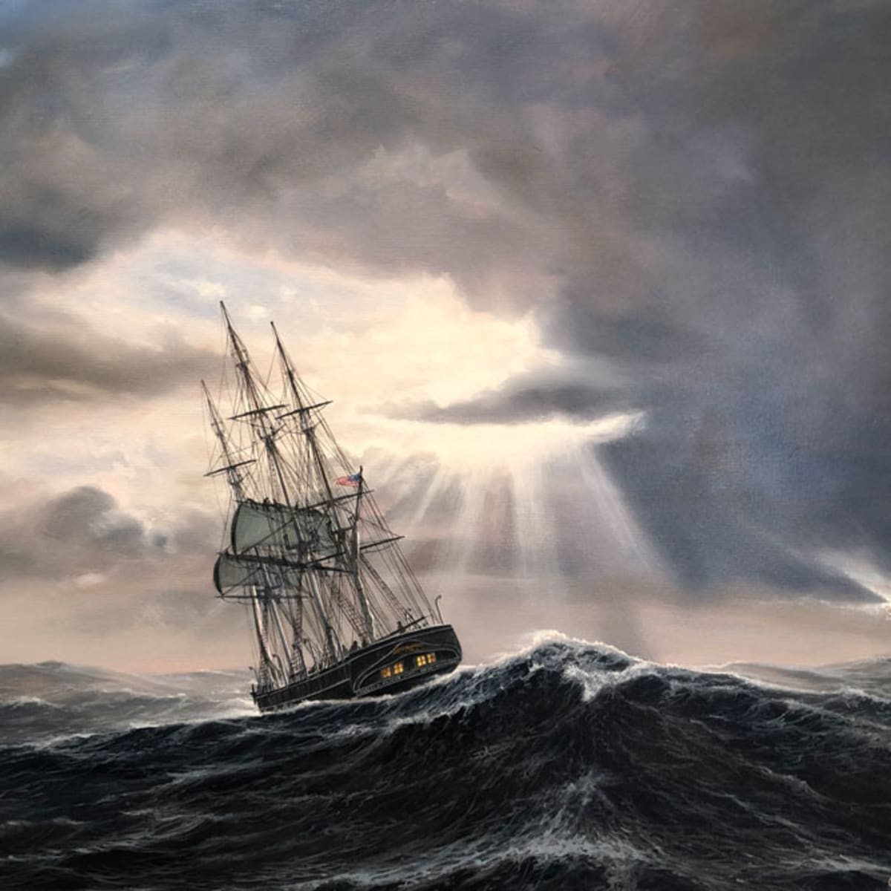
ST DOGMAELS AND CARDIGAN. A MARITIME HERITAGE. PART 2.
More connections
Family connections; the Lloyd family.
More of Cape Horn. Captain David James.
A local incident. Jamaica Inn or Whisky Galore? (1816/17)
Record breaking voyages of Captain Williams, Cannon House. (1915)
David Saunders and the Barbary Pirates (1760s)
Migration to Canada. Ballad of the Albion (1819). David Phillips. Diary of Voyage on the Active (1822)
Letters home from America, and Col. Britton Evans. (the Mathias family of Hendre)

Slide 4
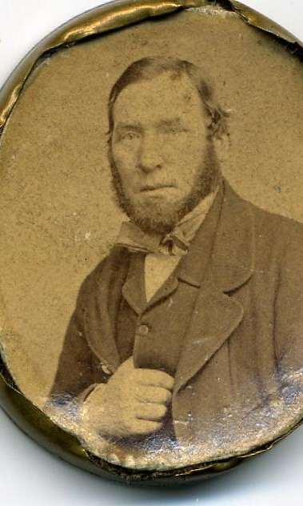
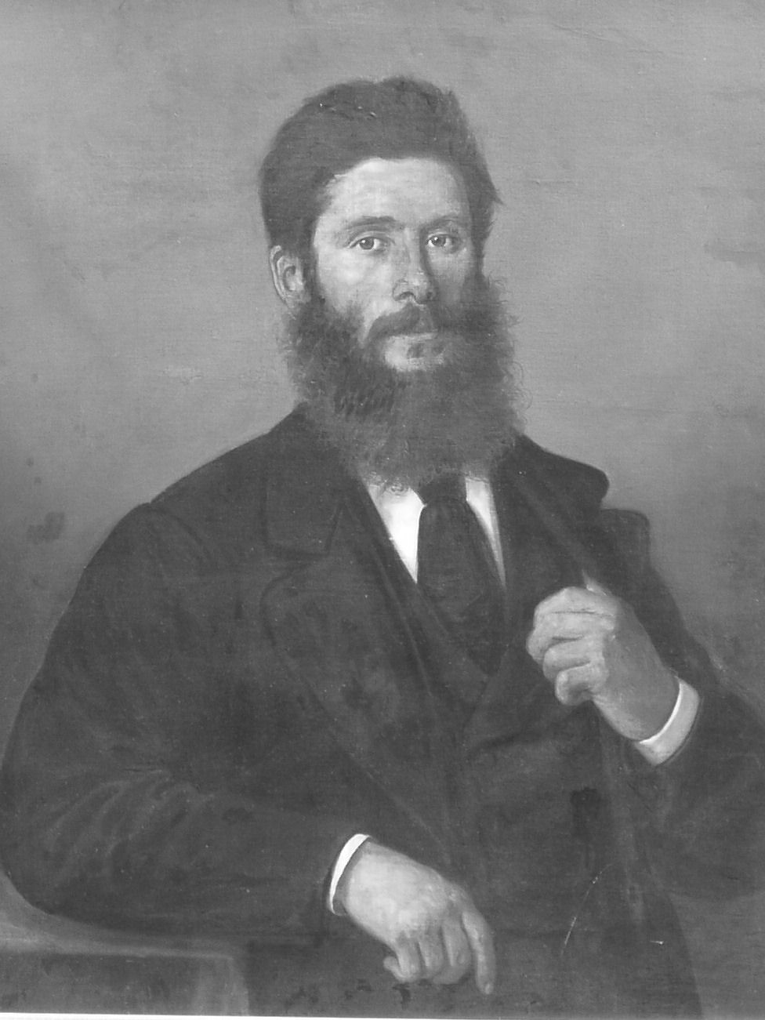
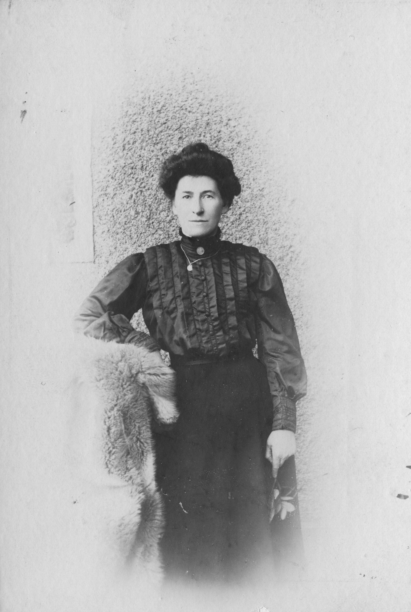
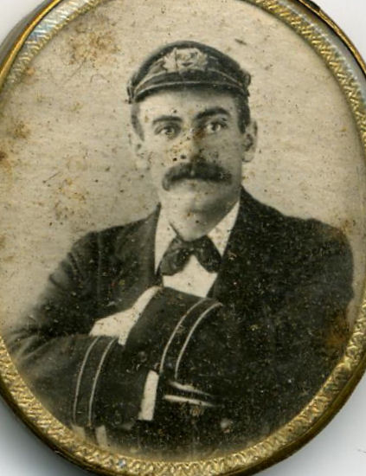
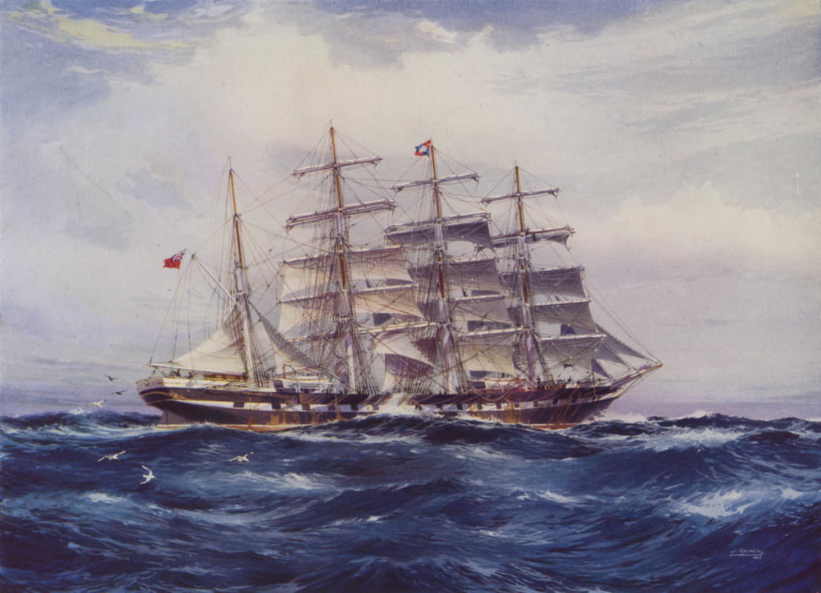
Peggy Martin, 1785-1856. ===
John Lloyd, d 1815. Master of the Peggy of Cardigan
George Lloyd, Sr, MM
Anne Lloyd = John Davies
Shadrach Lloyd, MM, of Abigail House
Bett Lloyd = Rees Lewis, MM
Elizabeth Lewis = James Williams, 1848-1882, MM
Anne Lloyd = David James, MM, b 1855, wrecked Cape Horn on the Colorado, 1887
Margaretta Davies = John Williams, MM (Cape Horner, drowned Valparaiso, 1879)
Sarah Williams, 1875 -1961 = James Owen, MM, 1873 -1954
Captain Williams, Cannon House
Record breaking voyage on the Medway in 1915.
Brother George Williams. Royal Australian Navy. DSO and CMG (WW1). Director of Navigation, State of New South Wales.
Notes:
Shadrach Lloyd . Lord Hartington. Schooner 170 tons

Slide 5
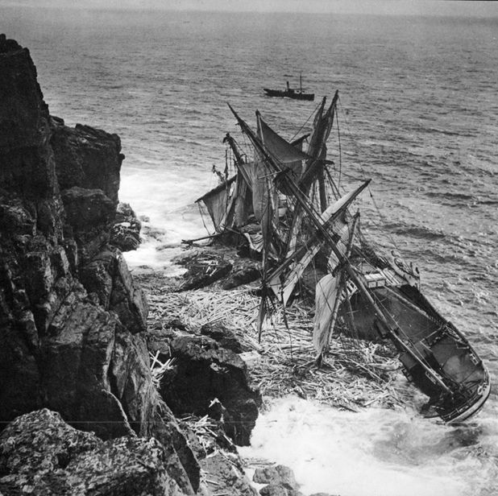
Captain David James. Son-in-Law of Shadrach Lloyd.
Another “Cape Horn” loss, in 1887. On this occasion all crew saved.
Extracts from https://museomaritimo.com/en/shipwreck
“According to own investigations, the English frigate "Glenmore" hit Cape San Vicente and the remains of it can be seen during low tides, totally destroyed by the onslaught of the sea. This happened in 1888 and his crew headed to Thetis Bay, which is a few miles from the place.
The "CORDOVA" sank in the Strait of Le Maire and its crew also went to the sub-prefecture of Bahia Thetis, this happened on July 26, 1888. The "COLORADO" was shipwrecked against Cape San Vicente on July 5, 1887, the entire crew was safely in Thetis Bay.”
CC number 018932
Kew refce; 122/70&83
Not an 1887 photo !!

Slide 6
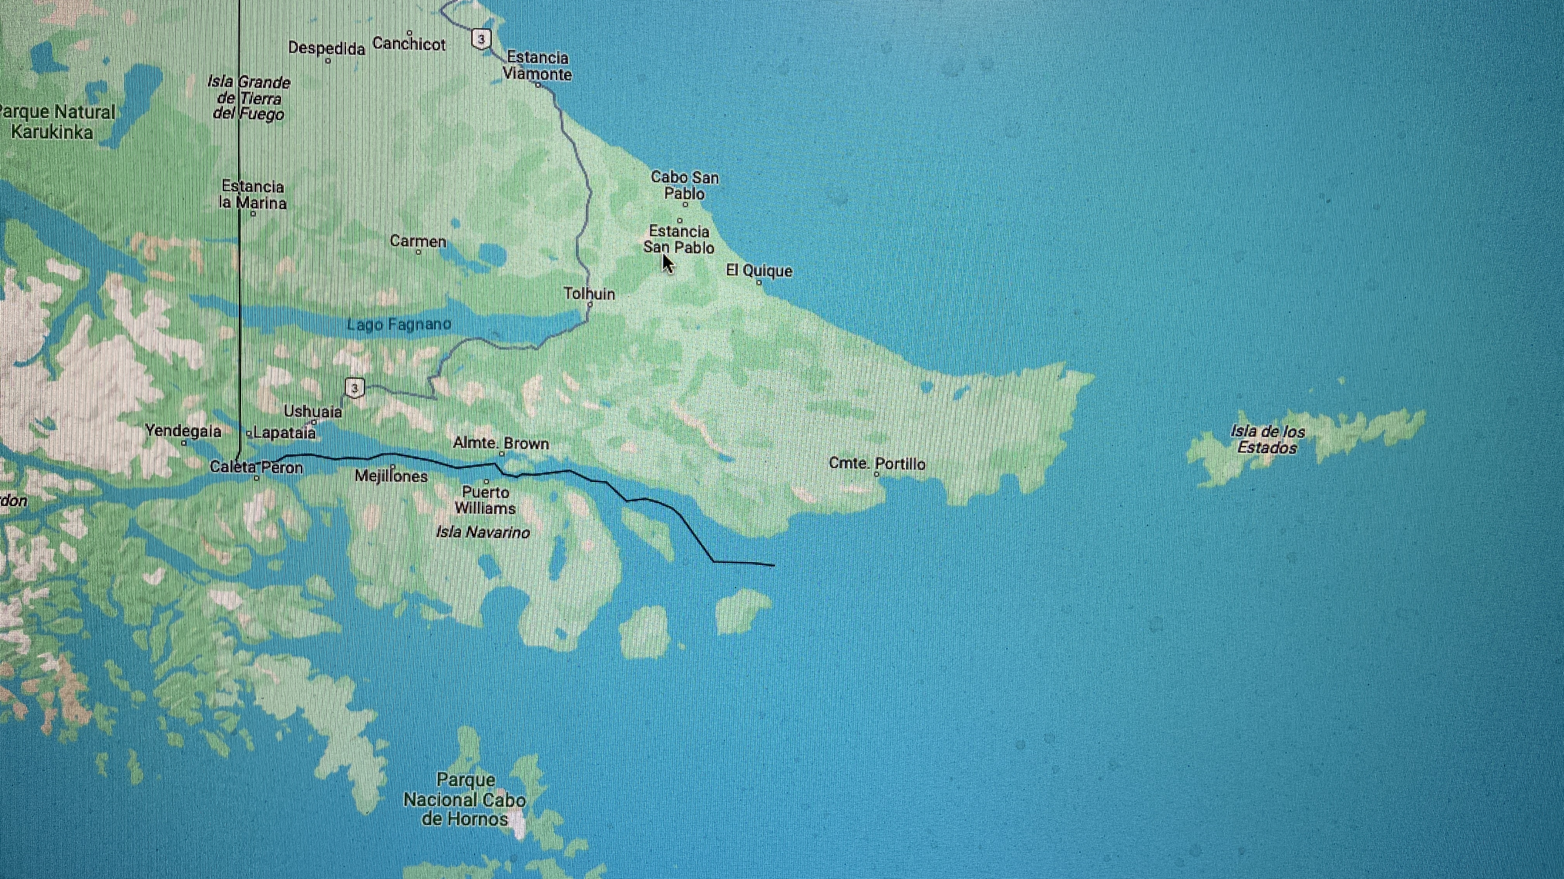
The treacherous Le Maire Strait and the vicinity of the Isla de los Estados
”One of the worst …, the treacherous Le Maire Strait and the vicinity of the Isla de los Estados and the south eastern sector of the Isla Grande de Tierra del Fuego, known as Peninsula Miter; especially its sector that faces the Atlantic.
…. the causes [of shipwrecks] are quite different from the Beagle Channel, Cape Horn or the Strait of Magellan. … in common is the treacherousness …,
… boats surprised by a storm or by the sudden calms associated with strong currents, were carried against the islands…... “
Cape Horn
Thetis Bay. Cape San Vicente
Le Maire Strait
”Below 40º South there is no law.
Below 50º South there is no God.”

Slide 7
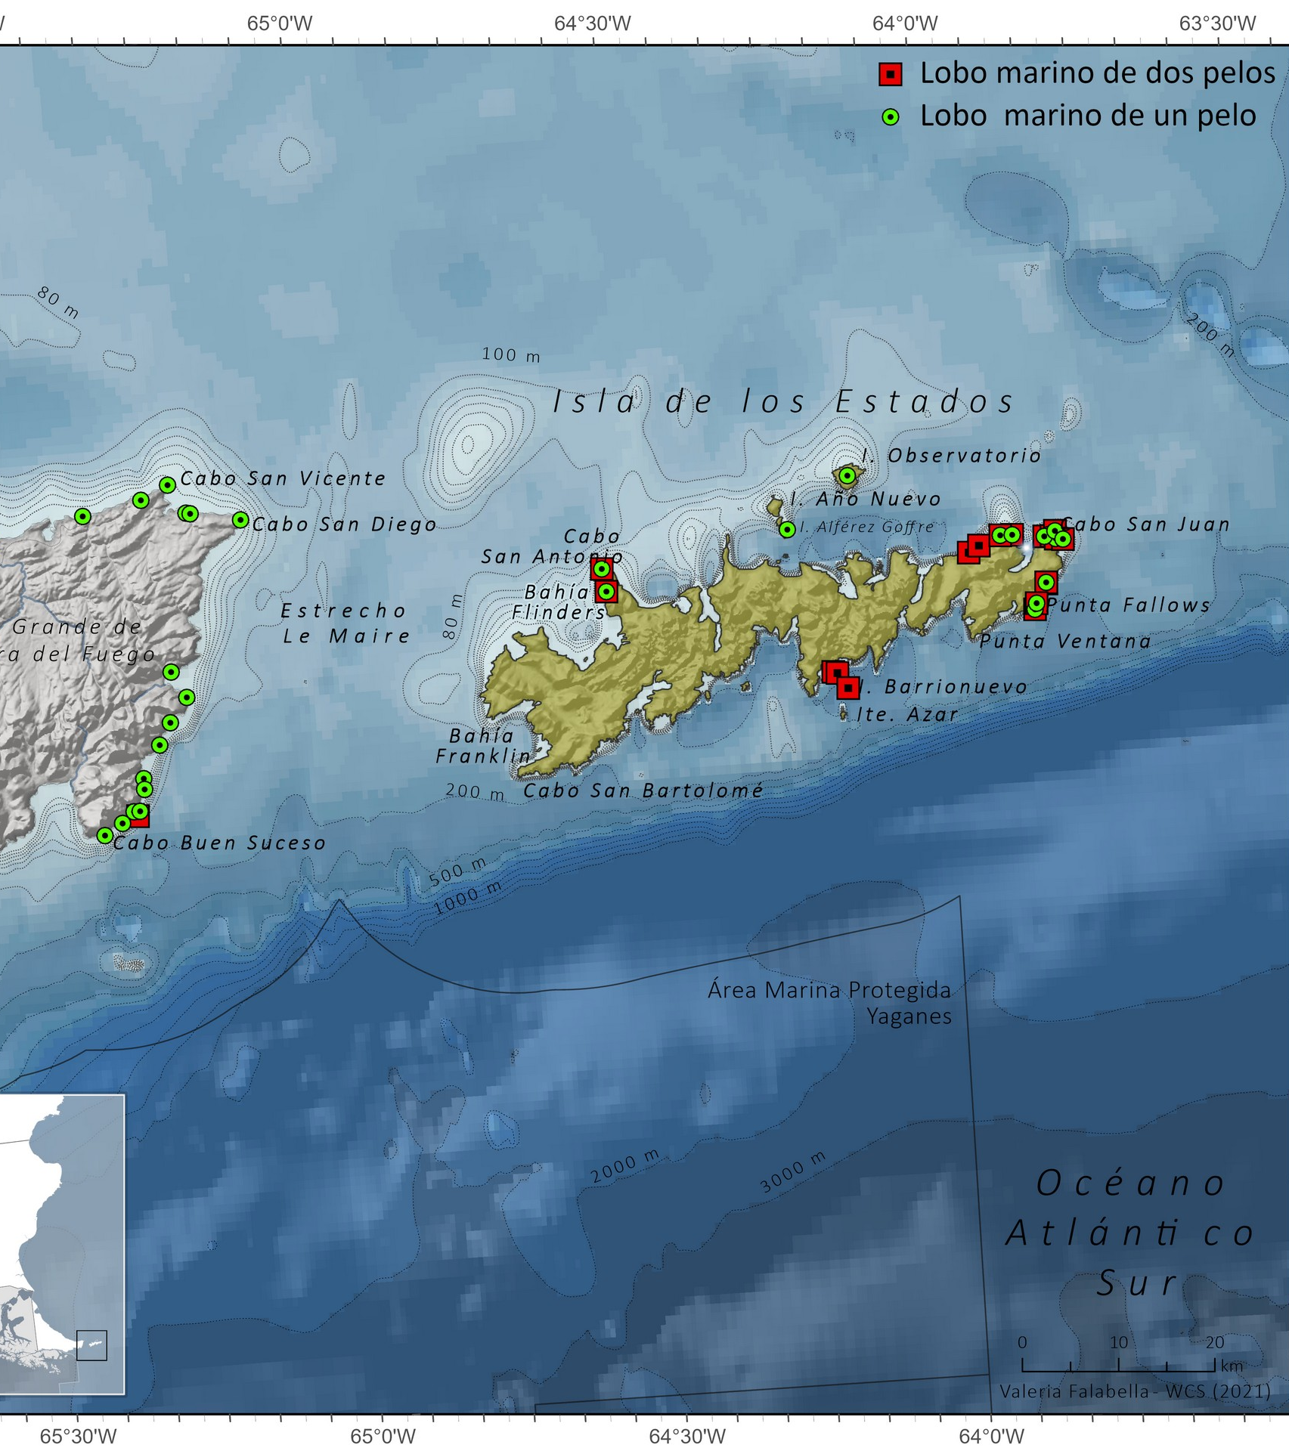
ISLA DE LOS ESTADOS AND THE STRAIT OF "LE MAIRE”
“In its vicinity, and especially on the north side, the coast has long shoals and is surrounded by stones, islets and some important islands. All of very low height and practically impossible to see during a closed night or with the typical calm fogs. To make things more complicated, there is a lot of current than in places like Cabo San Diego (Mitre Peninsula) where it reaches 4 knots. In moments of calm, frequent in the area, the ships were thrown against the stones or the long shoals that this coast gives off. The tides are of great amplitude exceeding 6 meters.
This caused that many ships have touched without intending to do so in those times when the cartography had many deficiencies.”
Capo San Vicente

Slide 8
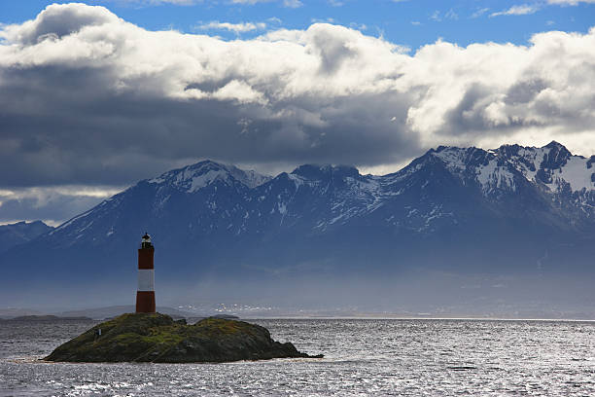
ISLA DE LOS ESTADOS
“…. the peculiarity of being almost always covered by a large cloud. It is that the clouds are trapped by its hills making it disappear from the horizon.”

Slide 9

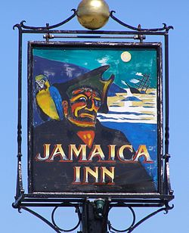
Jamaica Inn or Whisky Galore ?

Slide 10
THREE SHIPWRECKS AND CHAPEL EXPULSIONS
Poor navigation, Christmas cheer and moral outrage.
The story that follows begins in December 1816, with the loss of three ships along the Cardiganshire coast within the space of a few weeks.
The Elizabeth was a French vessel reported as sailing from Cette to Le Havre under the command of Captain Andre. .. Captain Andre’s navigational skills must be under suspicion. But at the time the incident was regarded as a deliberate wrecking instigated by the inhabitants of Aberporth. [source: Cardiganshire Shipwrecks]
The Elizabeth was carrying a cargo of wine that soon fell into the hands of the local populace, ensuring the prospect of a merry Christmas for all in the vicinity. A John Jenkins is recorded as having “died owing to intoxication cold and suffocation, found dead in the parish of Penbryn where a foreign vessel loaded with wine was wrecked and drank to excess the said wine.” A William Jones, “who drank too much and fell over a rock of great height into a stream of water and was carried by the flood.” Some regarded these untimely deaths as divine retribution.

Slide 11
Chapel minutes at Blaenwaun record these events.
A dim view was taken of participation by chapel members.
A ship ran aground in heavy weather, at a place called Cei bach. Another large ship had previously sunk in New Quay, carrying the same cargo of spirits …. The ship was wrecked and large numbers of the crowd that had gathered, looked on it as spoil and though prohibited by the Insurance officers, proceeded to plunder. To our grief, among them were many of our own members. We publicly warned the guilty against boldness on two separate occasions over the next two months, whilst we had time to find the culprits. [Translation by Mari Tan of Llanarth. Spirits are moddion, a word normally used for medicines.]
Some twenty members (including Peggy Martin) were then expelled, although many seem to have been re-admitted later. At the same meeting two sisters were also expelled for a different reason, one for adultery and one for “youthful frivolity”, and another for having an untidy house. If twenty members were expelled at Blaenwaun, then those in receipt of wines and spirits from other villages and congregations most probably numbered in the many hundreds.
The Bishop of St David’s also took an interest. He wrote to the clergy “whose parishes lie on the sea coast that they will lose no time in representing to their congregations in terms ‘sharper than a two edged sword’ the cruel and unchristian like enormity of plundering wrecks and that for the future they will preach to them on the subject once a quarter the flagrant criminality of this inhuman practice.”

Slide 12
Jamaica Inn ?
Most of the theories of how ships might have been lured onto the rocks do not stand up to 5 minutes analysis.
Stories of deliberate wrecking conspiracies abound all over coastal Europe, but no-one was ever caught and prosecuted. Seems unlikely in any activity involving conspiracy of many individuals.
Would you really set about wrecking in a village where half the men were at sea?
Plundering wrecked vessels was clearly a different story. And still is !!
Notes:
There are legends that some ships were deliberately lured into danger by a display of false lights. John Viele, retired U.S. Navy officer and author of a history of wrecking in the Florida Keys, states that such tricks simply would not work. He points out that mariners interpret a light as indicating land, and so avoid them if they cannot identify them. Moreover, oil lanterns cannot be seen very far over water at night, unless they are large, fitted with mirrors or lenses, and mounted at a great height (i.e., in a lighthouse). In hundreds of admiralty court cases heard in Key West, Florida, no captain of a wrecked ship ever charged that he had been led astray by a false light.

Slide 13
THE MEDWAY
ST DOGMAELS CAPTAIN WHO SET UP THREE WORLD RECORDS
On January 30, 1917, the sailing ship Medway—a steel four-masted barque of 2,516 gross which had been constructed for use as a training ship but which was capable of carrying nearly 4,000 tons of cargo—arrived at Tocopilla, Chile. There she loaded 3,700 tons of nitrate of soda for Cape Town and sailed on February 19.
This passage to Cape Town took 43 days and is a sail record for all time; the next best being 44 1/2 days made by a German ship. This was the first of three world records which the Medway made while her master was Capt. David Williams, Cannon House, St, Dogmaels

Slide 14
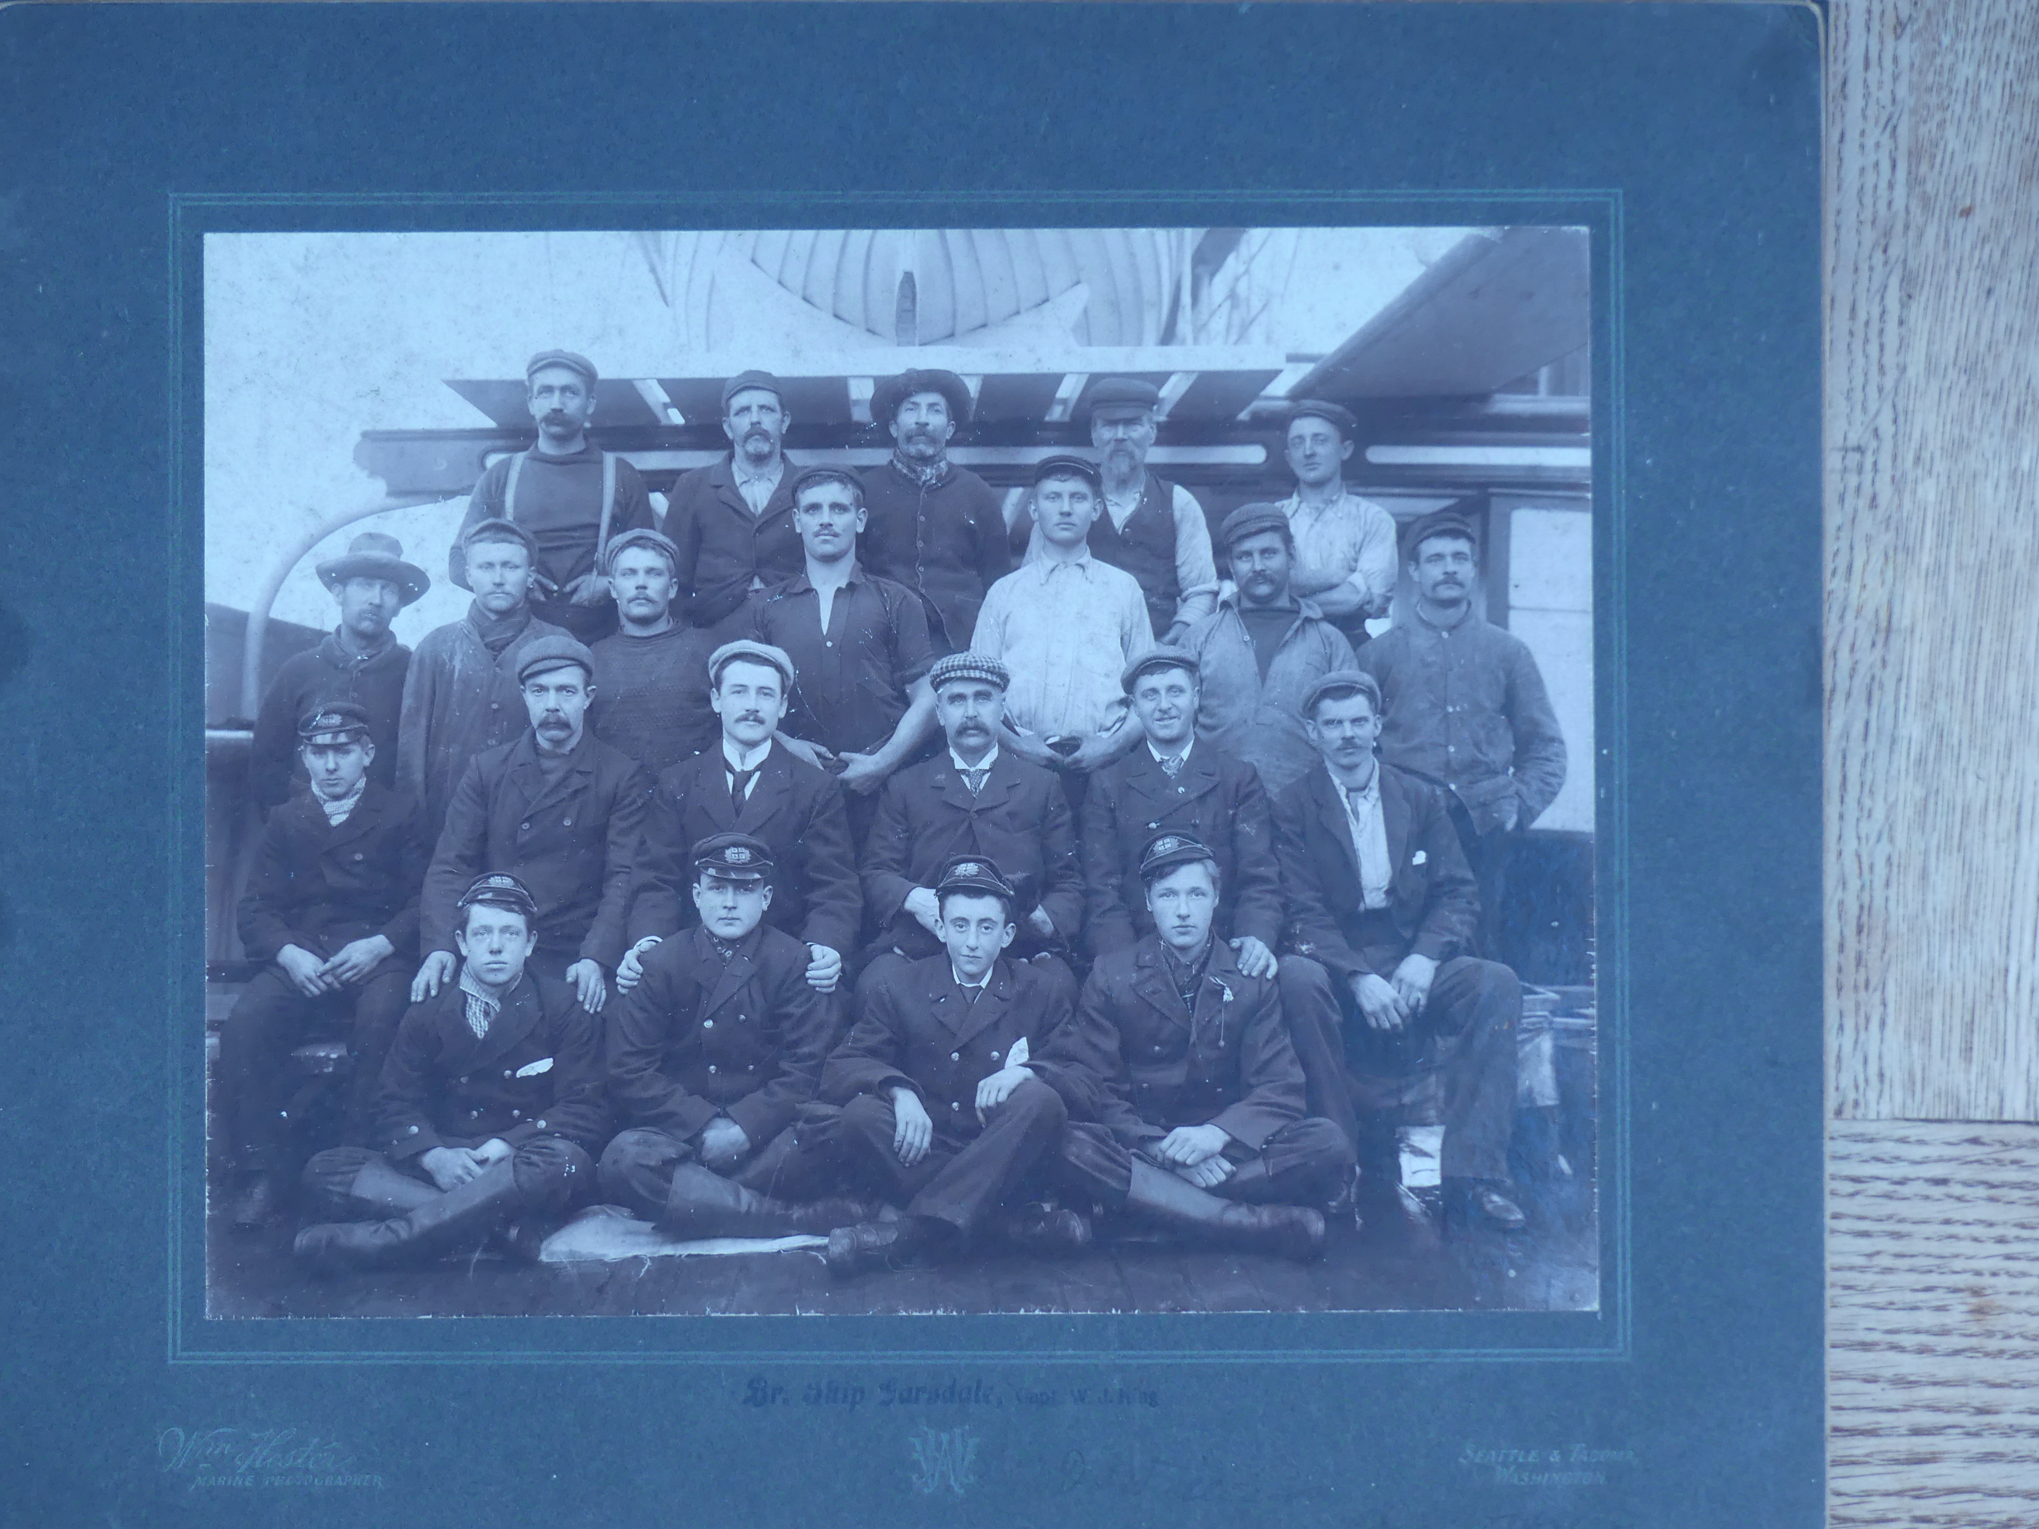
Captain Williams. Early career.
Capt. Williams went to sea at the age of 15 in 1892
Early career on the Garsdale, which ”threw her masts off the Horn”. Probably first or second mate at that stage in his career
He also served 12 years in the White Star Line from fourth to first officer in liners.
… and also as chief officer in their full-rigged sail training ship, the Mersey.
The most famous ship of the White Star Line is of course the Titanic (another St Dogmaels connection)

Slide 15
CREW OF THE GARSDALE
David Williams, Cannon House
Garsdale was on voyage from South Shields to Portland, O. with general cargo, and was dismasted and abandoned off Cape Horn on the 12th September 1905.

Slide 16
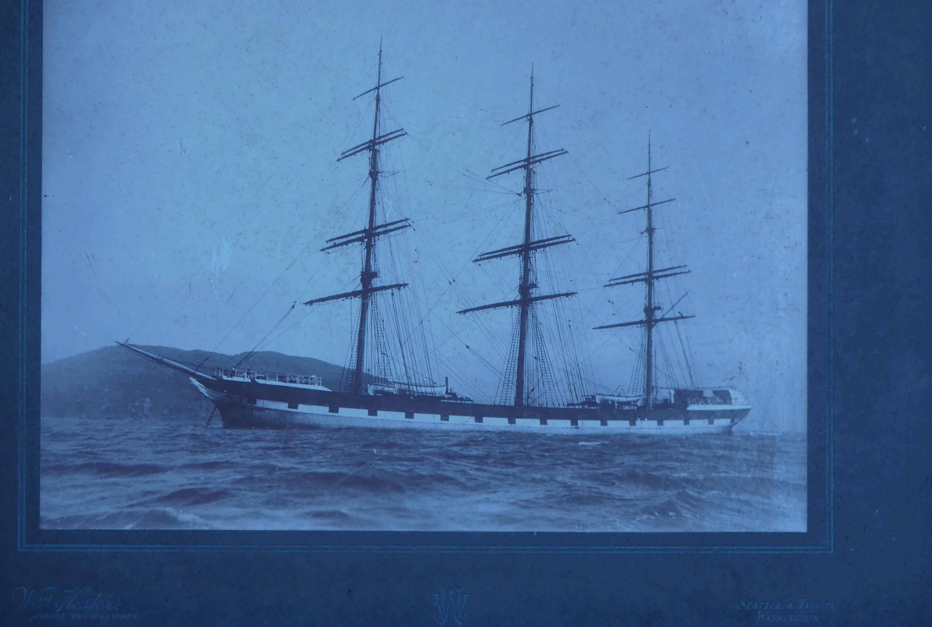
Captain Williams, Cannon House
Silver medals have been conferred by the King, on the recommendation of the President of the Board of Trade, upon M Joseph Laillou, chief officer, Francisque Fourgeras, boatswain, Jacques Poupon, boatswain, Arthur Grusson, engineer, Pierre Guibey, Francois Robin, Leon Depays, Desiré le Crou, Victor Argoat, Francois le Merdy, Goulven Balcon, Michel le Gal, and Alexis Courson, seamen, of the French ship BERENGERE, of Dunkirk, for rescuing the master and crew of the British sailing ship GARSDALE (1905) of Liverpool, abandoned near Cape Horn.

Slide 17
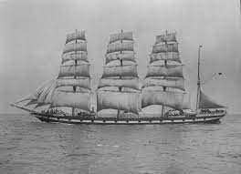
THE MEDWAY
Notes:
And a photo of the same ship

Slide 18
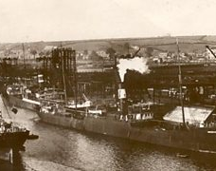
Epic voyage of the Medway
The record-breaking voyage began on September 14, 1916, when, with a Car­digan man, Mr. Richard O. Harris (who later commanded many ships himself) as her first officer and a 202 tons gen­eral cargo, 1,906 tons of cement and 1,543 tons of coal for Porto Grande, St. Vincent, Cape Verde Islands and San­tos, Medway sailed from Barry Roads unescorted and, with a fresh northerly wind giving her a speed of 10 knots, was soon out of the U-boat operating area.

Slide 19
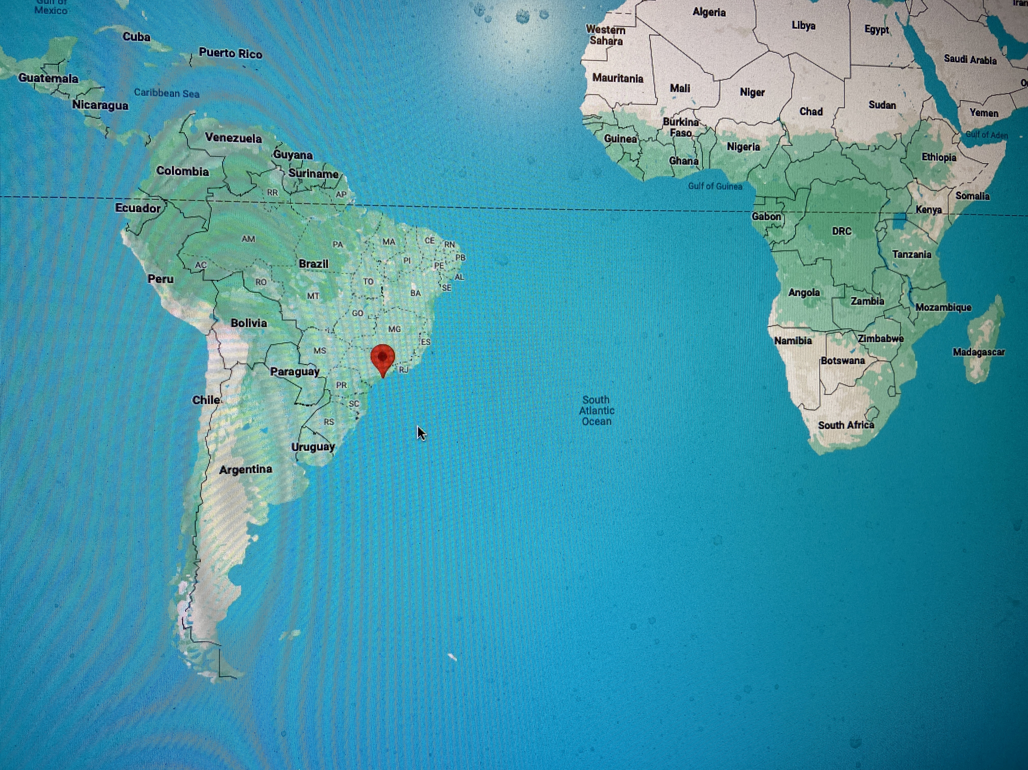
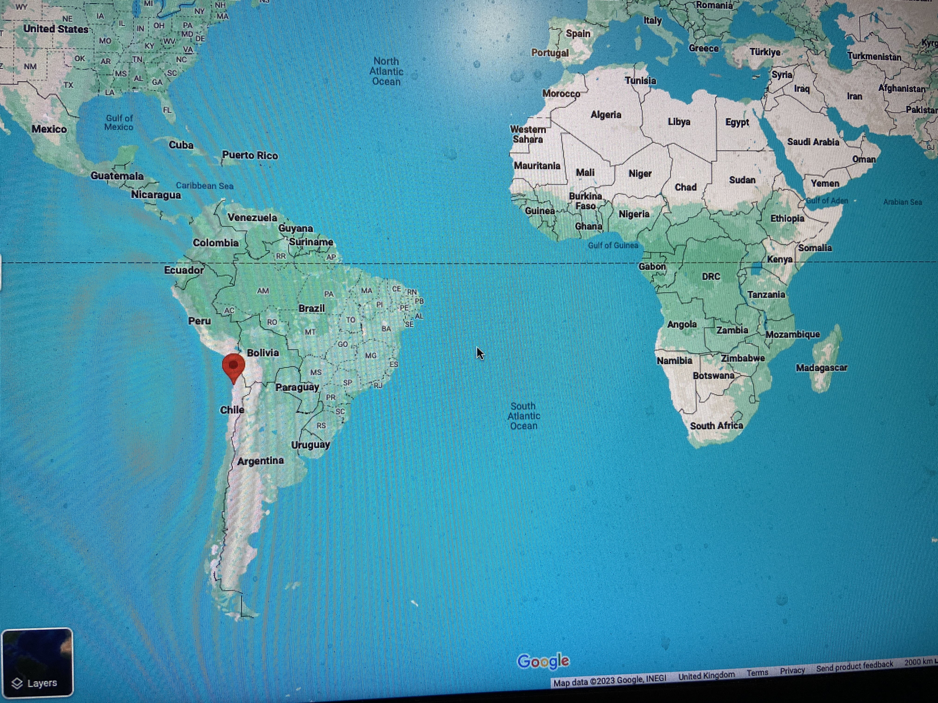
St Vincent - Santos - Tocopilla
St. Vincent was reached on October 6 after a passage of 22 days. The Med­way sailed for Santos on October 19 and arrived on November 10. Here the remainder of the cargo was discharged and she received orders for Tocopilla where she was to load nitrate of soda for Cape Town.
This entailed an east to west voyage round Cape Horn against the strong westerly gales and adverse currents experienced there in a southern summer. It was bad enough for a loaded ship, but Capt. Williams was to tackle this with his ship sailing high out of the water in ballast.
In his book Painted Ports, the story of the ships of Devitt and Moore, Capt. A. G. Course says of Capt. Williams: "He could not have been blamed if he had sailed his ship right, round the world with the strong¹ westerly winds driving his ship ahead; even though it would have taken 100 days under the most favourable conditions. But he sailed the Medway round Cape Horn and made Tocopilla in 52 days.”

Slide 20
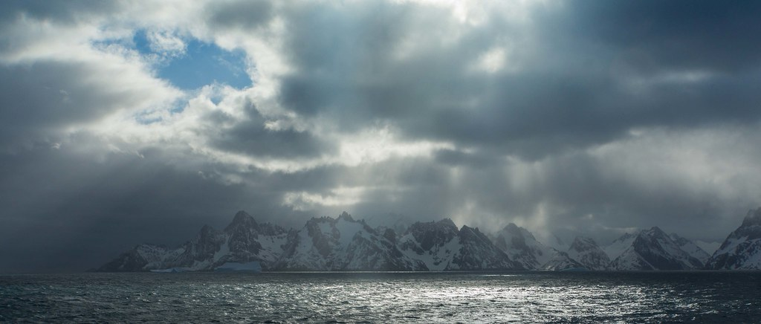
Tocopilla – Cape Town
Cape Disappointment
All-Time Record. Capt. Course says: "This passage to Cape Town was the best the Medway ever made. It took 43 days and is a record for all time, the next best being 44 1/2 days made by a German ship. After rounding Cape Horn - this time the easy way from, west to east- she encountered a north-easterly gale, and, instead of making direct for Cape Town, Capt. Williams set a course to the eastward to pass south of South Georgia Island. The Midway was abeam of Cape Disappointment at 5 00 p.m. on March 20, seven miles distant. That evening three large icebergs were passed, and the look-out was doubled. Next morning fog set in, but icebergs continued to be sighted, one being 300 feet in height.

Slide 21
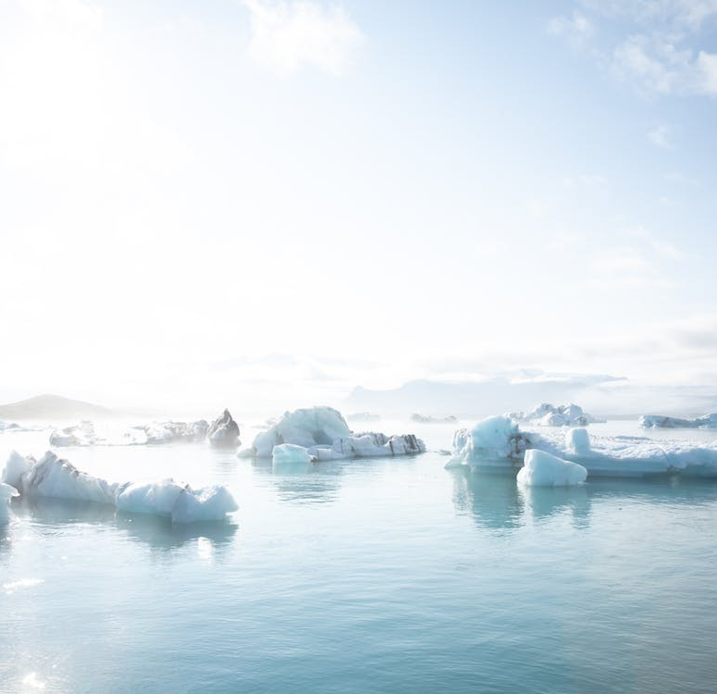
Epic voyage of the Medway
The Medway was in company with bergs, growlers and ice-islands for two days and nights during which time she was averaging a speed of 12 knots. The best logged speed on the passage was 13 knots. "Capt. Williams certainly got the winds he wanted on this passage. That north-easterly gale to the eastward of Cape Horn was truly lucky."
Growlers
Notes:
ST DOGMAELS CAPTAIN WHO SET UP THREE WORLD RECORDS
On January 30, 1917, the sailing ship Medway—a steel four-masted barque of 2,516 gross which had been constructed for use as a training ship but which was capable of carrying nearly 4,000 tons of cargo—arrived at Tocopilla, Chile. There she loaded 3,700 tons of nitrate of soda for Cape Town and sailed on February 19.
This passage to Cape Town took 43 days and is a sail record for all time; the next best being 44 1/2 days made by a German ship. This was the first of three world records which the Medway made while her master was Capt. David Williams, Cannon House, St, Dogmaels, who died at the West Wales General Hospital, Glangwili, on Friday, in his 91st. year.
Capt. Williams, who was the only surviving commander of Devitt and Moore's famous ships, was appointed master of the Medway at Cardiff in December 1914, two weeks after his 38th birthday. He then held his extra master's square-rigged certificate and had served 12 years in the White Star Line from fourth to first officer in liners and chief officer in their full-rigged sail training ship, Mersey.
The record-breaking voyage began on September 14, 1916, when, with a Car­digan man, Mr. Richard O. Harris (who later commanded many ships himself) as her first officer and a 202 tons gen­eral cargo, 1,906 tons of cement and 1,543 tons of coal for Porto Grande, St. Vincent, Cape Verde Islands and San­tos, Medway sailed from Barry Roads unescorted and, with a fresh northerly wind giving her a speed of 10 knots, was soon out of the U-boat operating area.
ROUND CAPE HORN .
“Below 40 South there is no law. Below 50 South there is no God”.
St. Vincent was reached on October 6 after a passage of 22 days. The Med­way sailed for Santos on October 19 and arrived on November 10, another 21-day passage. Here the remainder of the cargo was discharged and she received orders for Tocopilla where she was to load nitrate of soda for Cape Town.
This entailed an east to west voyage round Cape Horn against the strong westerly gales and adverse currents experienced there in a southern summer. It was bad enough for a loaded ship, but Capt. Williams was to tackle this with his ship sailing high out of the water in ballast. In his book Painted Ports, the story of the ships of Devitt and Moore, Capt. A. G. Course says of Capt. Williams: "He could not have been blamed if he had sailed his ship right, round the world with the strong¹ westerly winds driving his ship ahead; even though it would have taken 100 days under the most favourable conditions. But he sailed the Medway round Cape Horn and made Tocopilla in 52 days.”
This is the only time it was carried out by any Devitt and Moore's master."
After arriving at Tocopilla on Janu­ary 30, 1917, and loading 3,700 tons of nitrate of soda for Cape Town, the Medway sailed on February 19.
All-Time Record. Capt. Course says: "This passage to Cape Town was the best the Medway ever made. It took 43 days and is a record for all time, the next best being 44 1/2 days made by a German ship. After rounding Cape Horn - this time the easy way from, west to east- she encountered a north-easterly gale, and, instead of making direct for Cape Town, Capt. Williams set a course to the eastward to pass south. of South Georgia Island. The Midway was abeam of Cape Disappointment at 5 00 p.m. on March 20, seven miles distant. That evening three large icebergs were passed, and the look-out was doubled. Next morning fog set in, but icebergs continued to be sighted, one being 300 feet in height.
Another Record. The Medway arrived at Cape Town on April 3 and, after discharging her cargo, sailed in ballast to Tocopilla on May 1 to load another' cargo of nitrates. Capt. Williams set course to the east­ward, for although it meant sailing three-quarters of the way round the world, it had the advantage of fair wind sailing with the strong westerlies driving the ship. In terms of time it was the shortest or quickest way.
In fact another sailing record was made, 62 days from Cape Town to Tocopilla. It was not accomplished without careful planning. Capt. Williams decided to go well south, where the num­ber of miles in the degree of longitude are less, to shorten the distance by sail­ing on a Great Circle track, which is a straight line on the globe of the world. It paid him well for the daily average of the passage was 197 miles.
ROUND THE WORLD IN 81 DAYS
The course from Cape Town took the ship to the southward of Kerguelen Island, 30 miles to the southward Campbell Island, which is to the southward of New Zealand, and then to the northward through the howling fifties and roaring forties latitudes of the South Pacific. Excluding the 27 days spent in Cape Town and not counting the extra distance sailed to call at Cape Town the Medway sailed round the world, from position in latitude 40 degrees south on the eastern side of the South Pac­ific Back to the same position, in 81 days at an average daily speed of 204 miles. That is another sailing ship record.
Captain Williams made other voyages in the Medway, the last one being from Iquique in Chile to Cape Town. During ' this passage .negotiations were going on between, her. owners and the Anglo-Saxon Petroleum Company, who were acting on behalf of the Shipping Con­troller, for the sale and purchase of the Medway. Devitt arid Moore did not want to sell their only training ship, but the exigencies of the war demanded it and she was sold for £41,000. After her cargo was discharged at Cape Town the ship was sailed to Hong by Capt Williams; where she was converted to a bulk oil carrier, renamed Myr Shell, and used for service in the Far East.
His command of the Medway was a short span in the life of Capt. Williams who went to sea at the age of 15 in 1892 and had weathered many Cape Horn gales and breathless moments in windjammers before becoming master in those famous ships. In later years he was in command of many well-known. cadet training ships and was regarded as a leading ship's master before he retired at the end of the 1939-45 war.

Slide 22
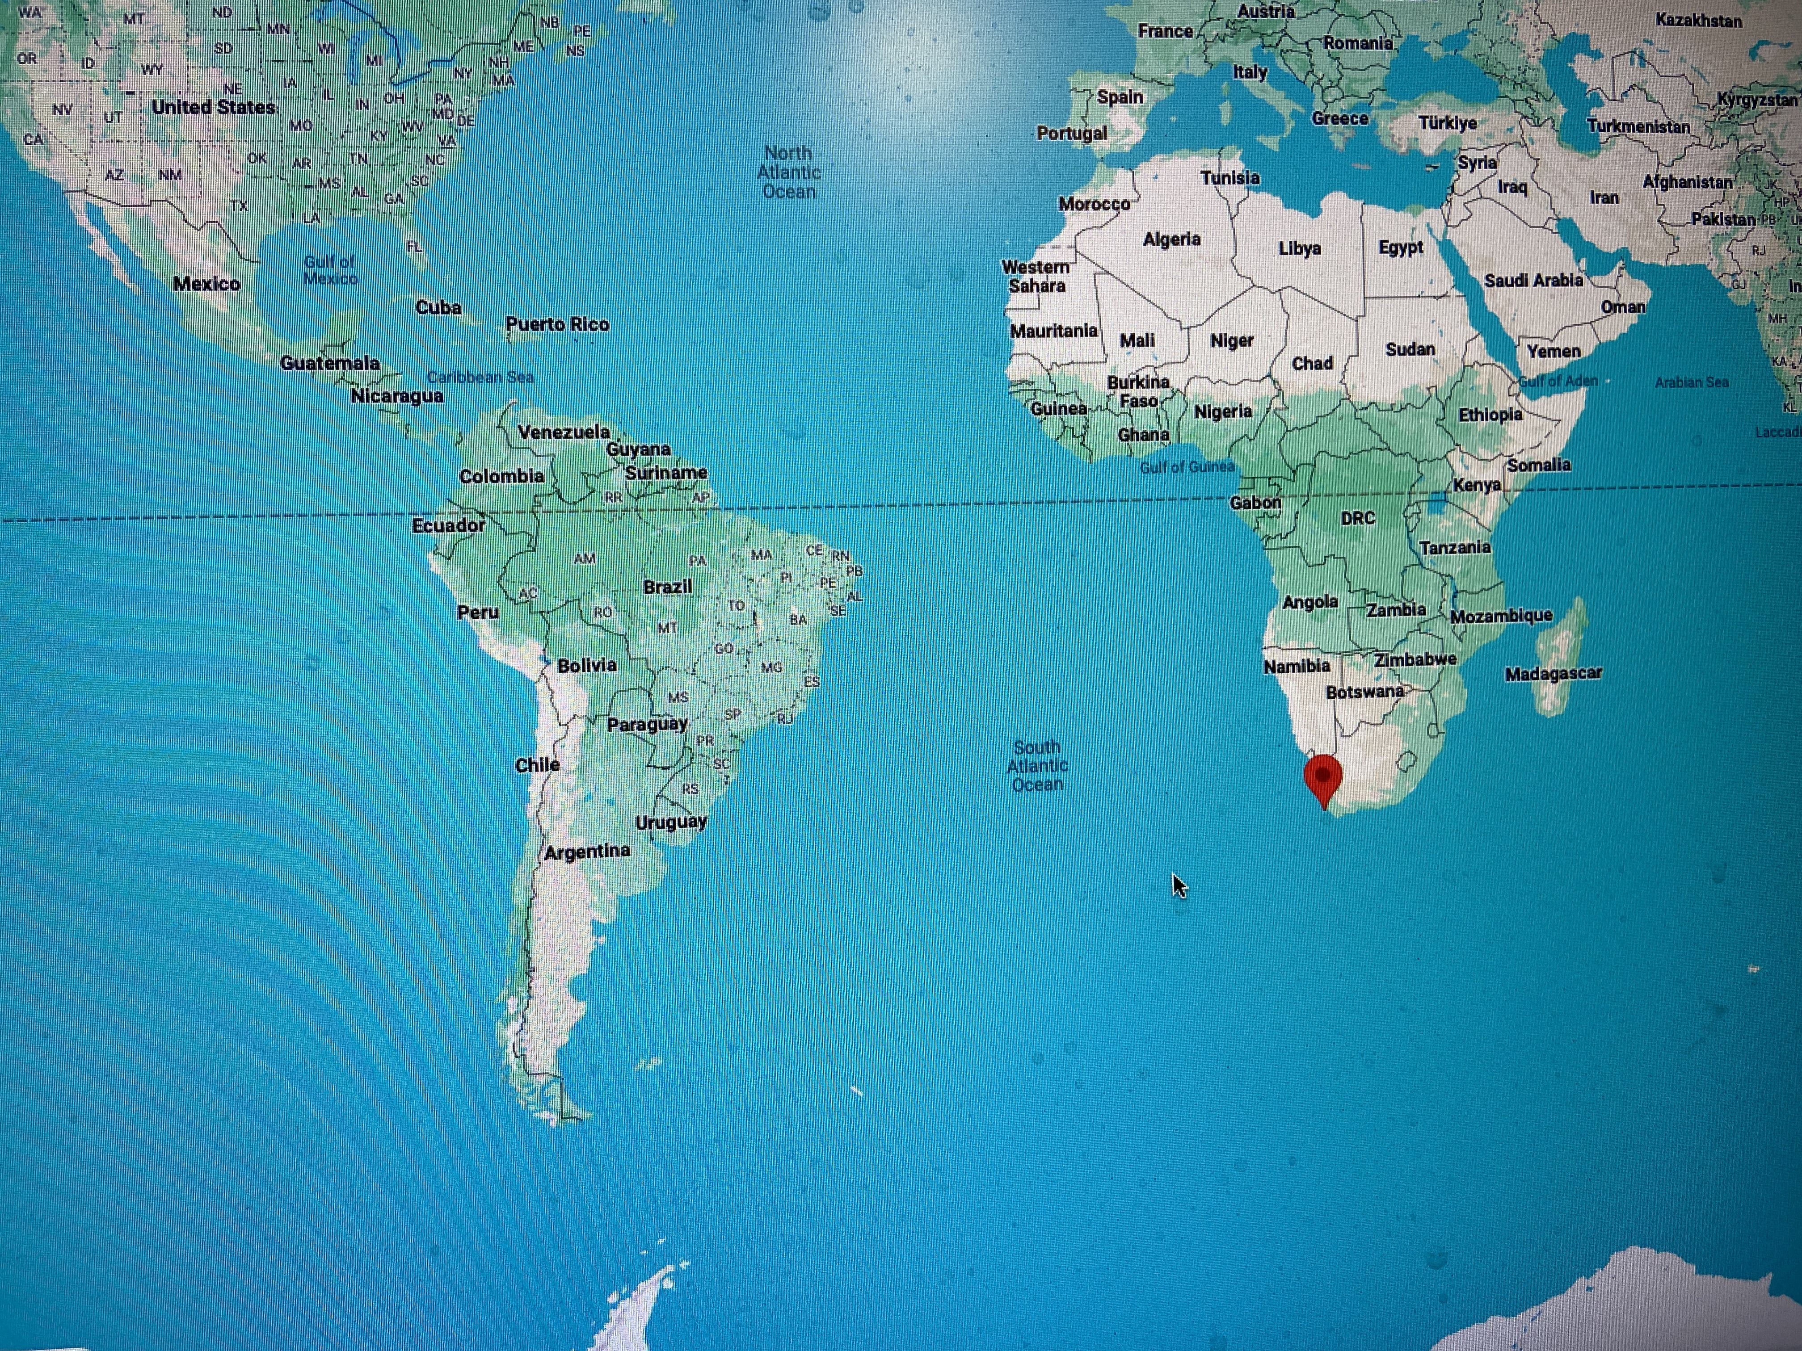
… and back to Tocopilla, the long way round …
Another Record. The Medway arrived at Cape Town on April 3 and, after discharging her cargo, sailed in ballast to Tocopilla on May 1 to load another' cargo of nitrates. Capt. Williams set course to the east­ward, for although it meant sailing three-quarters of the way round the world, it had the advantage of fair wind sailing with the strong westerlies driving the ship. In terms of time it was the shortest or quickest way.
In fact another sailing record was made, 62 days from Cape Town to Tocopilla. It was not accomplished without careful planning. Capt. Williams decided to go well south, where the num­ber of miles in the degree of longitude are less, to shorten the distance by sail­ing on a Great Circle track, which is a straight line on the globe of the world. It paid him well for the daily average of the passage was 197 miles.
ROUND THE WORLD IN 81 DAYS
The course from Cape Town took the ship to the southward of Kerguelen Island, 30 miles to the southward Campbell Island, which is to the southward of New Zealand, and then to the northward through the howling fifties and roaring forties latitudes of the South Pacific. Excluding the 27 days spent in Cape Town and not counting the extra distance sailed to call at Cape Town the Medway sailed round the world, from position in latitude 40 degrees south on the eastern side of the South Pac­ific Back to the same position, in 81 days at an average daily speed of 204 miles. That is another sailing ship record.

Slide 23
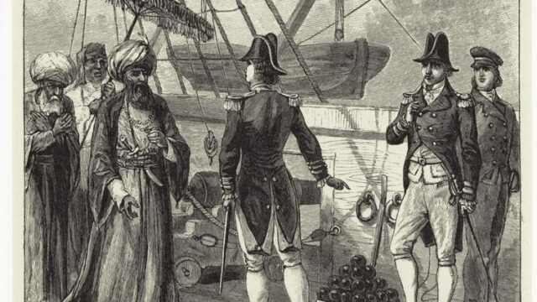
Barbary Pirates Hostage Crisis: Negotiating Tribute and Trade

Slide 24
ADVENTURES WITH THE CORSAIRS
Hazards for an 18th Century Sea Captain, David Saunders.
On the outside of Manordeifi Church, on the banks of the Teifi near Llechryd, stands the tomb of David Saunders (1680-1751) and his wife, born Susannah Morgan (1696-1750). David’s brother was the distinguished Welsh cleric Erasmus Saunders (of whom more later). The family home was at Clynyfelin, near Cilrhedyn.
Their third son David served as a merchant seaman in the East India Company, as captain of the Grosvenor. One of many hazards for merchant shipping was piracy, and when the Grosvenor set sail for Canton in 1767, she carried 26 pieces of ordnance and 45 barrels of gunpowder. The greatest danger came from the notorious Barbary Coast pirates, the Corsairs, whose range extended to the North Atlantic. Instructions to David included measures for the safety of his ship.
You must carry along with you a Mediterranean Pass, there being many Algerine Rovers abroad. Take immediate care to have and keep your arms fixed; to station your men at their several quarters; to put your ship in a good posture of defence; to have a sufficient number of cartridges filled with powder and a proportionable quantity of shot; to be always in readiness during this voyage, in case of a sudden assault. Trust no colours. Be very watchful at all times against surprises, and cautious of speaking with any ship; and if you can avoid it, speak with none during every part of the voyage.
Sources: Francis Green, in Historical Society of West Wales Transactions Volume II, 191.

Slide 25
In previous centuries pirates had captured thousands of ships, and raided coastal settlements across Western Europe, and even as far as Ireland, primarily to capture slaves for the markets in North Africa and the Middle East. The menace was so severe that stretches of coast in Spain and Italy were in consequence largely abandoned. Piracy had begun to diminish by the 18th century, as the more powerful European navies compelled the Barbary States to desist from attacking their shipping. But this was a long process. In 1767 the “Mediterranean Pass” was a document which identified a ship as being protected under treaty with Barbary Coast states, who required countries to pay a tribute in exchange for safe passage of ships and crews. The East India Company would clearly pay up in response to contemporary state sponsored terrorism. Piracy was only finally eliminated with the end of the Napoleonic wars in 1815, when the European powers agreed to suppress the Barbary corsairs entirely.
The company was also concerned with other risks to the cargo of tea. Take care no camphire be brought in the ship … on any account whatsoever, lest the scent of it spoil the tea; and let no more arrack than necessary be brought in the ship; and be sure it be stowed in such places, as will best prevent its doing the tea harm by its steam or scent. … musk may scent and thereby prejudice the tea, we hereby positively forbid the bringing of it.
Captain Saunders also received mysterious sealed orders from the Company’s “Secret Committee”: When in sight of St. Helena in your homeward-bound voyage, you are to bring-to about four leagues to the windward of the Island and send a boat ashore with a proper officer to acquaint the Governor who you are, with orders to return on board again forthwith, to inform you if all is well, and then, on making sail into the Road, you must show this signal, viz:- -Furl the foretop galliant sail and hoist a Dutch Jack at the foretop gallant mast head.
David Saunders survived these adventures. Coming into a family inheritance, he retired from the sea and his wealth increased when he married Susan, the daughter of one John Hughes of Tymawr, Cilcennin, Cardiganshire. He died on 10 January, 1815, aged 88.

Slide 26
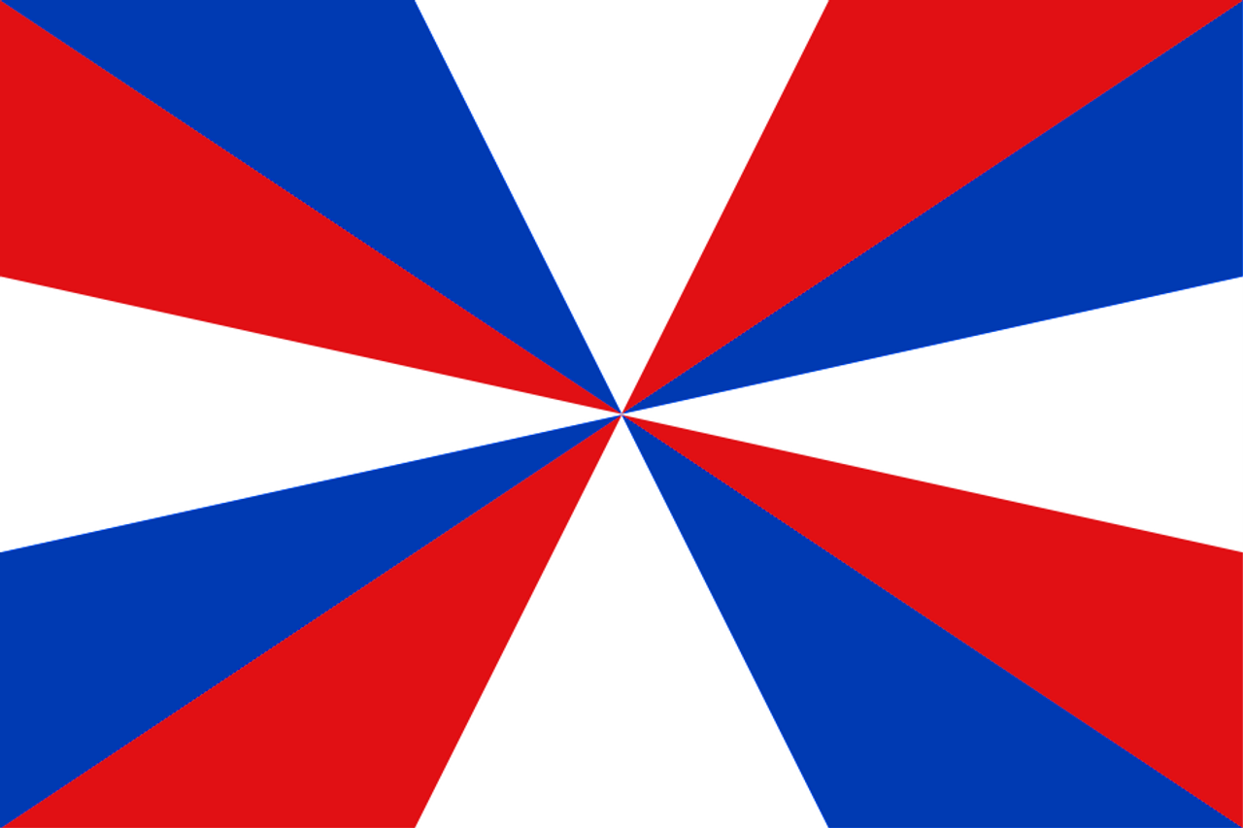
Dutch Jack

Slide 27
Emigration to Canada in the 1820s
Possible future subjects
Strangers from a Secret Land. Peter Thomas
David Phillips, the minister at Blaenwaun
The Voyage of the Albion in 1819
Diary kept by David Phillips – voyage of the Active 1822
Correspondence with Britton Evans (links to Mathias family of Hendre)

