Slide 1
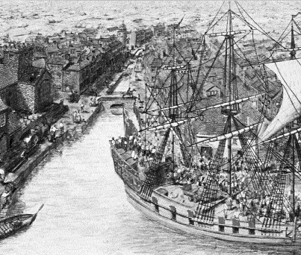
MIGRATION TO AMERICA,
AND LETTERS HOME
The Mathias family of Hendre and their descendants
Notes:
This is the product of a few things
First, a collection of letters I came across thanks to the late Tony Bowen of this village, letters and other material across 4 generations of the Mathias and Evans families
Later discovered how they came to be …. Their provenance …… Other descendants of the Mathias and Phillips families
A few bits of extra information about Britton Evans and descendants
Want to set in context. These were turbulent times and Colonel Britton Evans was at the centre of many of them.
Connection with the voyage of the Albion in 1819.
Finally the human element. What leads people to migrate and their attachments to home.

Slide 2
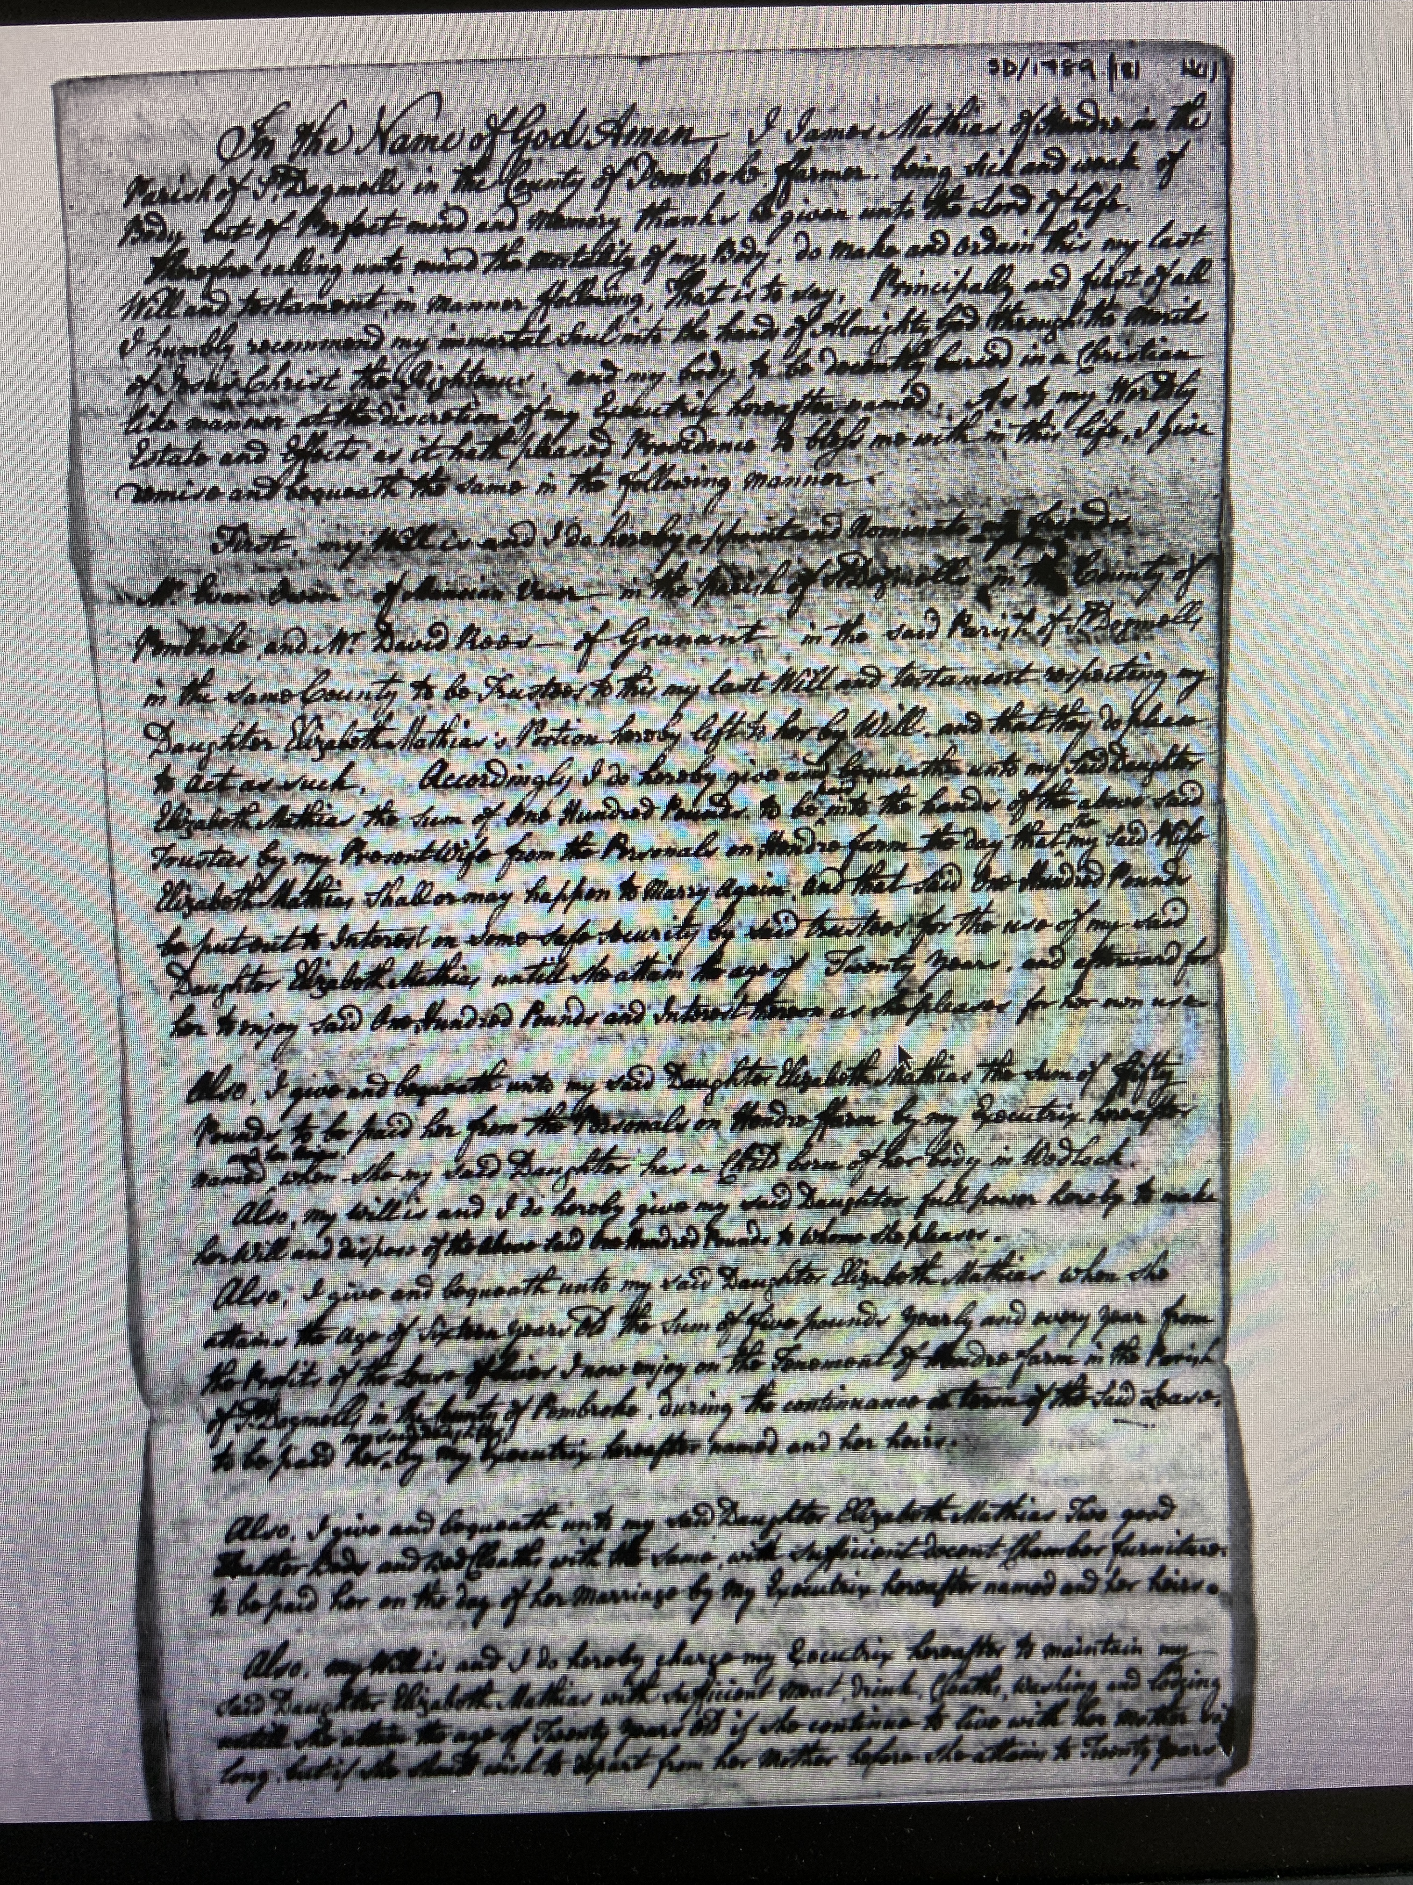
Sources for this story?
Family trees (Simon Carter)
Loose papers (from Tony Bowen)
Bill Griffith Jones
The Phillips papers (NLW)
Miscellaneous
Connections to the Albion story
Hendre
Trenewydd
Various historical articles and newspaper archives
Extract from the will of James Mathias 1789

Slide 3
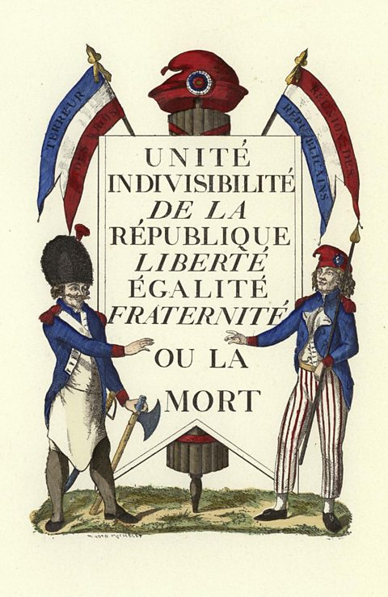

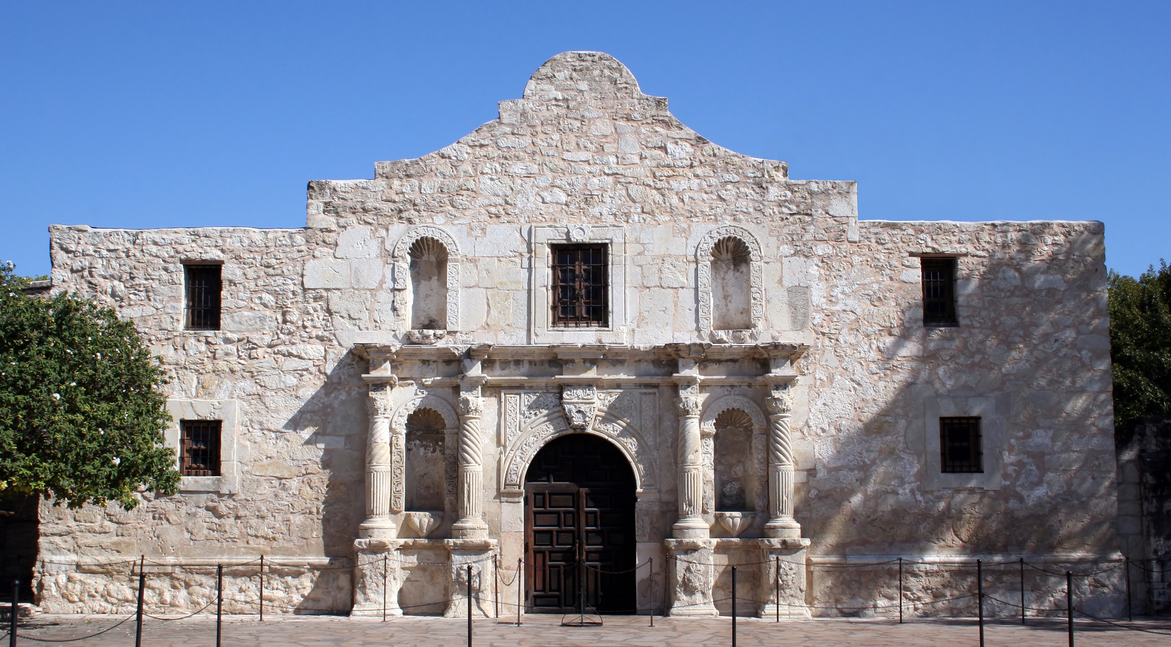
1760 1770 1780 1790. 1800 1810. 1820 1830 1840 1850 1860 1865
US privateer bombards Fishguard
US Civil War
Napoleonic Wars; end 1815
Crimean War 1853-56
Voyage of the Albion
American War of Independence
US war with Mexico.
The Alamo
War of 1812
The French Revolution,
1789 ..
David Mathias emigrates to North America with his young family in this period
Mary Evans letter 1821
David Mathias.
1791 letter
Britton Evans
Letter 1830, 1837
Britton Murat Evans. Son. Letters 1847-50
Notes:
A timeline. American independence, the French revolution, the War of 1812, the Mexican War (the Alamo) and the looming US Civil War over slavery
We could fit in the story of the attack on Fishguard and the Jemima Nicholas story

Slide 4

CAST OF CHARACTERS
John Evans, Dep Governor (1704-1709) of Pennsylvania with William Penn
David Mathias (1703-1804) Emigrates to States, c 1760?
Daniel (d. 1773), Lazarus (d.1793) and James (d.1789) Mathias brothers
Mary Mathias( c 1745-1822) in 1770 becomes Mary Evans
= Jonathan Evans, grandson
of John Evans above
Colonel Britton Evans
Elizabeth Mathias, 1775-1844 daughter of James Mathias who marries David Phillips (Blaenwaun) - her second husband
Sons. Napoleon Bonaparte, Henry Messena, Louis Washington, Britton Murat, and William. Daughter Josephine.
John Hervey Griffiths, who collected and transcribed the letters in c 1910. Great grandson of Revd Phillips and Elizth. Mathias
Britton Duroc Evans, son of Louis W. above. (1858-1920)
Notes:
The cast of characters
The Mathias brothers are the connection with St Dogmaels
The letters home are from the 4 generations of the family in America to their relations here from 1791 to 1850

Slide 5
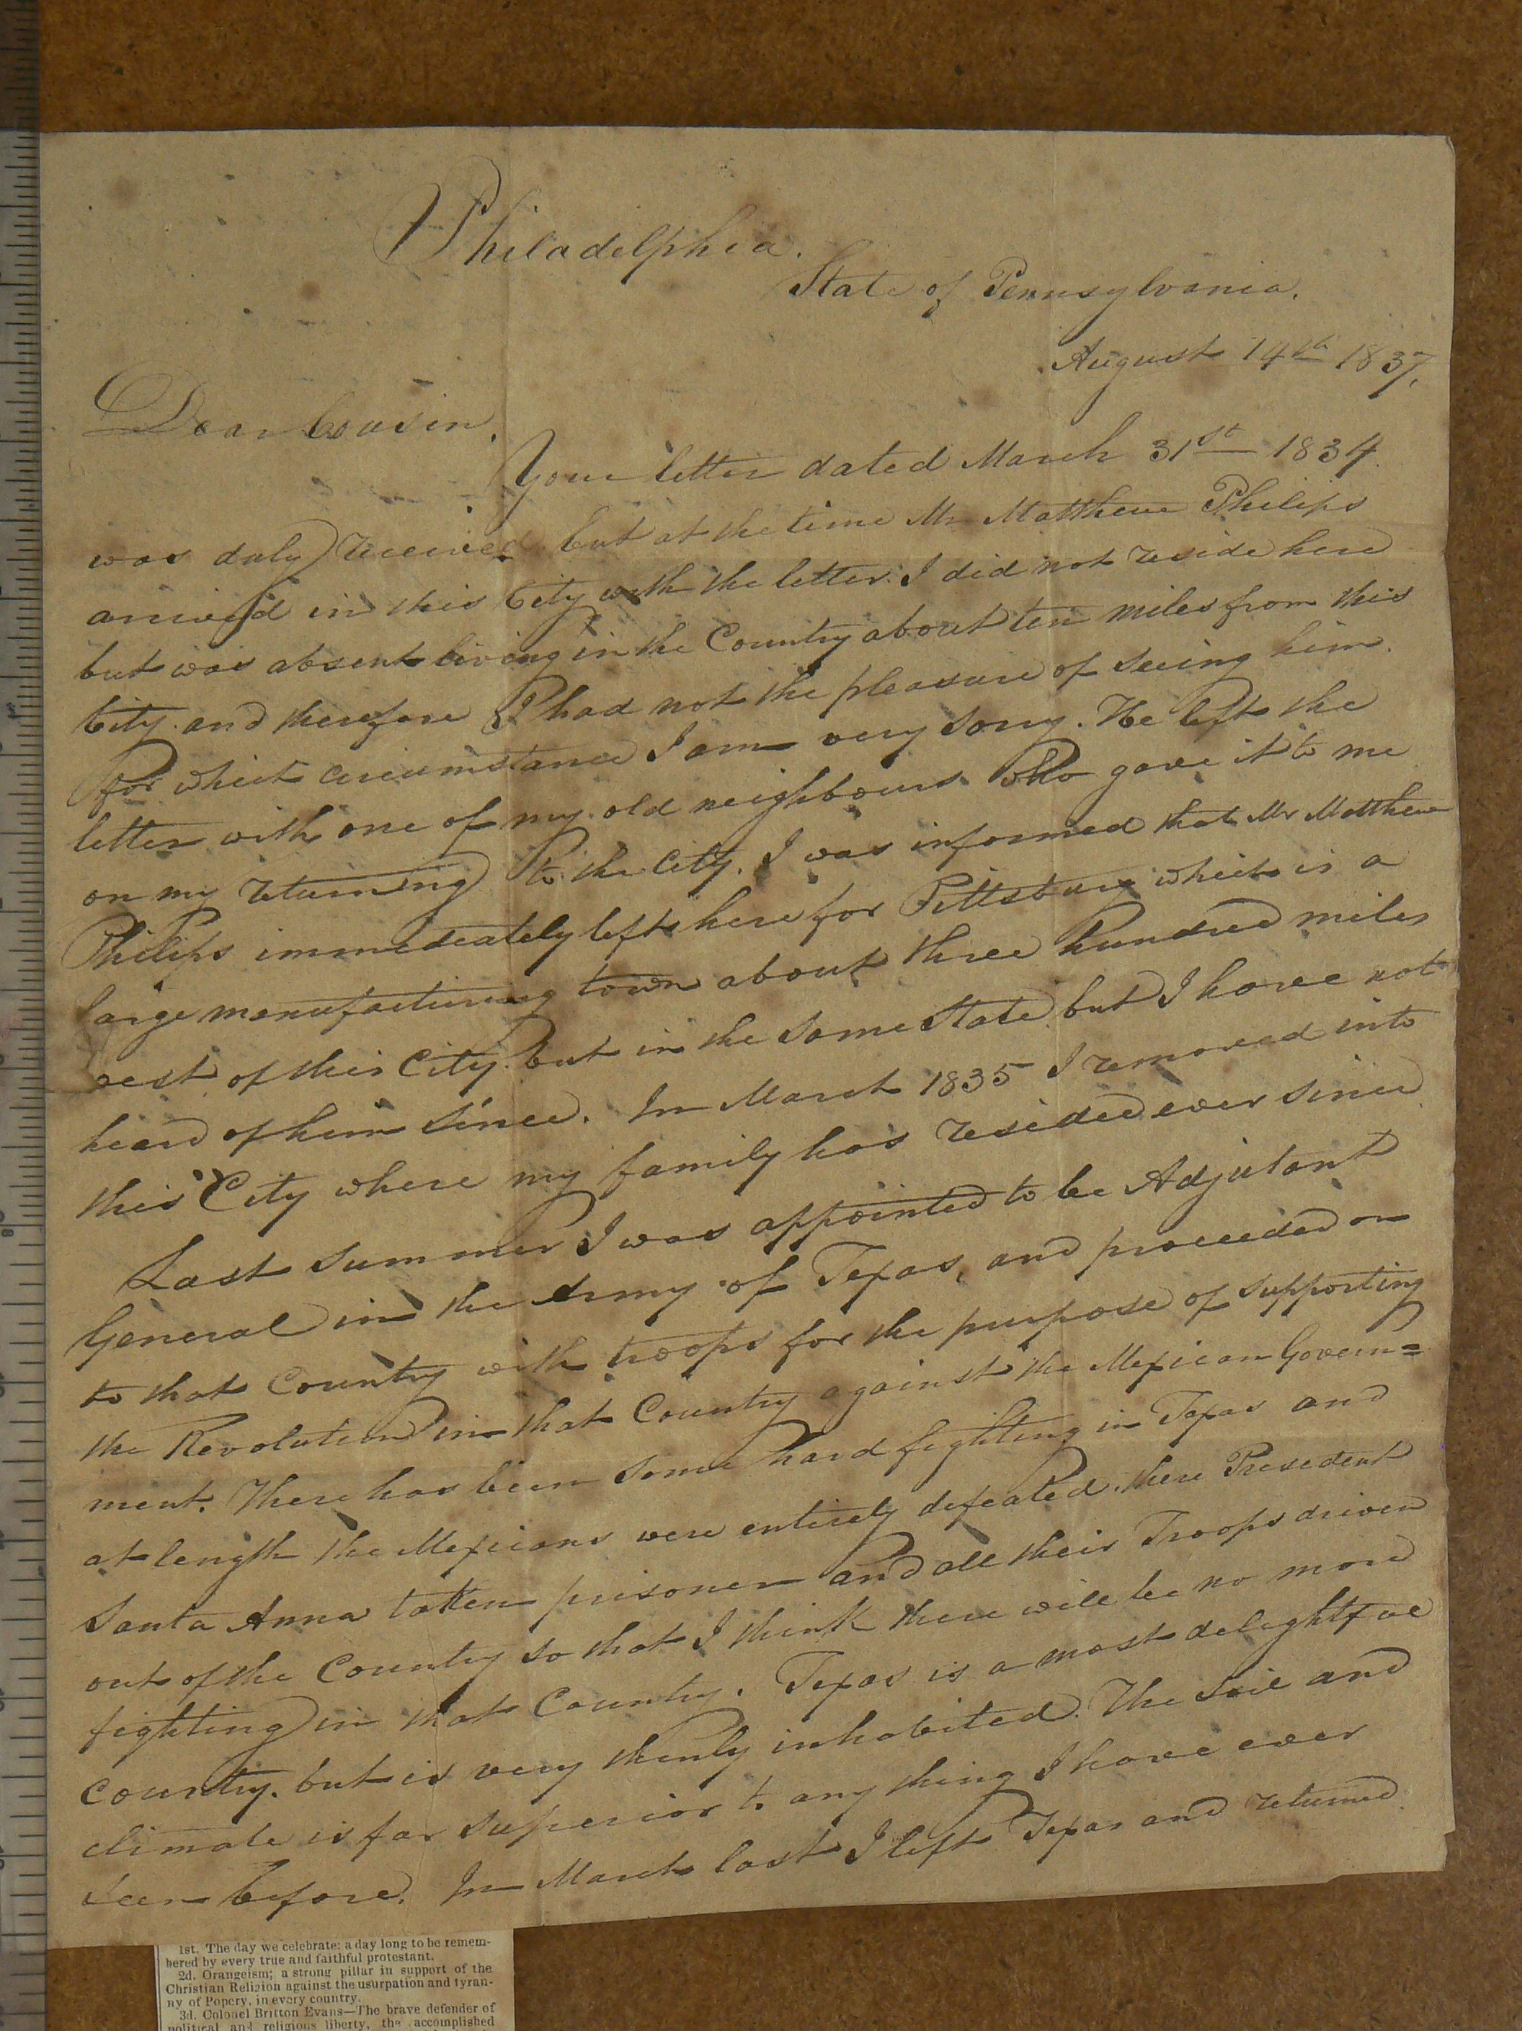
LETTERS FROM AMERICA
James Hervey GRIFFITHS collected together letters from PHILLIPS descendants, transcribed and printed them privately between about 1900 and 1910.
James was a great-grandson of David Phillips (Blaenwaun). … the Albion
Some of the letters have been translated from the original Welsh
https://archives.library.wales/index.php/phillips-family-of-st-dogmaels-papers (contains a few of the letters)
Original letter from Col. Britton Evans

Slide 6
Connections great and small
Mathias family of Hendre: David, Daniel, James, Lazarus
Elizabeth Mathias married Rev David Phillips of Blaenwaun; did letters home encourage the Albion project in the 1820s?
Britton Evans links us to revolutionary France, the War of 1812, the Alamo and more (and you thought things were bad now!)
Letters reveal feelings about Wales …
… and also attractions of the New World
… and some very personal things

Slide 7
LETTERS HOME
Chronologically we begin with David Mathias in 1791. Now an old man.
His daughter Mary Evans in 1820 gives family news, and extols the advantages of life in America.
Britton Evans himself. War of 1812. After the Alamo. Indian campaigns. Supports Greeks vs Ottoman Empire. (Some possibly less creditable episodes too.)
His son, Britton Murat Evans, has hopes of visiting Wales, and would like a Welsh wife (“famed for their beauty and industry”)
Another son Henry is a restless spirit.
Finally Louis, a physician, and his son, Britton Duroc Evans, who is a great pioneer in the treatment of mental health (and we shall start with him)

Slide 8
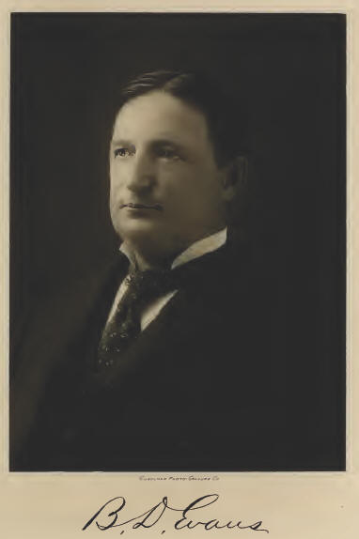
Britton Duroc Evans (1858-1920)
Excuse this brief flip forward 50 years
“Dr. Evans is one of the most conspicuous and honored representatives of the medical profession in New Jersey, and yet has not attained the prime of life. He was born in Caroline county, Maryland, in 1858, and is a son of Dr. Louis W. Evans, who was born in Ohio, during a temporary residence of his parents in that state. His father [ie Louis’s father], Colonel Britton Evans, had been sent there on a government commission.
He [Col. Britton Evans] was a direct descendant of Christmas Evans, the eminent Welsh divine. A gentleman of fine military attainments, he was commissioned lieutenant of artillery in the war of 1812 and served under General Harrison, taking an active part in the battle in which Colonel Johnson, afterward vice-president of the United States, is said to have killed the chief Tecumseh, and also in the battle of River Raisin, where he distinguished himself for bravery.
He took part in the war with Mexico, the Florida war, and at the time of his death was organizing a company to go to Greece to help her in her struggle for independence, against Turkey. His original commission, signed by Presidents Monroe and Madison, and also the original credentials which enabled him to organize a company in aid of the Greeks, are in possession of his grandson. Dr. Evans, of Morris Plains.”
Supposedly a piece in praise of the above, it focuses on his grandfather!
Notes:
All about Colonel Evans, his grandfather!!
Genealogy. Status of Christmas Evans link. Just not true!!

Slide 9
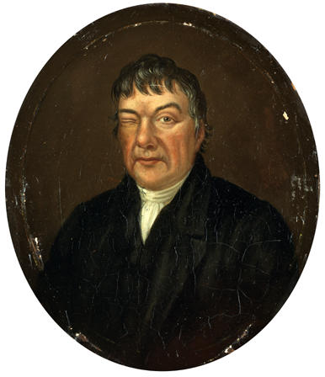
Britton Evans, Mental health pioneer, and Christmas Evans, preacher, no relation!!
Christmas Evans. 1766-1838

Slide 10
David Mathias. Letter of 1791 (at age 88)
Permeated by strong religious conviction
Laments his limited English… [my transcription clearly a translation]
… and laments his grandchildren’s limited Welsh
Tells us about his family links to St Dogmaels.
Probably does not know which brothers are still alive (only Lazarus)
Mentions his daughter Mary Evans, with whom he now lives.
No mention of the recent War (of Independence)

Slide 11
Mary Evans
Mary was born in Wales so would have been a native Welsh speaker; my guess is that this letter is also in translation
Letter records the death of her father aged 101
Tells us about her family, including youngest son Britton
Quite a lot about the advantages of life in America

Slide 12
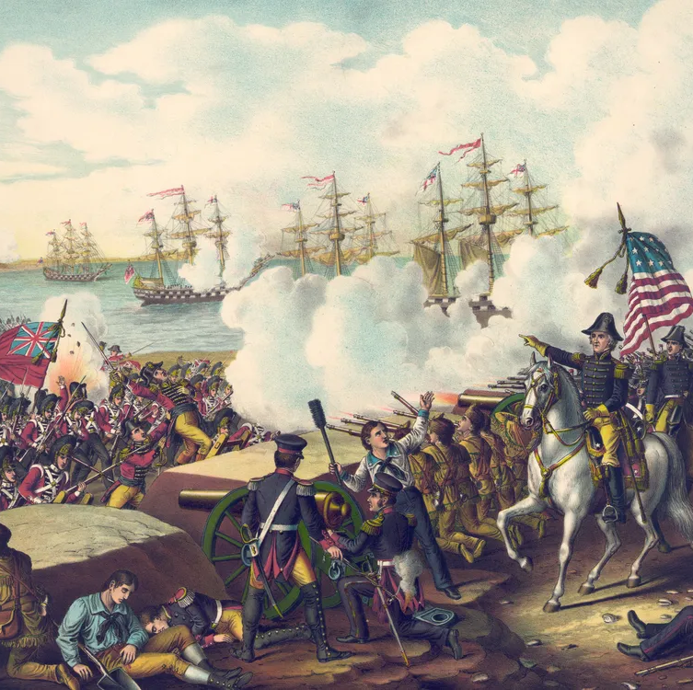
COLONEL BRITTON EVANS
C 1780 TO 1847

Slide 13
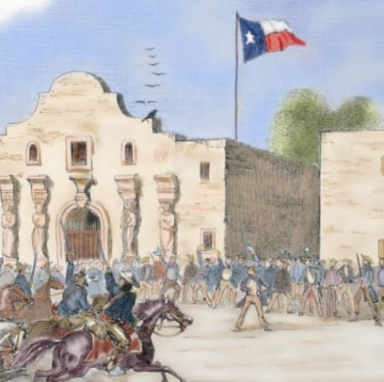
Britton Evans career
War of 1812
Texas and the Alamo
Philadelphia Riots
Indian campaigns
Support for the Greeks against the Ottoman Empire

Slide 14
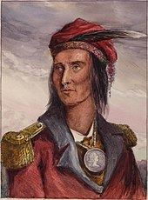
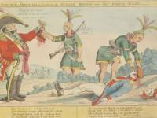
Colonel Britton Evans
Tecumseh, Shawnee chief (right).
Contemporary cartoon showing their alliance with British. Note the rather portly British officer.
War of 1812 against the British,
who had allied with the indigenous peoples
Raisin River
His children: Napoleon Bonaparte, Josephine, Henry Messena, Louis Washington and Britton Murat.
Reflects close connections, politically, with France and revolutionary ideals.
NB this was a war that the American colonists lost, with severe economic consequences

Slide 15
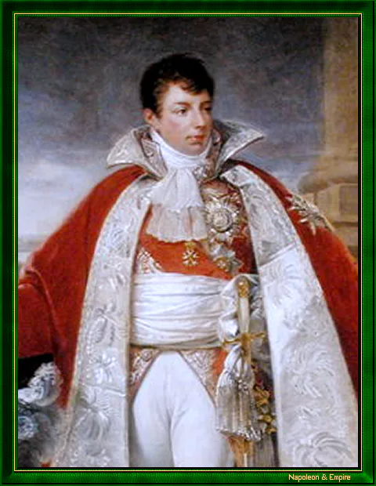
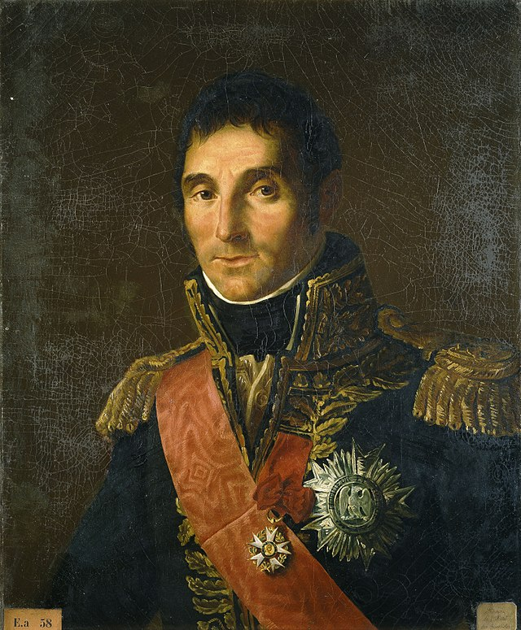
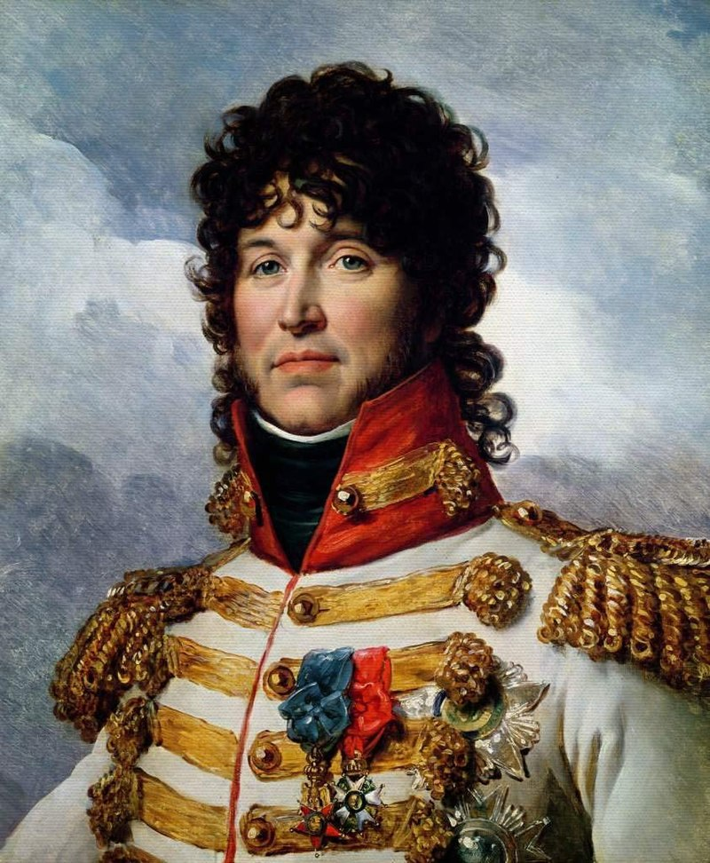
Family Revolutionary Sympathies. Boys named after Napoleon’s generals.
Not to mention Napoleon Bonaparte and Josephine!
Duroc Massena Murat
(Britton Duroc Evans) (Henry Massena Evans) (Louis Murat Evans)

Slide 16
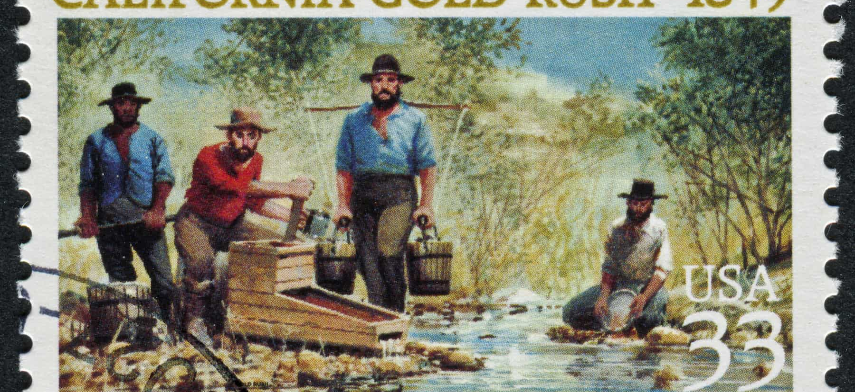
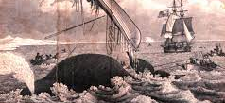
Henry Messena Evans. A restless soul.
According to his brother, he has been:
a farmer in Texas
a captain on one of his father’s ships
a lieutenant in the US Army
an officer in the Peruvian Navy
Several whaling expeditions
The California Gold Rush – the 49 er’s

Slide 17
TEXAS AND THE SLAVERY ISSUE
“The independence of Texas would result in a fine country being
opened up to emigrants and an added desideratum would be the
paving of the way for the abolition of slavery in the border slave states
of Delaware, Maryland, Virginia, Kentucky, and Missouri.”

Slide 18
SUSPICIOUS MOTIVES
“ the struggle going on in Texas was nothing but a grand scheme of iniquity
concocted for the purpose of re-establishing slavery in the Texas country. In a
succeeding article the writer essayed to "Trace the subject of the Texian revolt
through the whole concatenation of its primary causes and objects," and to set
forth the "motives of personal aggrandizement, avaricious adventure, and
unlimited, enduring oppression" actuating the vast combination of
interests that was behind the Texas revolt.
“… the revolt was not so much the deed of the actual settlers as of the land
speculators and slaveholders in the United States.”
This did not reflect the sentiment of a majority of the citizens of Philadelphia, and
in consequence the editor of the Gazette found him-self denounced as a "bloody
papist”

Slide 19
MIXED FEELINGS ABOUT TEXAS
“Another reason why there was not a greater general sympathy
in favor of the colonists, [according to this journal], was that enthu-
siasm was subdued by statements respecting the dubious character
of the leaders, such as Houston, for instance. The character
of the emigrants was in keeping with that of such unscrupulous
men as Austin, Archer, Wharton, Burnett, and the rest; for "all
the murderers, swindlers, horse-thieves who have fled the Southern
states for the last ten years" have gone to Texas. Those who did
not find it safe to live at home had found an asylum in Texas.”

Slide 20
SIMILAR AMBIVALENCE IN THE SLAVE STATES
”It is more surprising to find a voice from Mississippi protesting in a similar
vein against the independence of Texas. In speculating upon the effect on the
South of the independence of Texas this writer is of the opinion that the
only thing that can render the independence of Texas desirable or its
annexation to the United States worth while is the hope that she would
become the slave market of the whole South. The acknowledgment of Texas
independence will prove a dark day for the South, our territory being
already of sufficient extent and our frontier enlarged enough.”

Slide 21
SO WHERE DID BRITTON EVANS STAND ?
“… expressed the determination of 'those present to embark under Colonel Evans and
offer their services to Houston; to wear the badge of mourning on their left arm for the Texan
martyrs of liberty; to appeal for help for the general Texas committee; and finally as friends of
religious and civil liberty the members declared their readiness to sacrifice all for the Texan cause.
At the meeting it was resolved to form a company to emigrate to Texas under Colonel Britton Evans
and join the army of Houston. … On Saturday the 16th of July, a vessel left New Castle with between
fifty and sixty volunteers bound for Texas. … A dispatch from Bermuda, dated August 2, 1836,
stated that the American schooner, General De Kalb, one Matthews, master, had put into port for
food and water. The vessel had been out ten days from Philadelphia and was bound for New
Orleans. She carried between forty and fifty volunteers comprising privates and officers …. These
were described as being somewhat "pugnacious in disposition”.”

Slide 22
AND THE VERDICT OF HISTORY ?
The sober verdict of history has recorded that the Texas revolution was
"a legitimate measure of self-defense" against the despotism of Santa
Anna. That the revolution succeeded was due in part to the moral and
material assistance rendered the struggling Texans by the citizens of Pennsylvania.

Slide 23
REFERENCES
https://archives.library.wales/index.php/phillips-family-of-st-dogmaels-papers
Ackknowledgement: South Western Historical Quarterly

Slide 24
Britton Murat Evans
Son of Colonel Evans
Writes a number of letters in the 1850s
Laments that his brother Henry is unlikely to marry as he is not of a “settled disposition”

Slide 25
Louis Washington Evans
The second son, Dr. Louis Evans, father of our subject, was a graduate of two of the medical schools of Philadelphia and practiced for many years in that city. He was twice married, his first union being with Miss Patton, of Philadelphia. After her death he removed to Maryland, where he married Miss L. Boone, a direct descendant of Daniel Boone, the celebrated Kentucky pioneer.

Slide 26
Letter to David Phillips
4. Letter from Britton Evans to Revd David Phillips.
Addressed to the Reverend David Phillips. July 12th, 1830.
Dear Cousin.
Your letter of the 5th March 1828, was duly received in the Month of June of the same Year by the hand of Mr. John Phillips, who called at my house on his way to the City of Baltimore, but of whom I have not heard since. Mrs. Mary Evans, my Mother, to whom you directed your letter is long since deceased. She died on the 6th March 1822. And my Sister Anna, who was single and lived with my mother during her lifetime, died in a Year afterwards, I have but One Brother living, whose name is Owen. He resides about One hundred and twenty five miles westwardly from this City, and about five miles southwest from a village called Carlisle, Cumberland county, in this state. He has a wife and numerous family of children, and is the eldest of our family now living. I have but one sister now living whose name is Elizabeth. She is married *******************
They reside about thirty five miles
******* my Brother Owen, On the great * * * *
************ about five miles west of a * * *********** in Chester County in this State *********** and has a large family of children. 'I am the Youngest, of my Mothers family. I have a wife and six children. The Children are named as follows: Elizabeth Pauline. Mary Josephine, Napoleon Bonaparte. Louis Washington. Henry Messena. Britton Murat. I was absent from this City about Nine Years, during which time I served as an officer in the United States Army, having been in Canada and along our Northern Frontier contending against the British Troops and Savages together during the late war,
I returned home to this City in the latter part of the Year 1821, in sufficient, time to settle my Mothers affairs and witness her departure into another, and, I trust, a better world.
After my return from the active service of the Army I was appointed a Justice of the Peace, arid Colonel of the State Troops, which offices I now hold. I reside on my own property, No. 276 South 4th Street, being a Three Storey Brick House. I have been thus minute in my details of the family in order that should you or any of my other relations ever visit this Country, yon will the more readily be enabled to find some part of our family. I should be much pleased to hear from you on the receipt of this letter, in which I should wish to be informed of the names, residence and circumstances of all my relatives in Wales, as it is a subject with which I am but partially acquainted.

