Slide 1
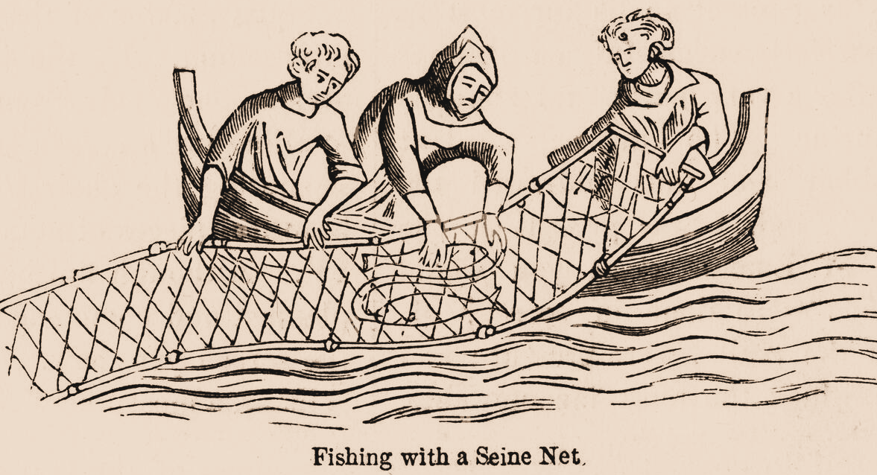
Seine Net Fishing
Mike Marshall
21/03/2024

Slide 2
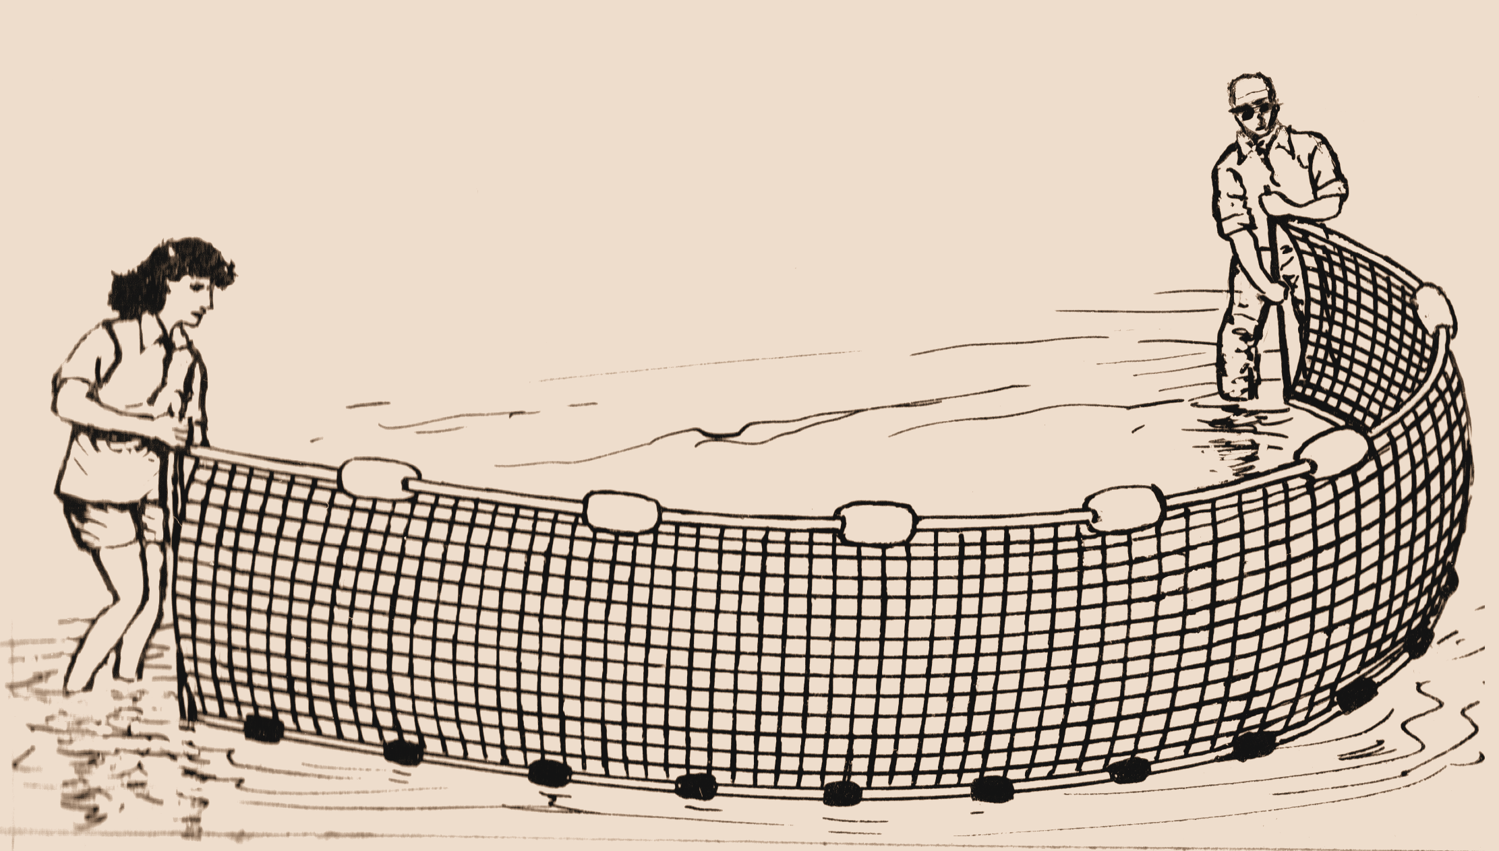
Definition
Seine fishing is a method of fishing that employs a surrounding net, called a seine, that hangs vertically in the water with its bottom edge held down by weights and its top edge buoyed by floats. Seine nets can be deployed from the shore as a beach seine, or from a boat.

Slide 3
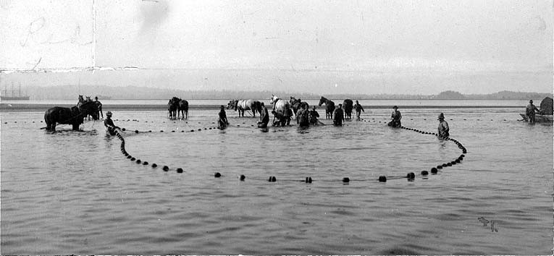
Types 1
Beach seine
  The beach seine is employed by anchoring a section of netting on the shoreline, then dragging the net into the water and surrounding the fish, before pulling it ashore.

Slide 4
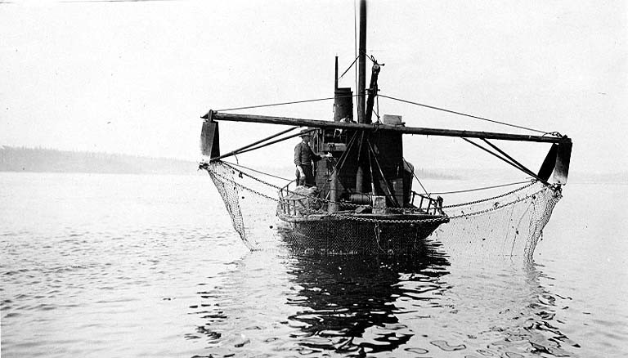
Types 2
Purse seine
  A common type of seine is a purse seine, named such because along the bottom are a number of rings. A line (referred to as a purse-line) passes through all the rings, and when pulled, draws the rings close to one another, preventing the fish from "sounding", or swimming down to escape the net.

Slide 5
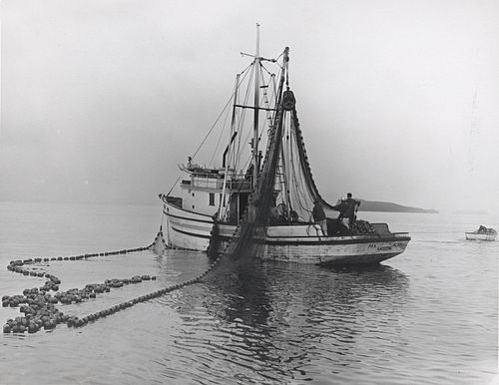
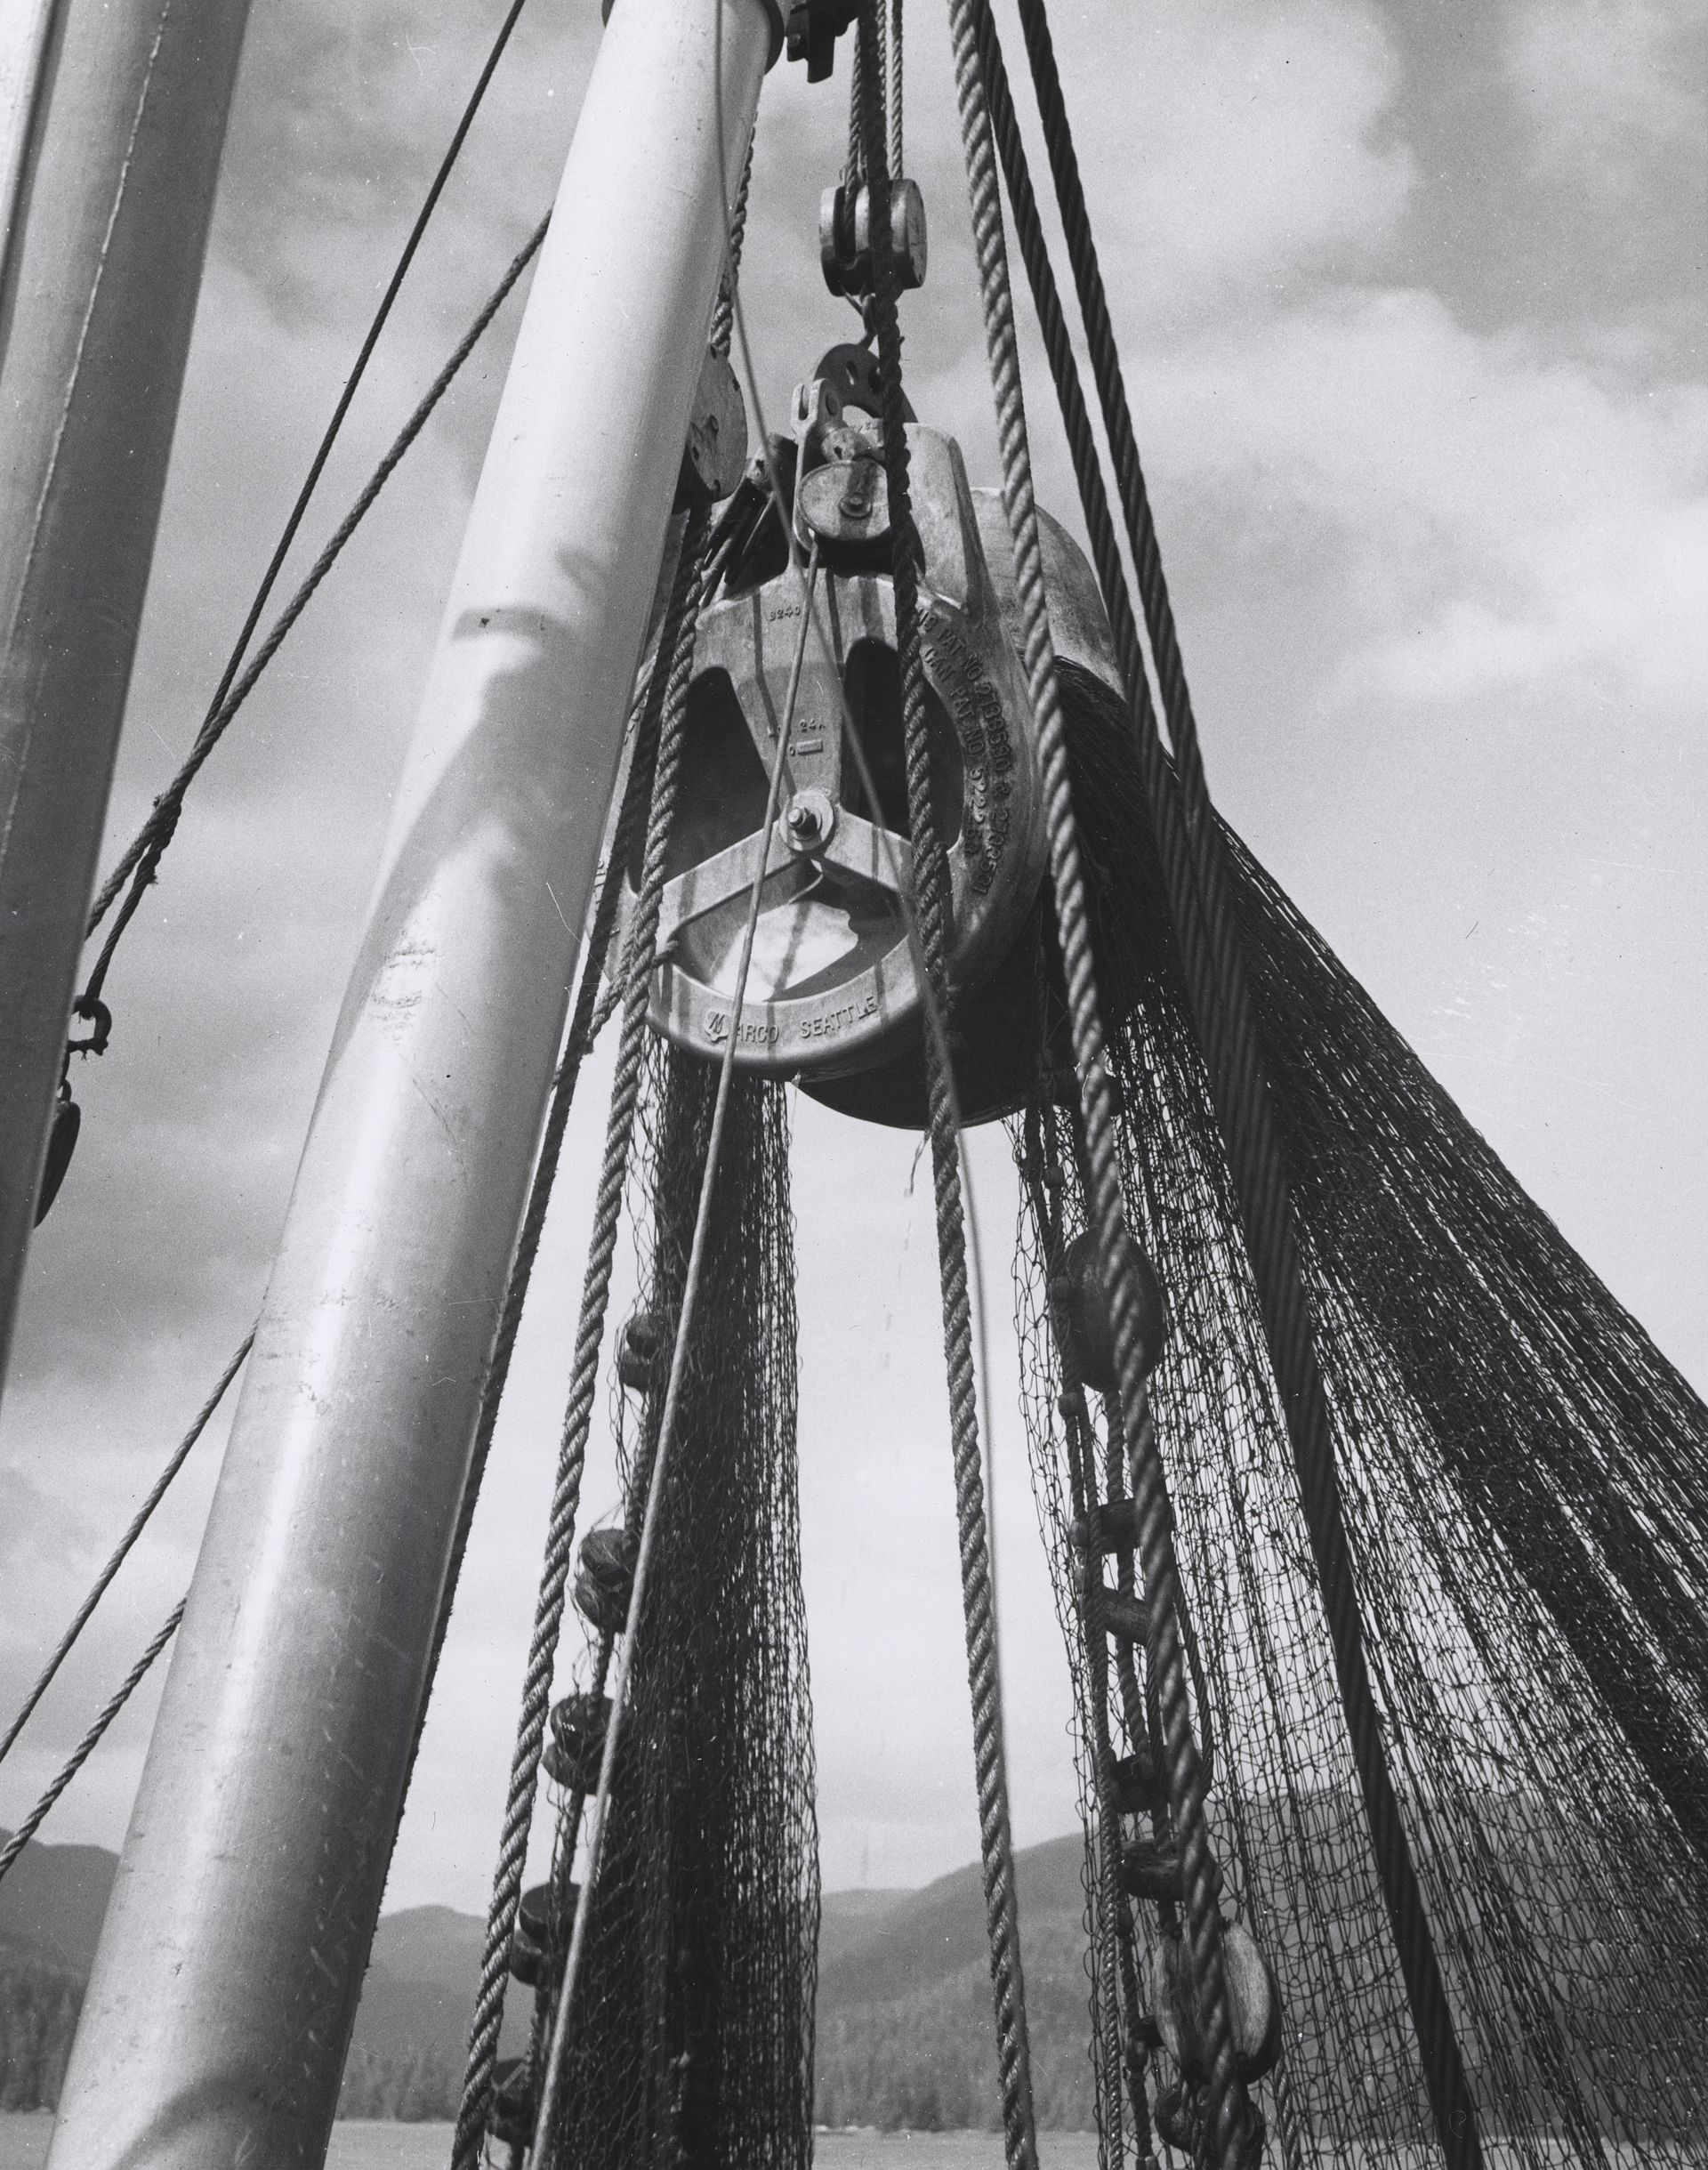
Types 3
Power block
  The power block is a mechanized pulley used on some seiners to haul in the nets.

Slide 6
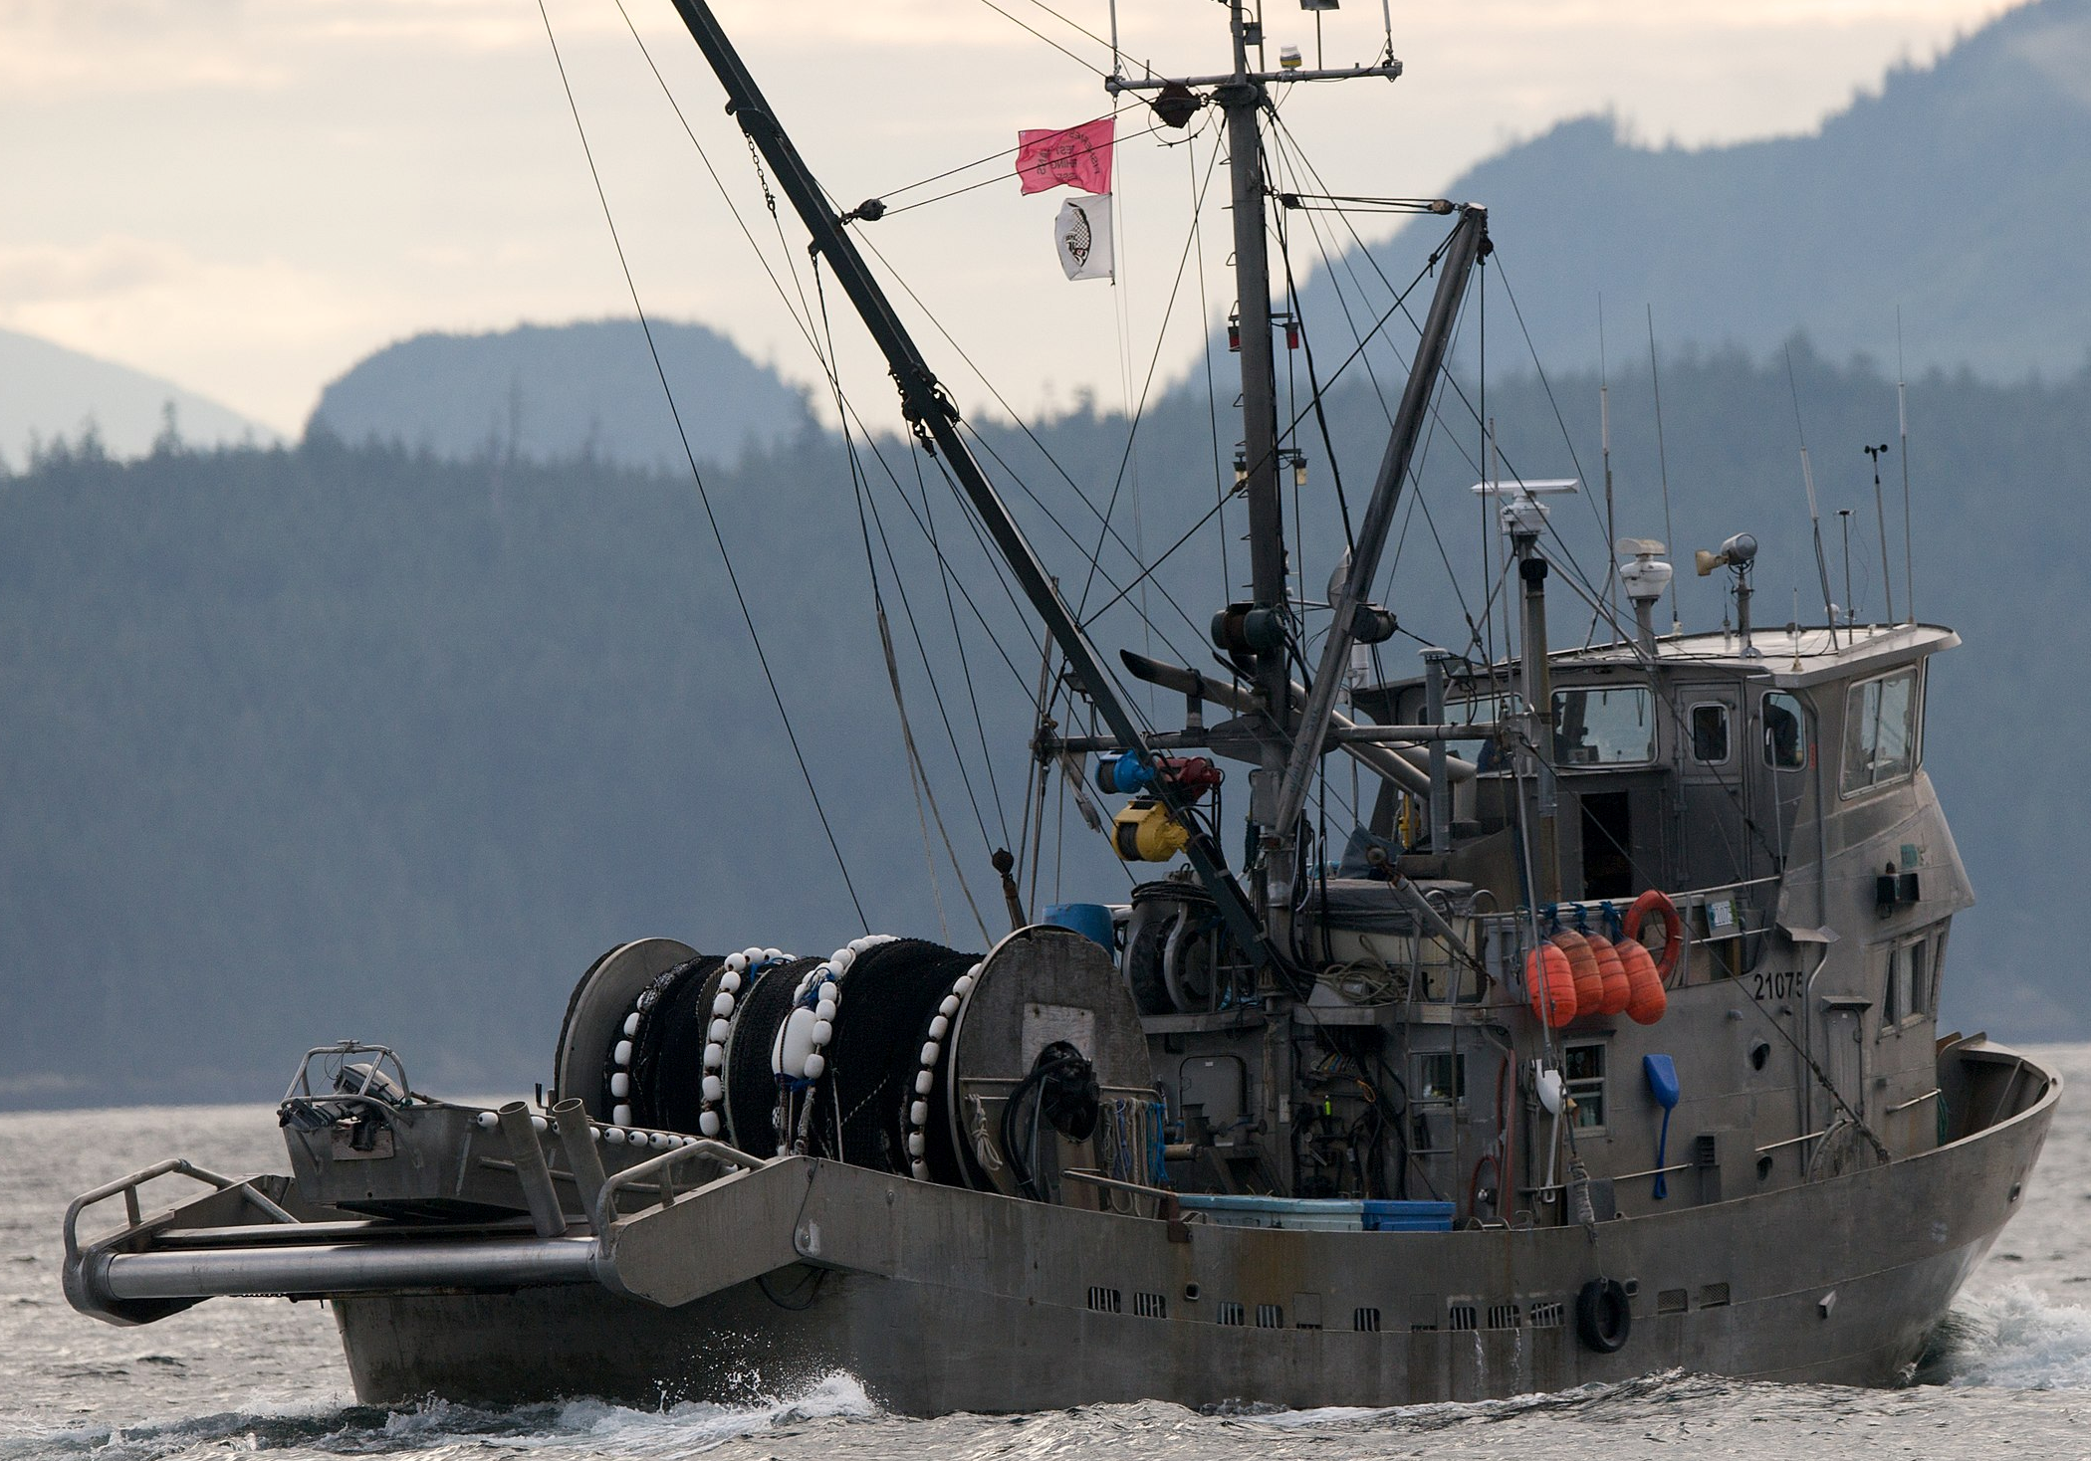
Types 3
Drum
  The drum seine uses a horizontally mounted drum to haul and store the net instead of a power block. The net is pulled in over a roller, which spans the stern, and then passes through a spooling gear with upright rollers. The spooling gear is moved from side to side across the stern which allows the net to be guided and wound tightly on the drum.

Slide 7
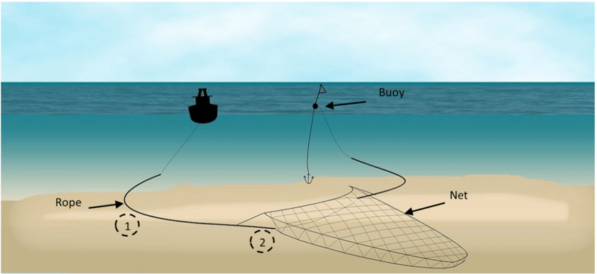
Types 4
Danish seine
  A Danish seine, also occasionally called an anchor seine, consists of a conical net with two long wings with a bag where the fish collect. Drag lines extend from the wings and are long so they can surround an area. The seine boat drags the net in a circle around the fish. The motion of the warps herds the fish into the central net.
  .

Slide 8
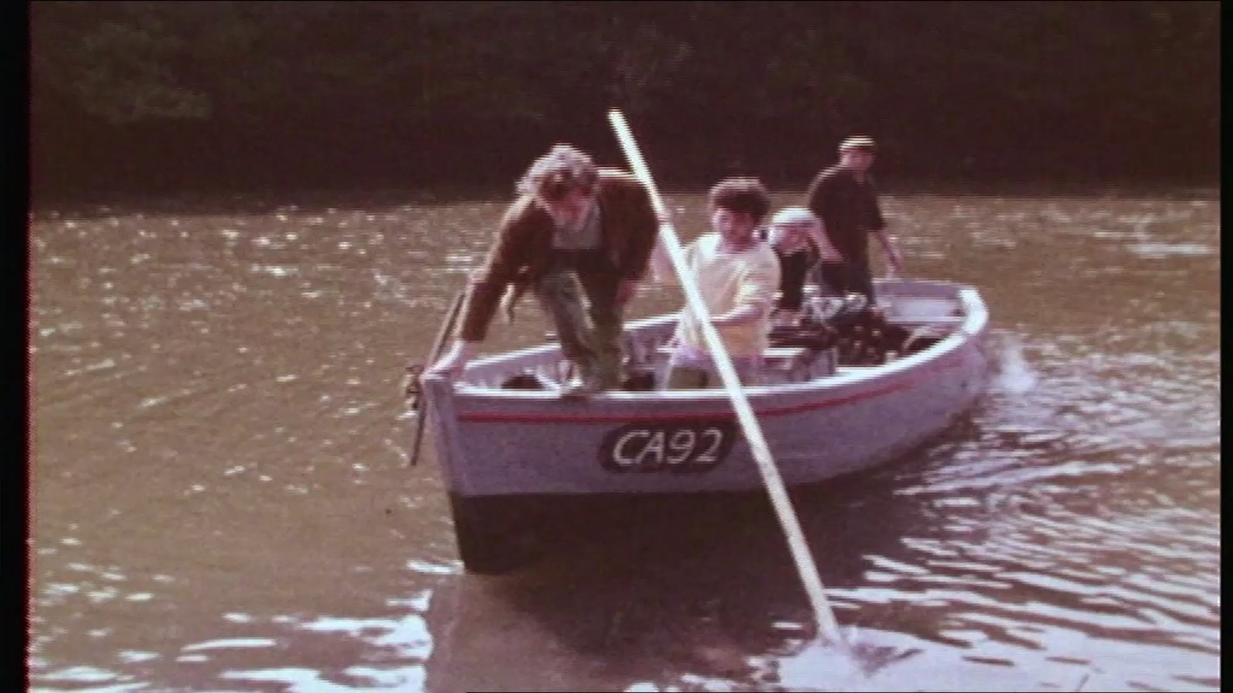
St Dogmaels Seine
Net Fishing
  .

Slide 9
History - 1
The oldest known net, dating back to 8300 BC
12th Century - Abbot Fulchard, first abbot St. Dogmaels Abbey
1188 Giraldus Cambrensis, on his tour of Wales
1603 George Owen of Henllys in his The Description of Pembrokshire
1840 Plenty of fish
1850 Concern about fish stocks
1860’s It became necessary to introduce a Fishery Act
1861 There were 42 seine netters, sixteen of the boats fishing from St. Dogmaels.
1871 300 salmon were caught on one tide.

Slide 10
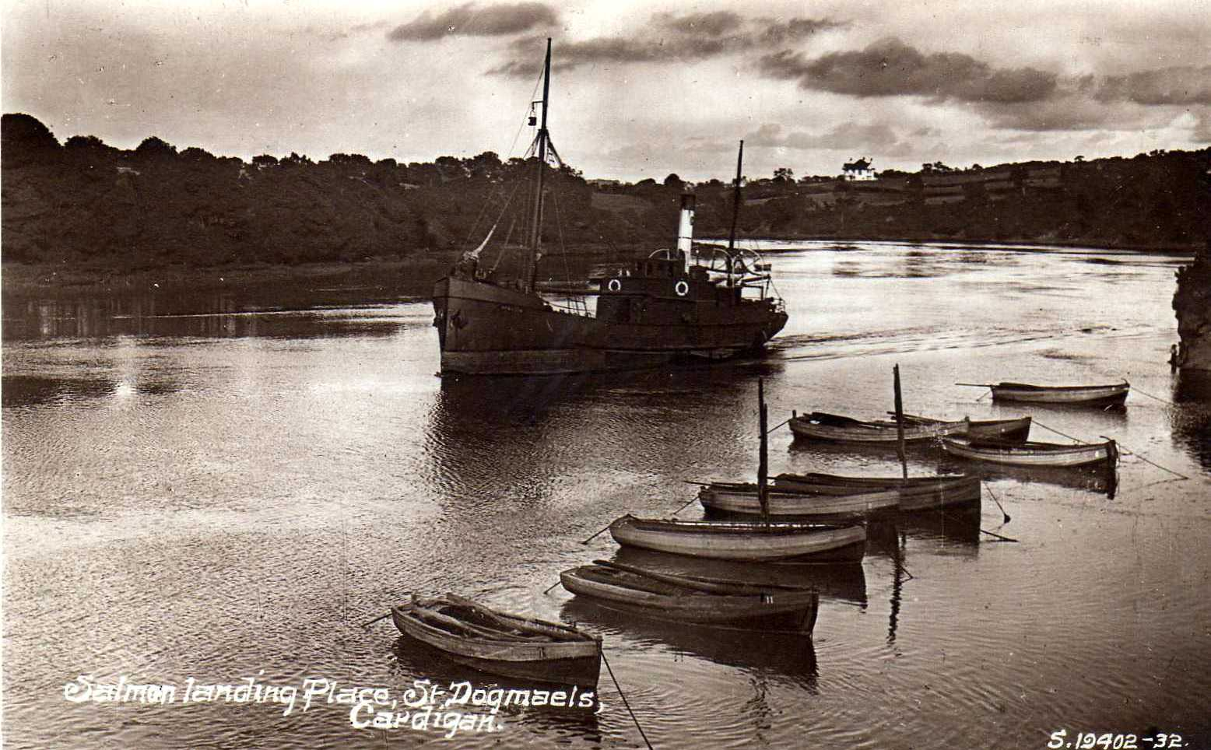
History - 2
By 1886 a new Fishing Act was introduced more restrictions.
20th Century Changes to fishing style
Decline of boats
  1920: 20
  1939: 13
  1970: 3/4
  1999: 1

Slide 11
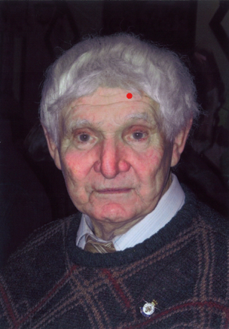
SÂN (Seine)
Salmon Fishing at
St. Dogmaels
Number of boats
Where to fish?
Where sold?
Fishing restrictions and drying?
Share money?
Which boat?
Treating nets
How to fish using seine net
The deep pools on the river were called , pwll y
Castell, pwll Nawpus, pwll Nantywerig, pwll Sano
Article by Mr. Eilir Phillips.
LLECHWEDD, CWMINS, ST. DOGMAELS

Slide 12
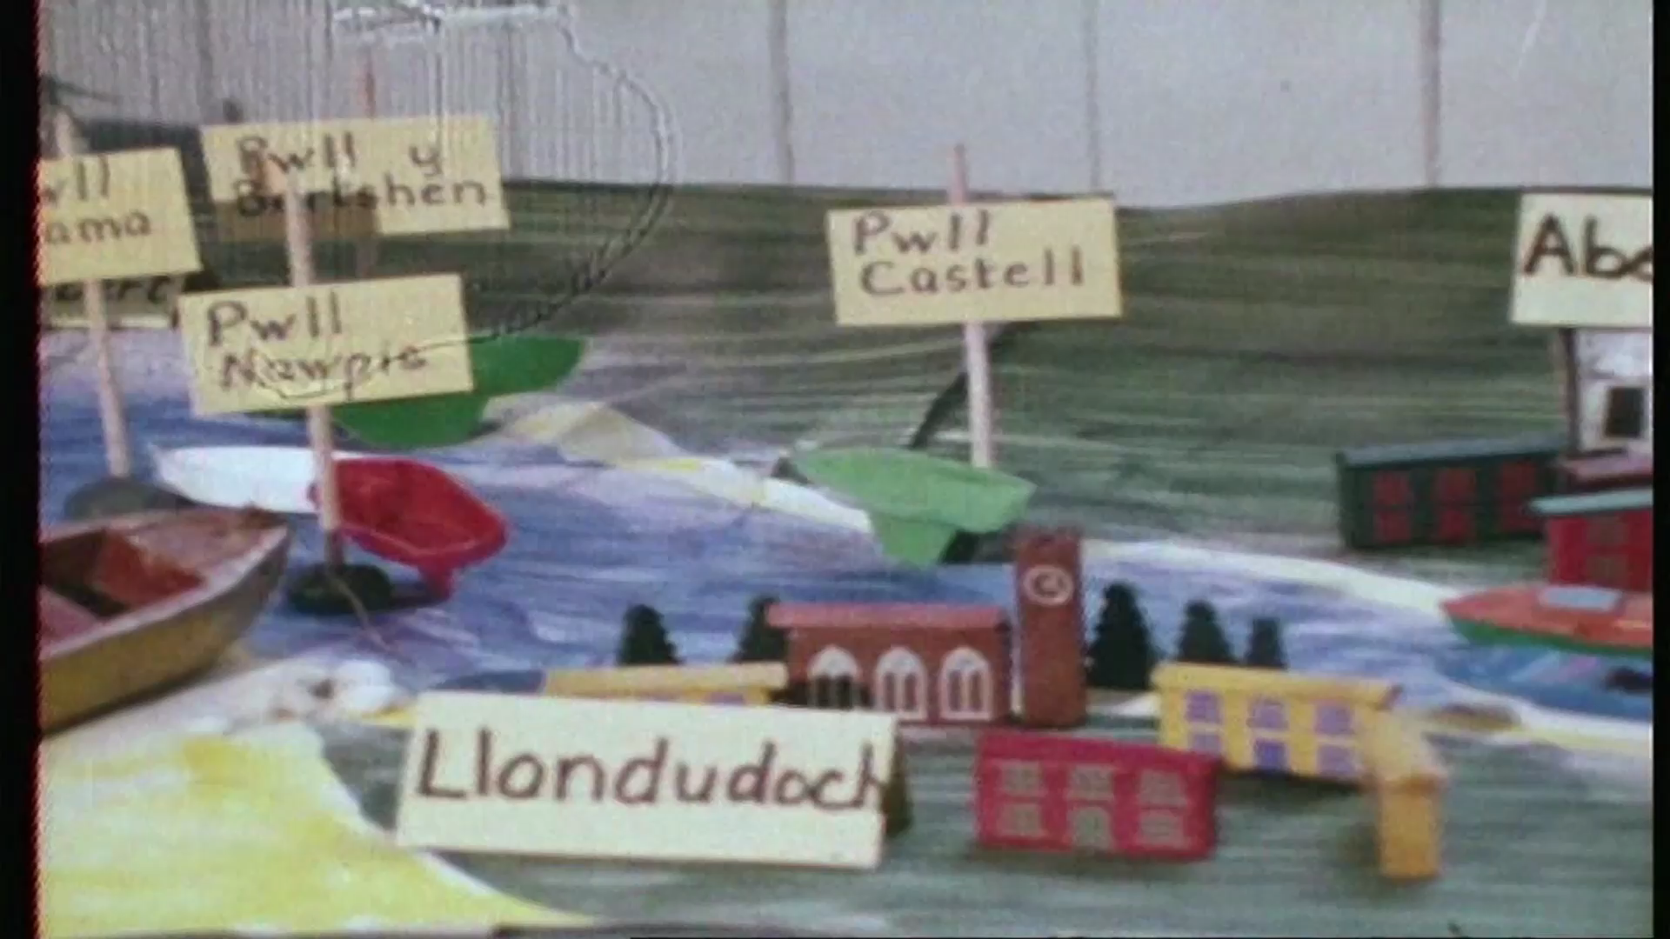
Enwau pyllau
Not found on maps but:

Slide 13
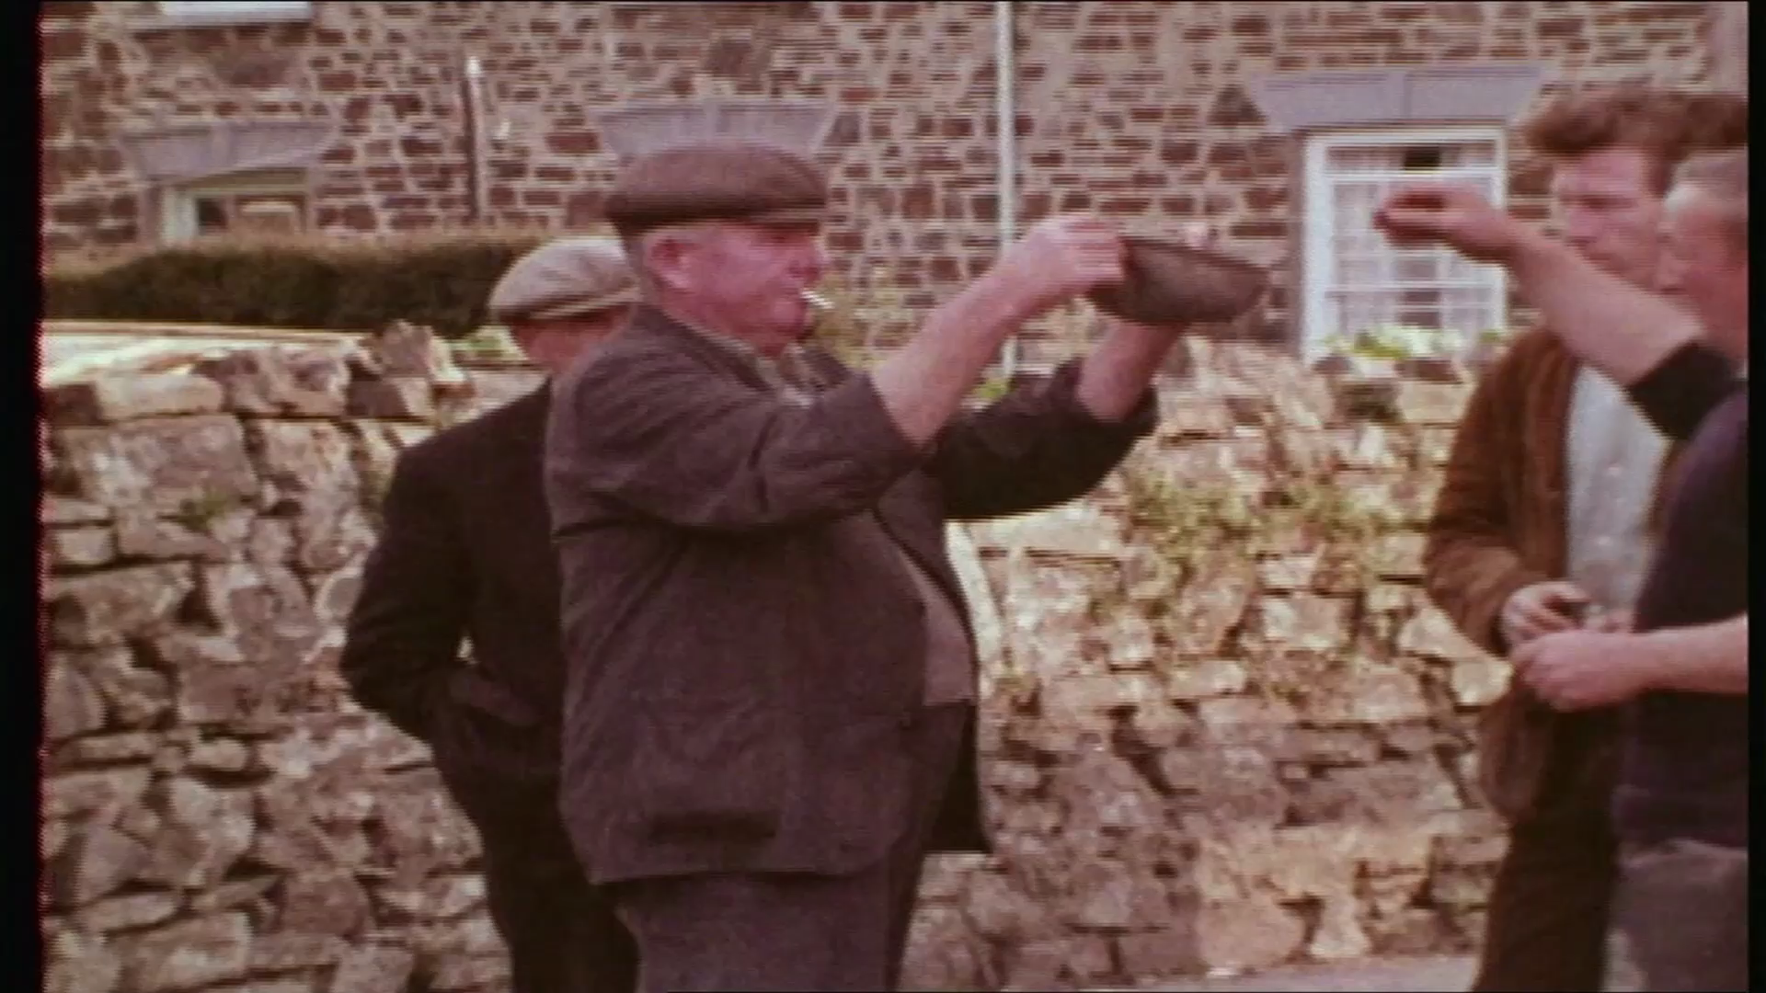
Dewis pwll

Slide 14
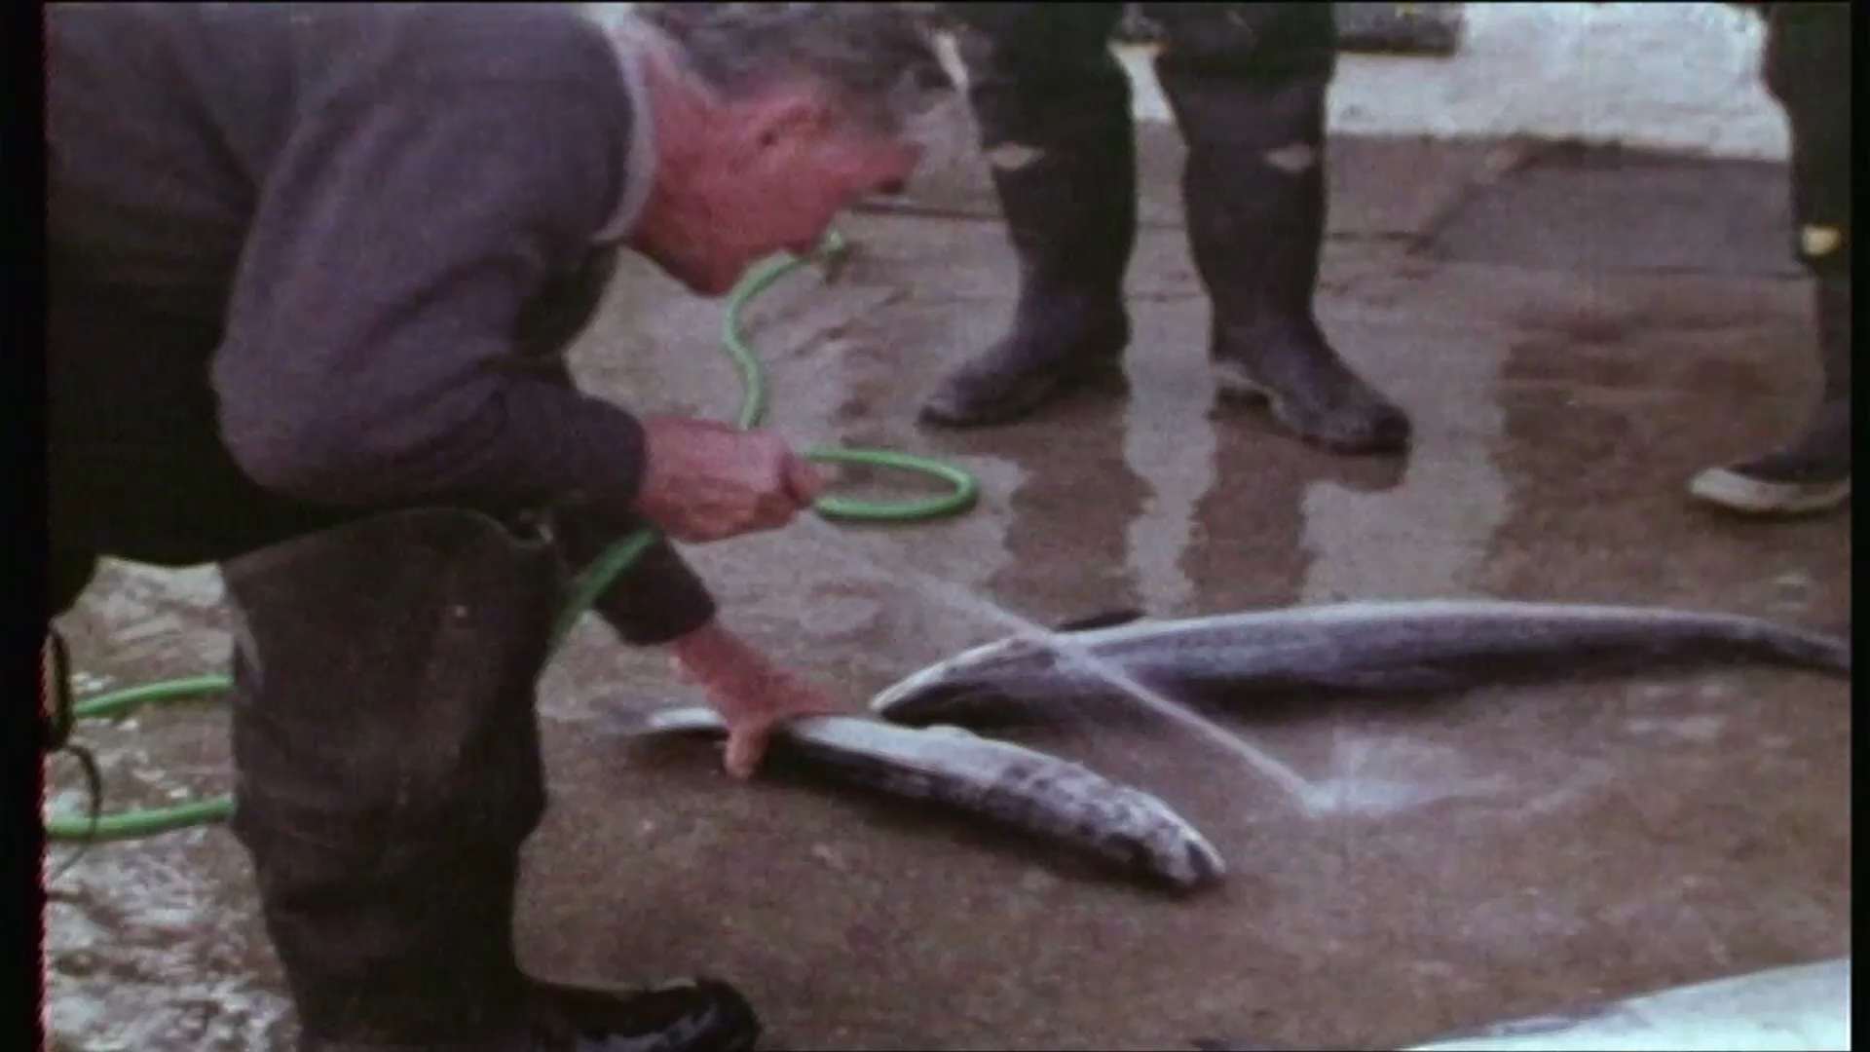
Washing &
WeighingFish

Slide 15
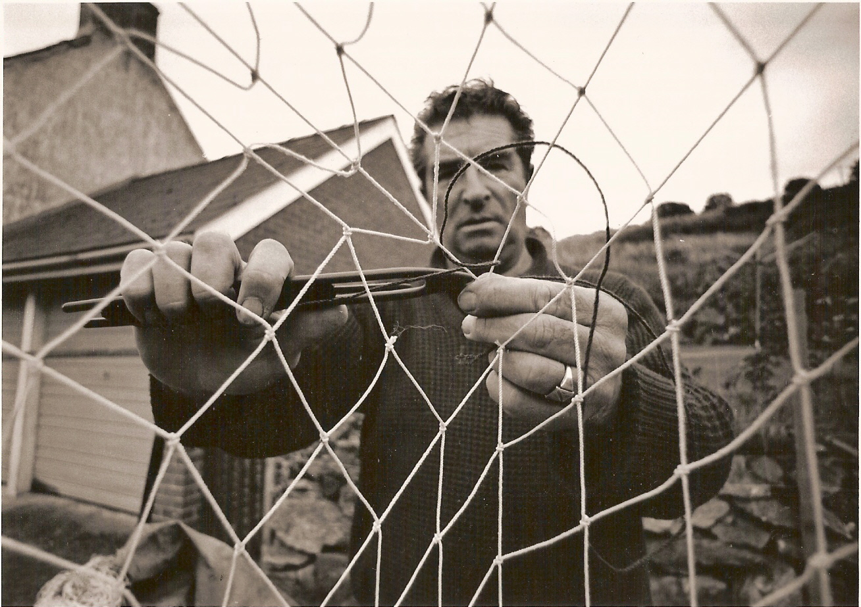
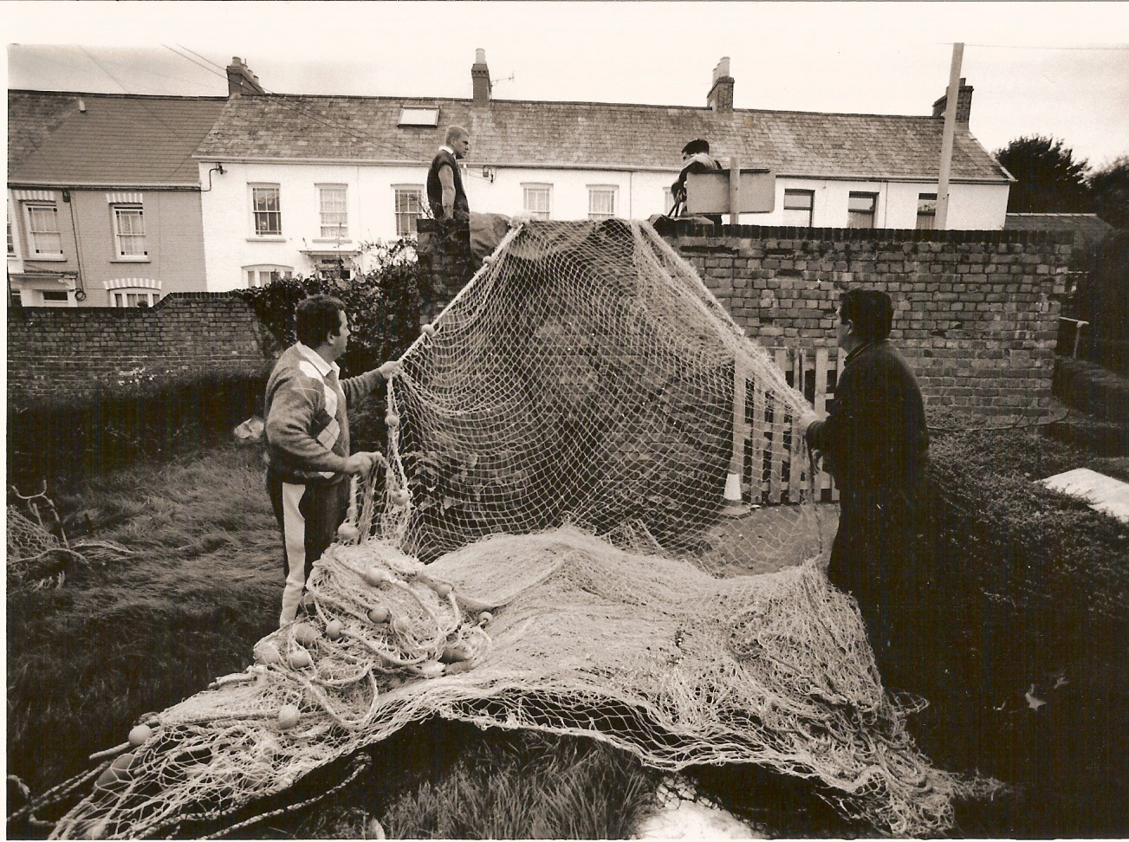
Seine Nets
Mending nets Drying nets

Slide 16
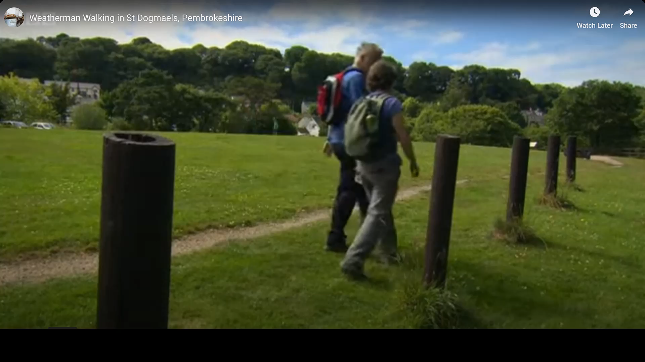
Net Drying

Slide 17
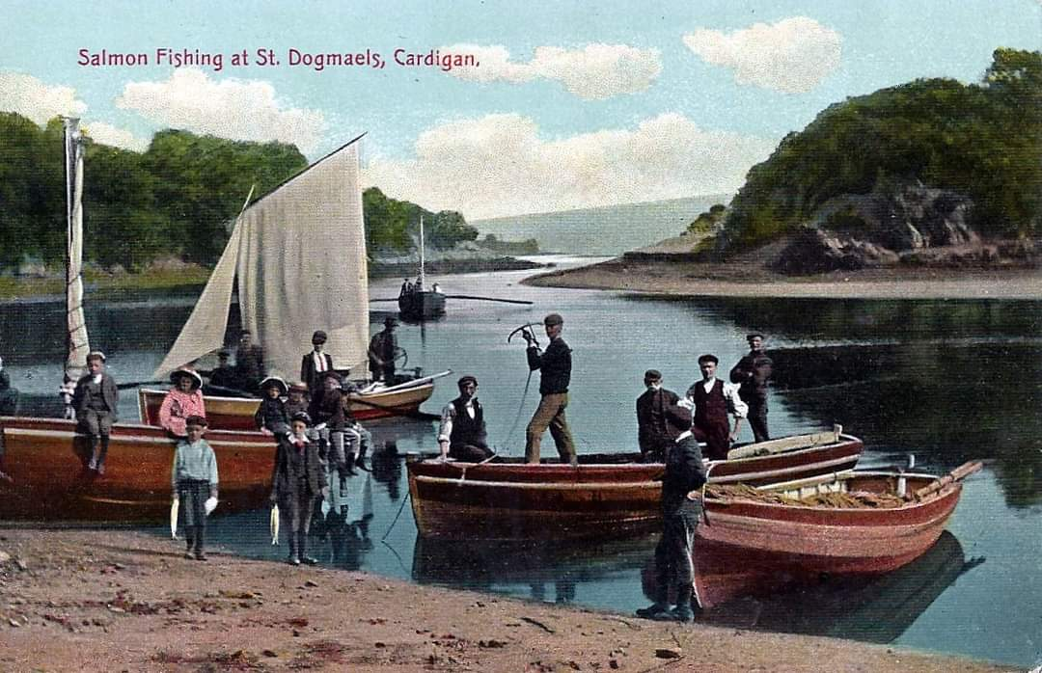
SÂN (Seine)
Salmon Fishing at St. Dogmaels

Slide 18
Acknowledgements
Glen Johnson
Eilir Phillips
The History of St. Dogmaels Abbey - Prichard
Gateway to Wales - William Lewis
Tivyside ‘Those were the Days' Donald Davies’
Geoffrey Asson, Sincerity, St. Dogmaels

